Slide 1
Visiting the University of Essex
The University of Essex Outreach Team

Slide 2
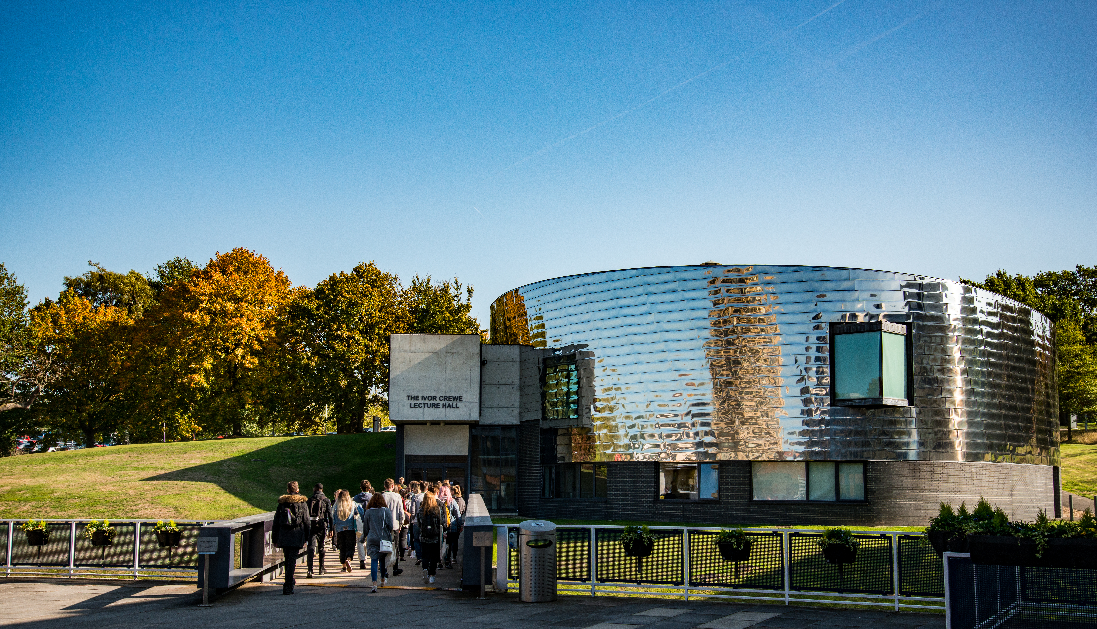
Visiting the University – slide 1 of 1
What to expect on your visit
A tour of our fantastic facilities at Colchester
Workshops and/or tasters delivered by University of Essex staff and lecturers
The opportunity to ask our student ambassadors questions about their university life
Look out for Campus cat! A black and white cat who lives on our campus and has been adopted as our University mascot!
The Ivor Crewe Lecture Hall

Slide 3
HEAT Registration – slide 1 of 1
In preparation for your visit
To help us effectively plan, track, monitor, evaluate and research the effectiveness of University of Essex school/college activities, we collect a range of data from the students we work with. We use a legal basis of consent to process the data requested by this form, which means that your data is needed for the work that we do but we would like your consent to use it.
To find out more about how we store and treat your data, please see our privacy notice at: https://www.essex.ac.uk/schools-and-colleges/privacy-statement
You also have the option to sign up as a University of Essex 'enquirer.' This means you consent to receiving updates from us about the courses you're interested in, but you can opt out of this at any time.
The url for your data collection will be provided in your bespoke pre-workshop presentation.
A birds eye view of Colchester campus

Slide 4
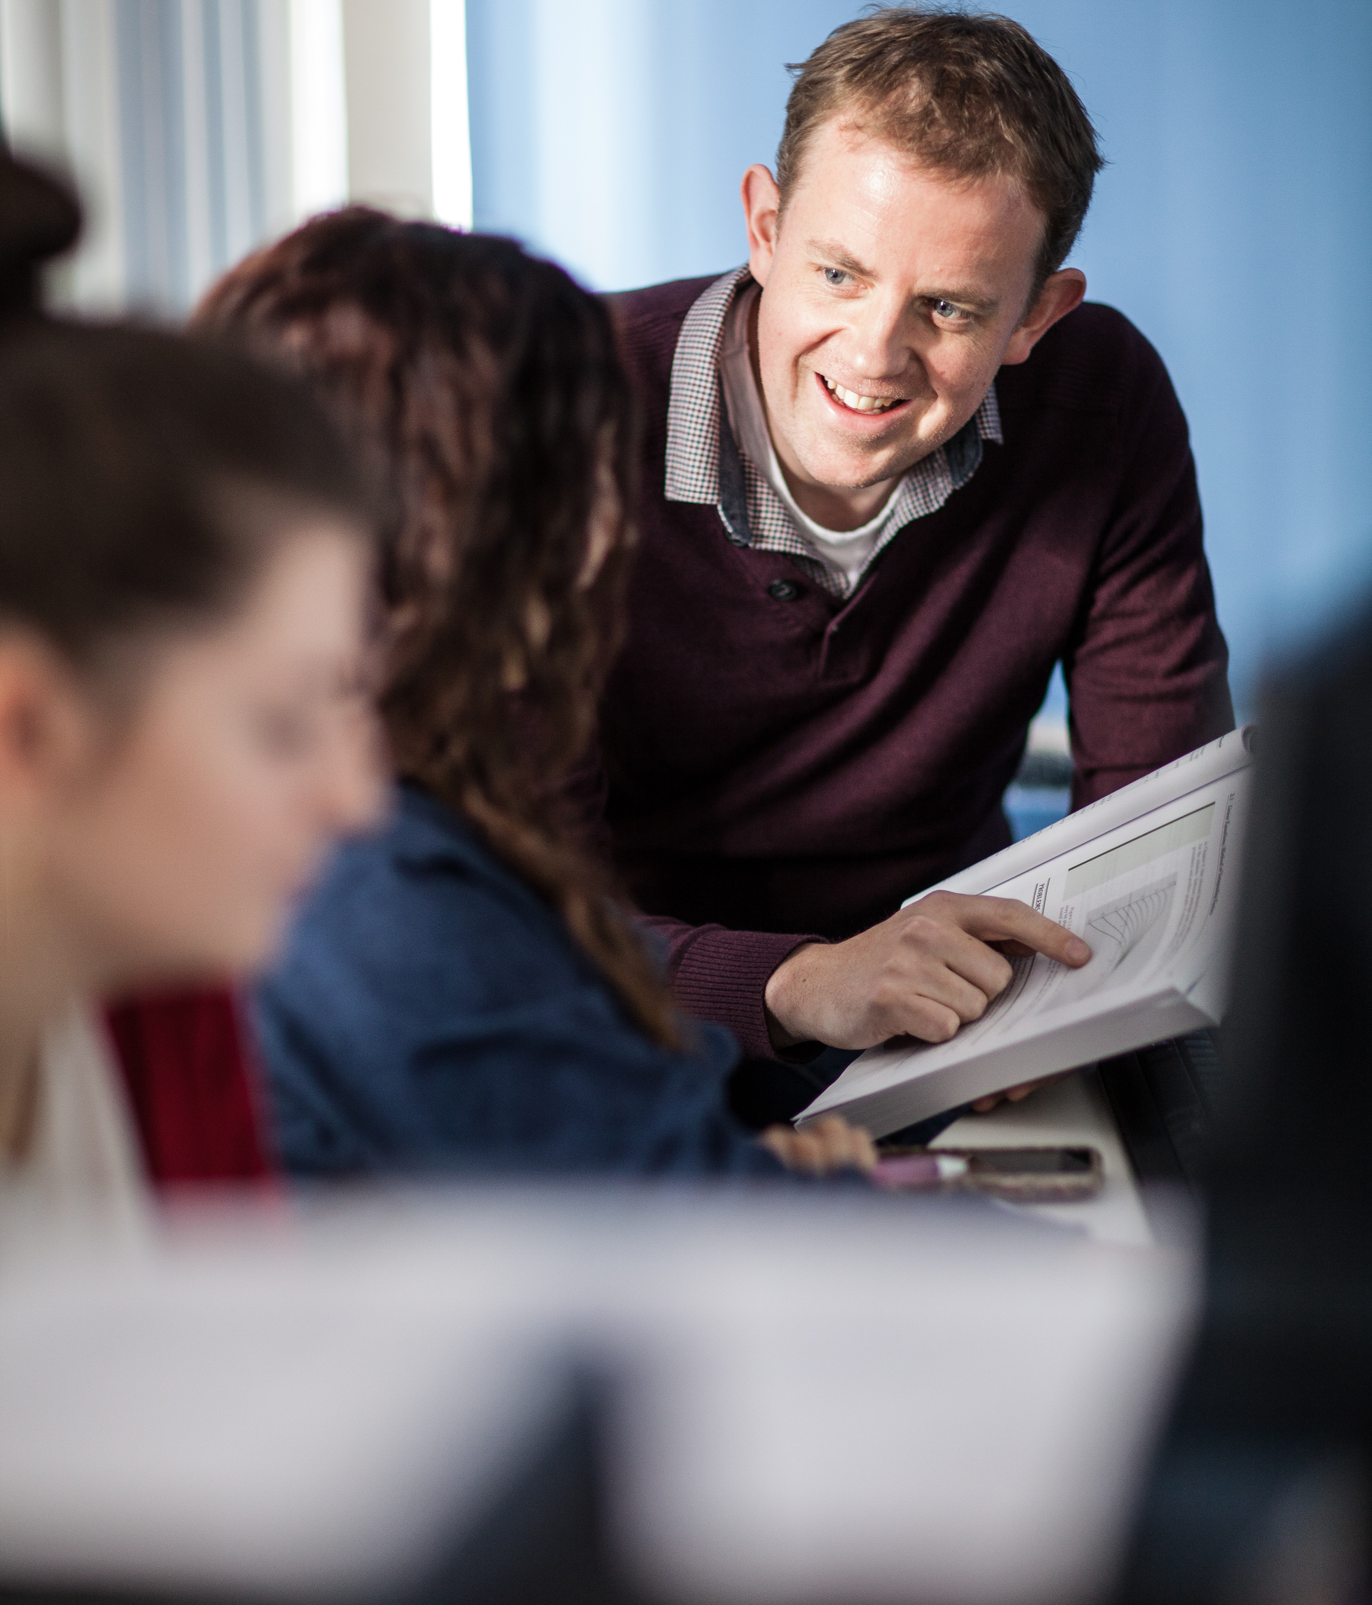
Pre event survey– slide 1 of 1
In preparation for your visit
We'd love to know your current thoughts about university!
Please complete our short online survey. This will help us to make our activities even more relevant to you and other students who visit us.
You do not have to give us this information, but if you do, all of your responses will be anonymous; we will not be able to trace your responses back to you and we will store the information safely and securely at the University of Essex in line with GDPR regulation.
The url for your pre-event survey will be provided in your bespoke pre-workshop presentation.
A birds eye view of Colchester campus

Slide 5
Activity slide 1 of 1
Activity
Watch this video and then complete one or more of the following activities
In small groups identify similarities and differences between school and University.
Using a device, explore our virtual campus. Try and find the following places:
The Library (extra task: what is the library called?)
The Student Union (extra task: what square is the SU located on?)
The Towers accommodation (extra task: what colour are the bedsheets?)

Slide 6
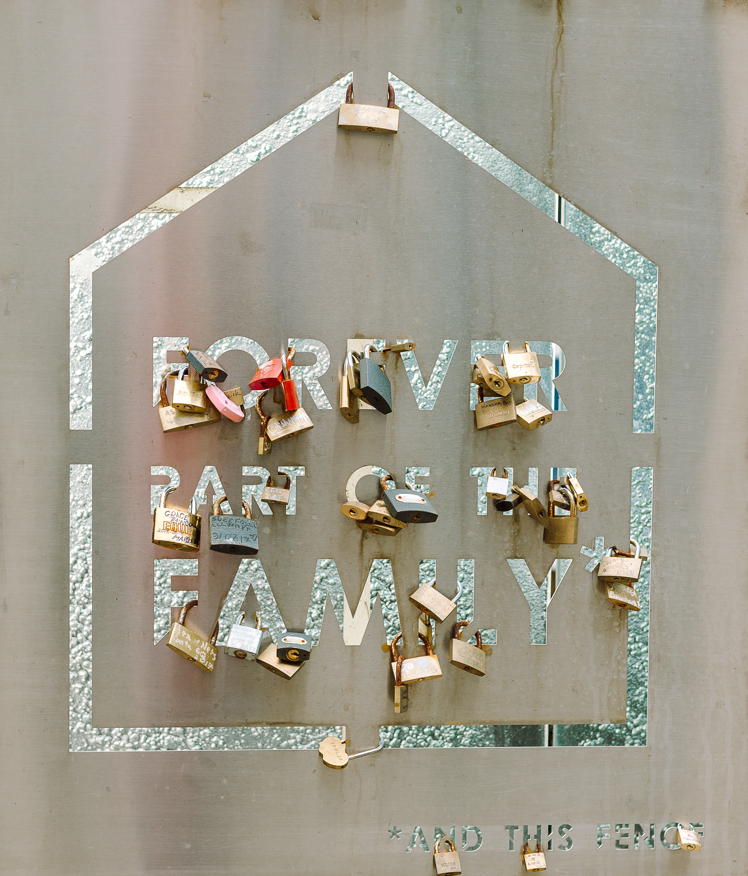
Question time – slide 1 of 1
Submit your questions
Want to know more about student life at University?
If there’s anything you are particularly interested to know about, we might be able to include it into your visit.
You have 2-3minutes to think about questions you’d like to ask our students and staff and pass them to your teacher so we can receive them before your visit.
Padlocks on sign

Slide 7
outreach@essex.ac.uk

