Slide 1
Contractor
Briefing
December2017_v1217

Slide 2
Welcome
Notes:
On behalf of the University I would like to welcome you to the University of Essex.
Please watch this video and take on board the points raised.
I will tell you essential safety information to deliver your project safely, and successfully, at the University.
For more information refer to the Contractor Handbook

Slide 3
Notes:
Our campus is a wonderfully diverse community.
When you are on campus you represent the University.
Always be respectful towards other contractors, staff, students and visitors.
Please be well behaved and respect the rules and regulations of the University.

Slide 4
Conduct and appearance
As an educational establishment we try to instil the importance of health and safety.
We require contractors to lead by example in demonstrating high standards of health and safety.
Notes:
You will need to be appropriately dressed and wear the right personal protective equipment for the job you are undertaking.
You will need to ensure visitors to your site are also appropriately dressed.
Our staff are vigilant and will report behaviour they feel is unsafe.
The University does monitor contractor safety standards.
Failure to comply can result in being excluded from site.

Slide 5
Security
Notes:
The University’s Security Team are based on Square 3 in the Information Centre.
It’s open 24 hrs a day, 365 days a year.

Slide 6
Security
If the Security team know where you are they can quickly get help in an emergency.
You will need to be aware of where you are working.
Telephone 01206 872125
Emergency 01206 872222
Notes:
If you are using an internal phone call 2222.
You will need to go there out of hours to collect any keys you require, permits to work or permits to access.

Slide 7
Fire
Know the fire exits and alarm call points where you work.
Read the Fire Action Notice.
Co-operate with Fire Evacuation Stewards or Security.
Work to minimise the risk from fire and false alarms.
Notes:
For more on expected contractor fire safety, read the Contractor Handbook.

Slide 8
First Aid
Before work identify:
your First Aider
Location of your First Aid kit
In an emergency contact Security.
01206 872222
Notes:
Do not dial 999.
This can delay the emergency services getting to you.
Security can quickly organise emergency service response for you.

Slide 9
Working safely
Follow these safety guidelines.
Failure to do so will mean you and your company will be removed from site permanently.
If in doubt – ask your University Contact.
Always work safely.

Slide 10
Risk assessment and method statements (RAMS)
Make sure you read, understand and follow the risk assessments and method statements (RAMS) for your work.
RAMS must be suitable and sufficient.
If not a permit will not be issued.
Notes:
Before coming onto site you’ll be given information.
This is about your risk assessments and method statements (RAMS).
Your manager or supervisor will complete the RAMS for the work that you do. You must have your RAMS with you whilst working on site.
RAMS identify the things that may cause harm and injury in the workplace and what needs to be in place to protect you, your workmates and others from harm.
If work or hazard level changes you must stop work, make the area safe as necessary and consult your line manager or University Contact.

Slide 11
Permit to Work System
Any work or inspection that you do will need either a permit or authority document from the relevant section in the University.
On completion of work the permit must be returned to your University contact or Estate Management Section (EMS) Helpdesk.
No permit. No work.
Notes:
You must have permission from your University Contact who will issue the permit before work starts
They detail the specific risks in the areas you are going into to carry out works.
You must read and understand them and work within the limitation. Do not move outside of it.
They must be signed by the relevant person and you must sign off the permit when the work is complete. All permits must be left with your relevant University contact or EMS Helpdesk if your contact is not available. For out of hours, please leave the signed permit with the Information Centre.
If you have any queries go back to the person who issued it.
Do not ignore permit to work signs.
Remember. No permit. No work. Contractors failing to comply with these requirements maybe barred from site in the future.

Slide 12
Lifting operations
Lifting operations can only be carried out by trained and competent people.
Notes:
There are beams and eyes located around campus installed during its construction and are no longer safe.
Only use beams and lifting equipment that has an in date and visible sticker or ScafTag detailing the next inspection and test. If not, do not use it.

Slide 13
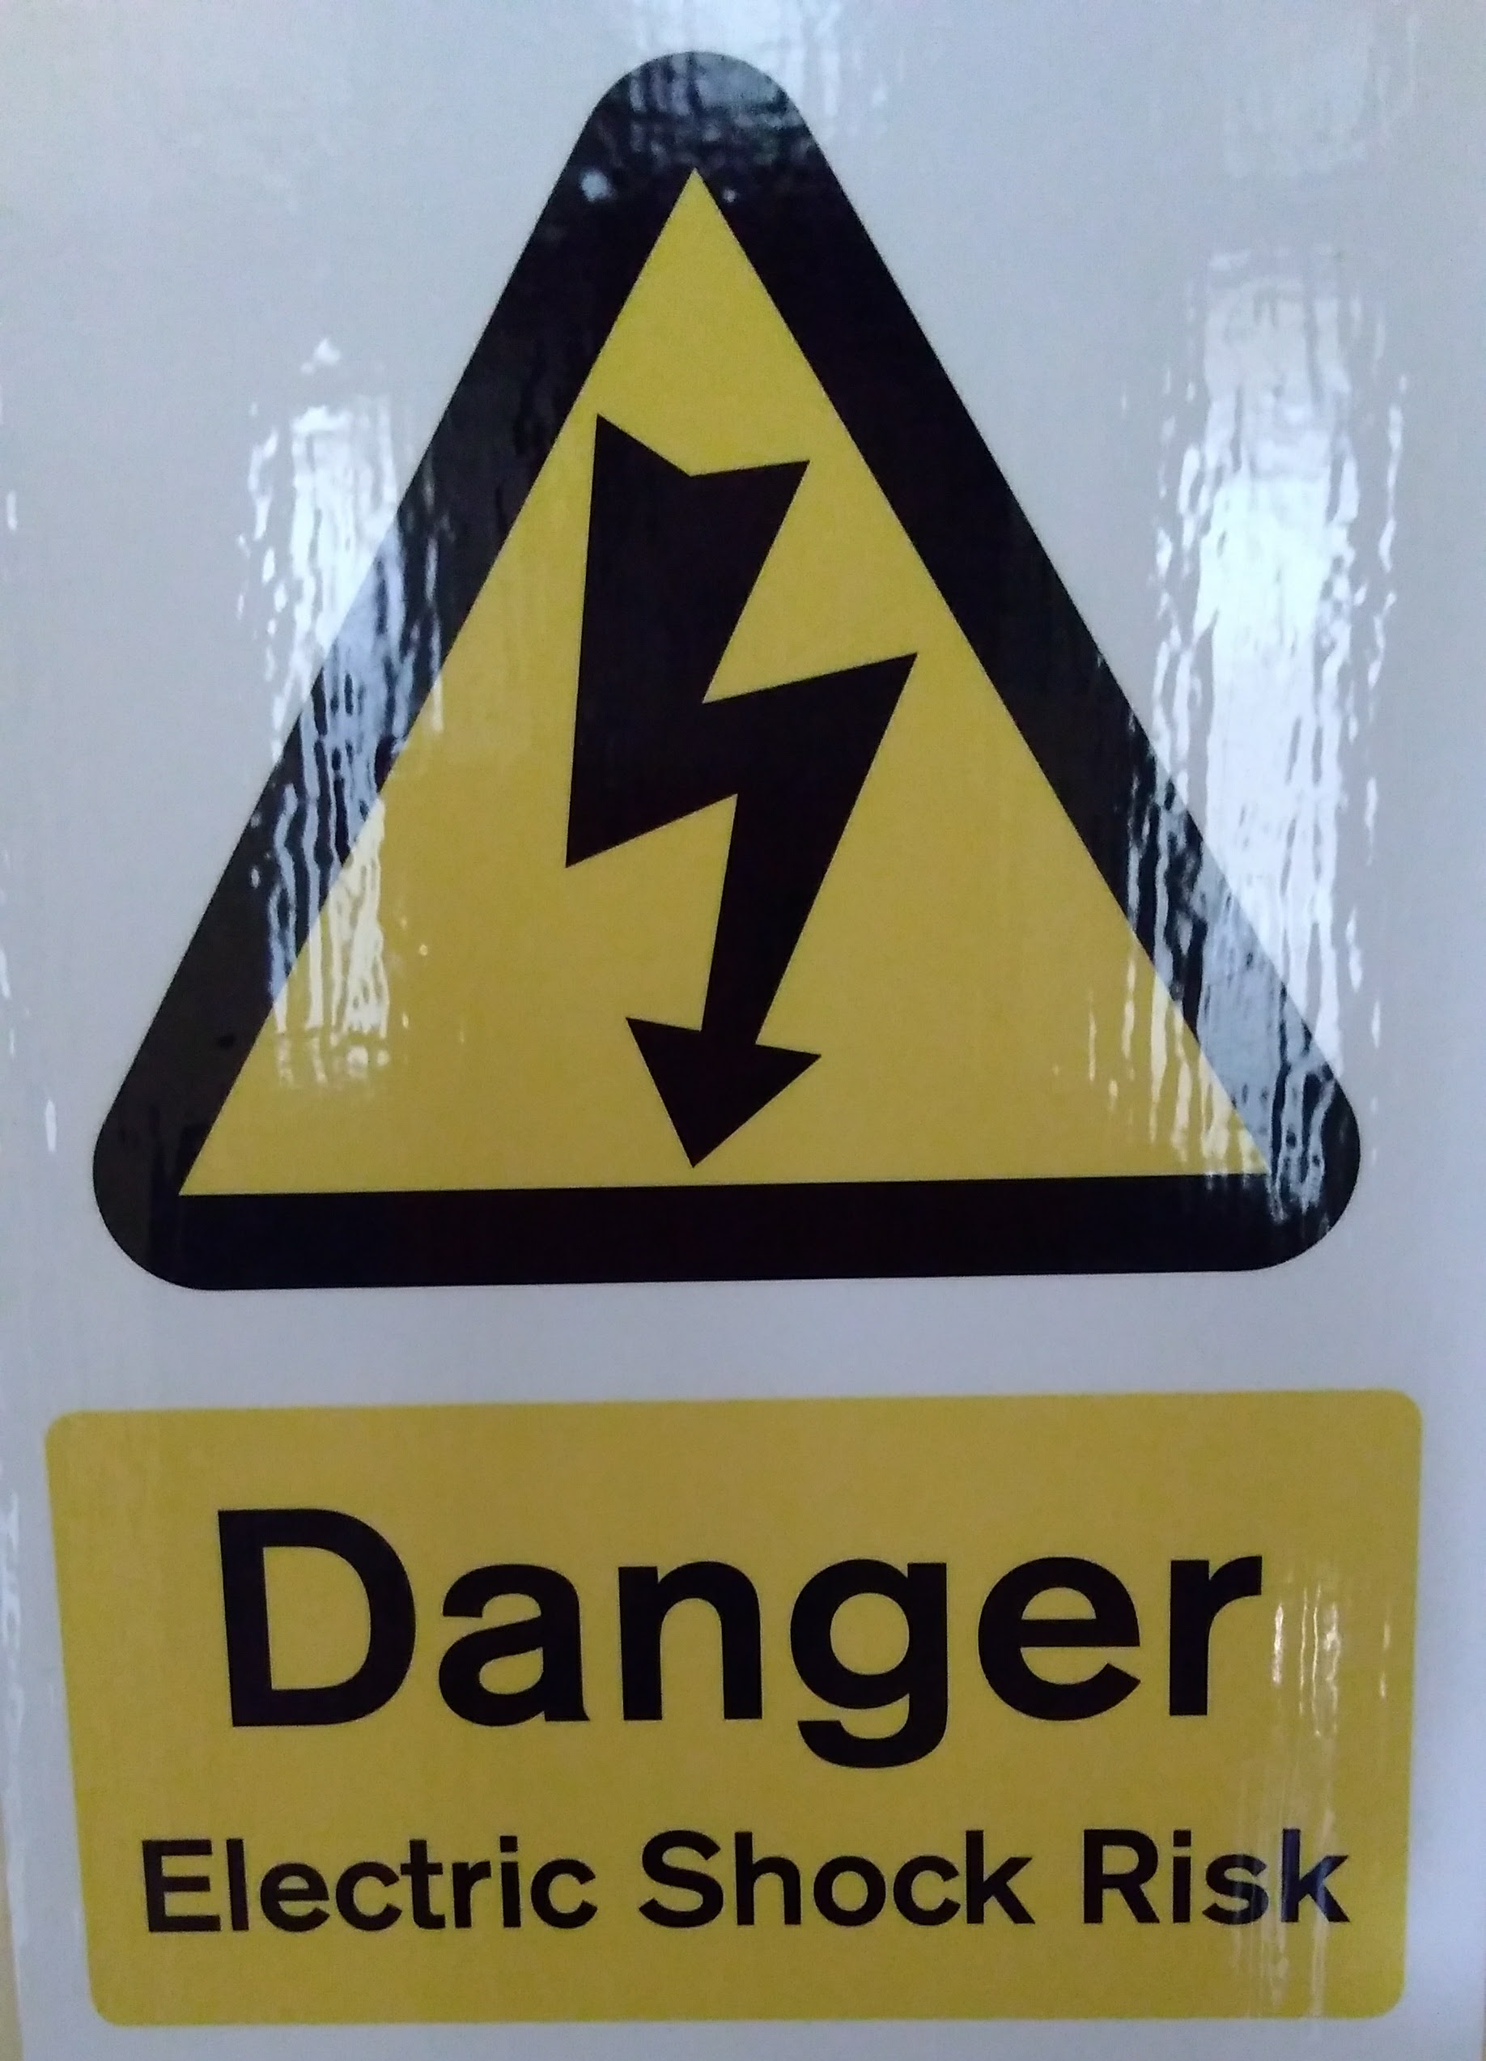
Electrical safety
Consider all services to be live.
Use battery tools as the first option or 110v supply where feasible.
If you need to use 230v power tools or task lighting you must use a RCD adaptor.

Slide 14
Confined spaces
Only work in confined spaces if you have a Permit to Work document from your University Contact.
You must be competent and have had the correct training.
Notes:
The University has confined spaces.
A confined space is anywhere which is suitably enclosed (though not always entirely) and where serious injury can occur from hazardous substances or conditions within the space or nearby (for example lack of oxygen).
If you need to enter or work in a confined space you will need a permit and to be trained before you go in to them.

Slide 15
Plumbing
Speak to your University Contact before breaking into hot or cold water supplies.
Do not reconnect without appropriate collaboration.
Notes:
Check the Contractor Handbook for more information. You may need a Permit to Work.

Slide 16
Asbestos
Check Asbestos Surveys, relating to your area of work, and be certain that asbestos will not be disturbed.
If you are uncertain contact your University contact before continuing and obtain formal consent prior to starting the work.
Notes:
Hand book p 11 INPUT.

Slide 17
Excavations
Do not break or penetrate ground without the express permission of your University Contact.
Many services run below the surface.
Notes:
You may need a permit to work.

Slide 18
Working at height
Only work at height if you:
Have the right access equipment
Received the correct training and are competent
Where necessary, have a permit to work
Notes:
Working at height is any work undertaken where there is a risk of injury through falling to a lower level. It covers roof work, ladders, mobile elevated working platforms, mobile towers and scaffolds.
All working at height must be risk assessed and have a method statement.
Access authorisation is needed to go on roof areas.
Safety equipment is installed on all university roof areas. Man safe wire systems and safety handrails are tested and inspected at regular intervals. People using these must be trained.

Slide 19
Traffic and road safety
Vehicles must be driven with due caution.
Pedestrians have priority.
Take particular care under podia and in residential accommodation areas.
Notes:
Drive your vehicles with due regard to the Highway Code and within the speed limits on campus. Make sure your vehicle has a relevant MOT, insurance and is roadworthy. Even though we are private land we require you wear a seat belt and do not use a phone whilst driving
Secure your vehicle and the load on campus.
Absolutely no driving or parking on the grass without formal agreement from the University.
We have accommodation areas that are barrier entry. Please remember pedestrians have priority and drive slowly.

Slide 20
Parking
Contractors must park in the Contractor Car Park or within their working compound where permitted.
If alternative parking is required and agreed, register your vehicle at the EMS Helpdesk.
Notes:
Parking is limited and in demand.
Contractors must park in the contractor car park. Do not park in the main campus car parks. If you need to park in a space central to campus you will need to book a contracts bay in advance. You can register your vehicle at the Estate Management Helpdesk in room 6.003 or by emailing EMS-Helpdesk@essex.ac.uk. You can contact them on 01206 872959.

Slide 21
No parking
Bays marked for disabled drivers or block disabled spaces.
On double yellow lines,
On carriageways, hatched areas and delivery areas
Block access for emergency vehicles, for example in North Towers causeway.
Notes:
At the University of Essex we operate a considerate parking system. By observing our rules you are helping make parking easier for everyone. There is a penalty for not parking in line with our terms and conditions and your vehicle may be banned from campus or your company asked to leave campus.

Slide 22
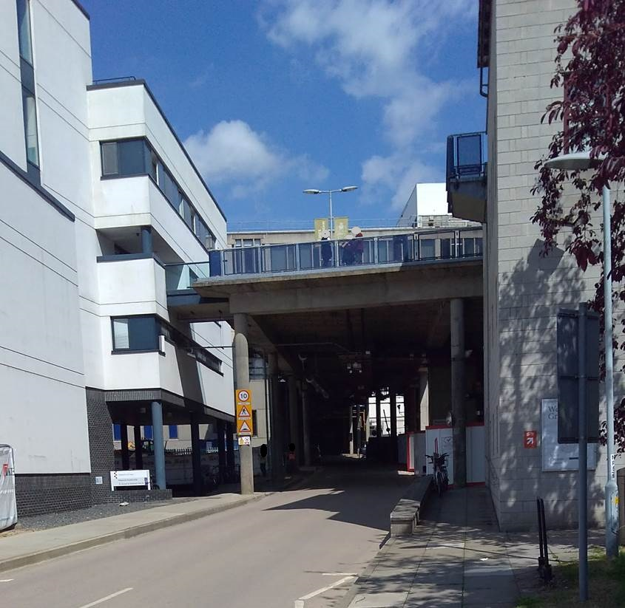
Under podia
Notes:
Drive slowly, dip your headlights and do not drive or park in the pedestrian walkways. Consider using a banksman when reversing in pedestrian areas.
Pedestrians have priority.
Consider what is above you. Be aware that the Under Podia area is used by pedestrians, cyclists and other vehicle users. Take extreme care in this area. You must remain within the speed limit at ALL times.

Slide 23
Day Nursery
Sign in and out during normal Nursery hours
Hand mobiles into reception
Do not take photos unless supervised by Nursery staff
Exhibit good H&S - think about babies and young children
Cooperate with Nursery staff
Notes:
You’ll need to take part in pre-start meetings. You’ll be given Nursery contact details and agree the additional control measures needed to manage the risk from dust, fumes and odours into areas occupied by babies and young children.
Nursery staff have the authority to stop work immediately if they believe there is a risk to the children. If this happens, make the area safe as necessary whilst further decisions are made.
To ensure safeguarding, you will not be left alone with the children and no mobiles allow. For work monitoring purposes you can only take a photo only the direct supervision of a member of Nursery staff.

Slide 24
Protecting the environment
Turn off heating, appliances and lighting
Not wasting materials
Recycling and properly disposing of waste
Ensuring compliance with environmental law
Ask at the EMS Helpdesk for more information.
Notes:
Protecting the environment.
Help the University maintains high environmental standards by:
Turning off heating, appliances and lighting when not in use
Not wasting materials needed for a job
Recycling and properly disposing of waste
Not leaving vehicles or generators idling
Ensuring compliance with relevant environmental law
The University has team which can help with environment concerns, questions and ideas and a recognition scheme for our greenest contractors. Visit our sustainability webpages ask at the EMS Helpdesk for more information.

Slide 25
Round up
University
Contractors
Contractors work safely.
Meet legislation, standards, good practice.
You
Follow RAMS, permits.
Report concerns.
H&S is a core value.
Everyone works safely to minimise risk.
Notes:
The University makes health and safety part of how we do things.
It is important that everyone, including contractors, work safely to minimise the risk of injury and ill health.
When you are undertaking work we expect you to do it in way meets legal requirements and current good practice. This includes following your risk assessment and method statement, permit to work systems.
If you are concerned about anything or find anything untoward please refer it to a supervisor, manager or University Contact. You can also refer to your Contractor Handbook.
Thanks for watching.

