Slide 1
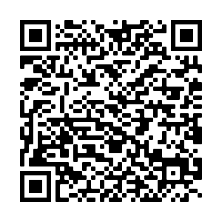
Thank you for visiting the University of Essex
The University of Essex Outreach Team

Slide 2

Time to reflect slide 1 of 1
Reflection
You have 5 minutes to discuss with the person next to you:
The best part about your visit to the University of Essex
Something new you learnt during the visit
What your plans are following the visit e.g. to research future careers.
Student studying on laptop

Slide 3
Next steps slide 1 of 1
What are your next steps?
Since your visit to the University of Essex, have you made any progress with your next steps/decision-making?
Reflect on what you learnt on the day and think about your next steps. Use the table and the examples below to visualise your own plans.
2 weeks from now | 2 months from now | 1 year from now | 2 years from now
e.g. I’d like to have finalised my GCSE options. | e.g. I’d like to explore options following my studies at school. | e.g. I’d like to have received 5 GCSE’s at a Grade 4+

Slide 4
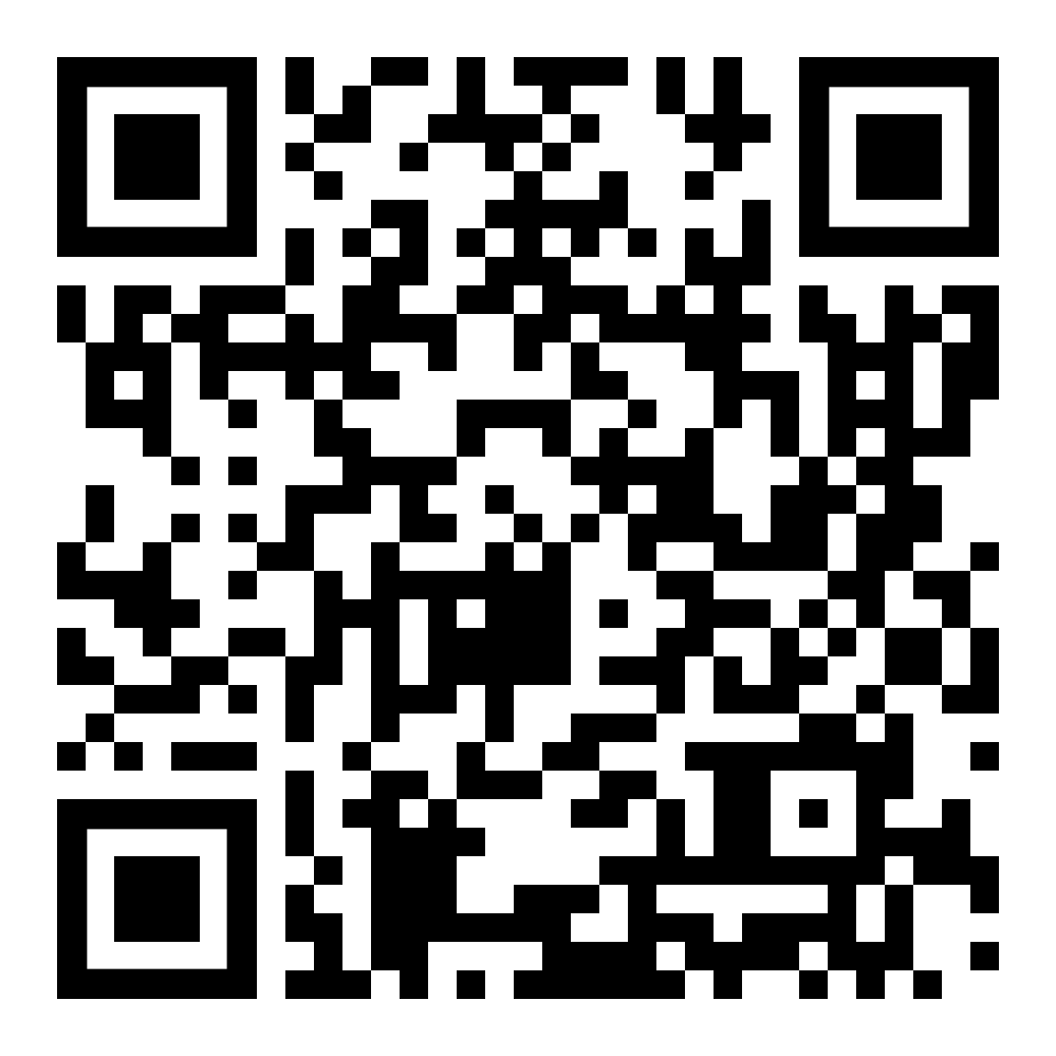
Short online course information slide 1 of 2
Online Courses
Aimed at students in years 10-11, our Further Studies Preparation Programme aims to boost students’ confidence and help them to progress with their next steps. Complete the six modules independently or as a whole course and receive a certificate on completion.
A great way to develop current and new skills that will contribute to your future and will look great on future applications.
Enrol for the Further Studies Preparation Programme.
Topics include:
Guidance on the transition from school to sixth form/college
Communication and socialising skills
How to study and revise independently
Planning for your future and employability tips
Finance and budgeting help
Useful life skills for now and in the future

Slide 5

Next steps slide 1 of 1
What next?
Tune in to our new podcast on Spotify
Search ‘Understanding University, The Ultimate Uni Podcast’ to listen!
If you have anymore questions, please chat with our current students and staff on Unibuddy…
www.essex.ac.uk/life/chat
Check out other events/activities at Essex in 2021-22
www.essex.ac.uk/schools-and-colleges/events

Slide 6
Useful resources – slide 1 of 1
Online Resources
Please use the following resources to support your next steps
www.essex.ac.uk/schools-and-colleges/student-resources
Resources and events to support students
www.makehappen.org/guides/
Guides to help answer your higher-education related questions
www.ucas.com
Course Search: search by course, region or institution
www.discoveruni.gov.uk
Collects results from real student surveys
Statistics on student experience, contact hours & graduate jobs

Slide 7
outreach@essex.ac.uk

