Slide 1
Super Stars
A bright and brilliant future
Session two – Who and what inspires us

Slide 2
Aims of the session slide 1 of 1
Session Aims
Explore what inspires and motivates us
To understand what aspirations are
To look at the achievements of some aspirational people and how they achieved them
Who motivates and inspires our University students? What aspirations did they have growing up and still have?

Slide 3
Aspirations
Aspirations quote slide 1 of 1
“ Shoot for the moon. Even if you miss, you’ll land among the stars”
- Les Brown

Slide 4

What are aspirations slide 1 of 2
What are aspirations?
When you hear the word ‘aspiration’ what does it make you think of?
Aspirations are our hopes or dreams of achieving something. If we have clear aspirations, it can help us to achieve our goals
Notes:
Supporting notes:
Activity One, part A:
Ask the students to discuss their ideas in small groups. Idea’s should be recorded on flip chart paper and shared with the rest of the class.
The students can record their personal ideas in their super stars work book, session two activity one.
Aspirations are our hopes or dreams of achieving something.
If we have clear aspirations, it can help us plan to achieve our goals. Today, we are going to look at aspirations and why they are important.

Slide 5
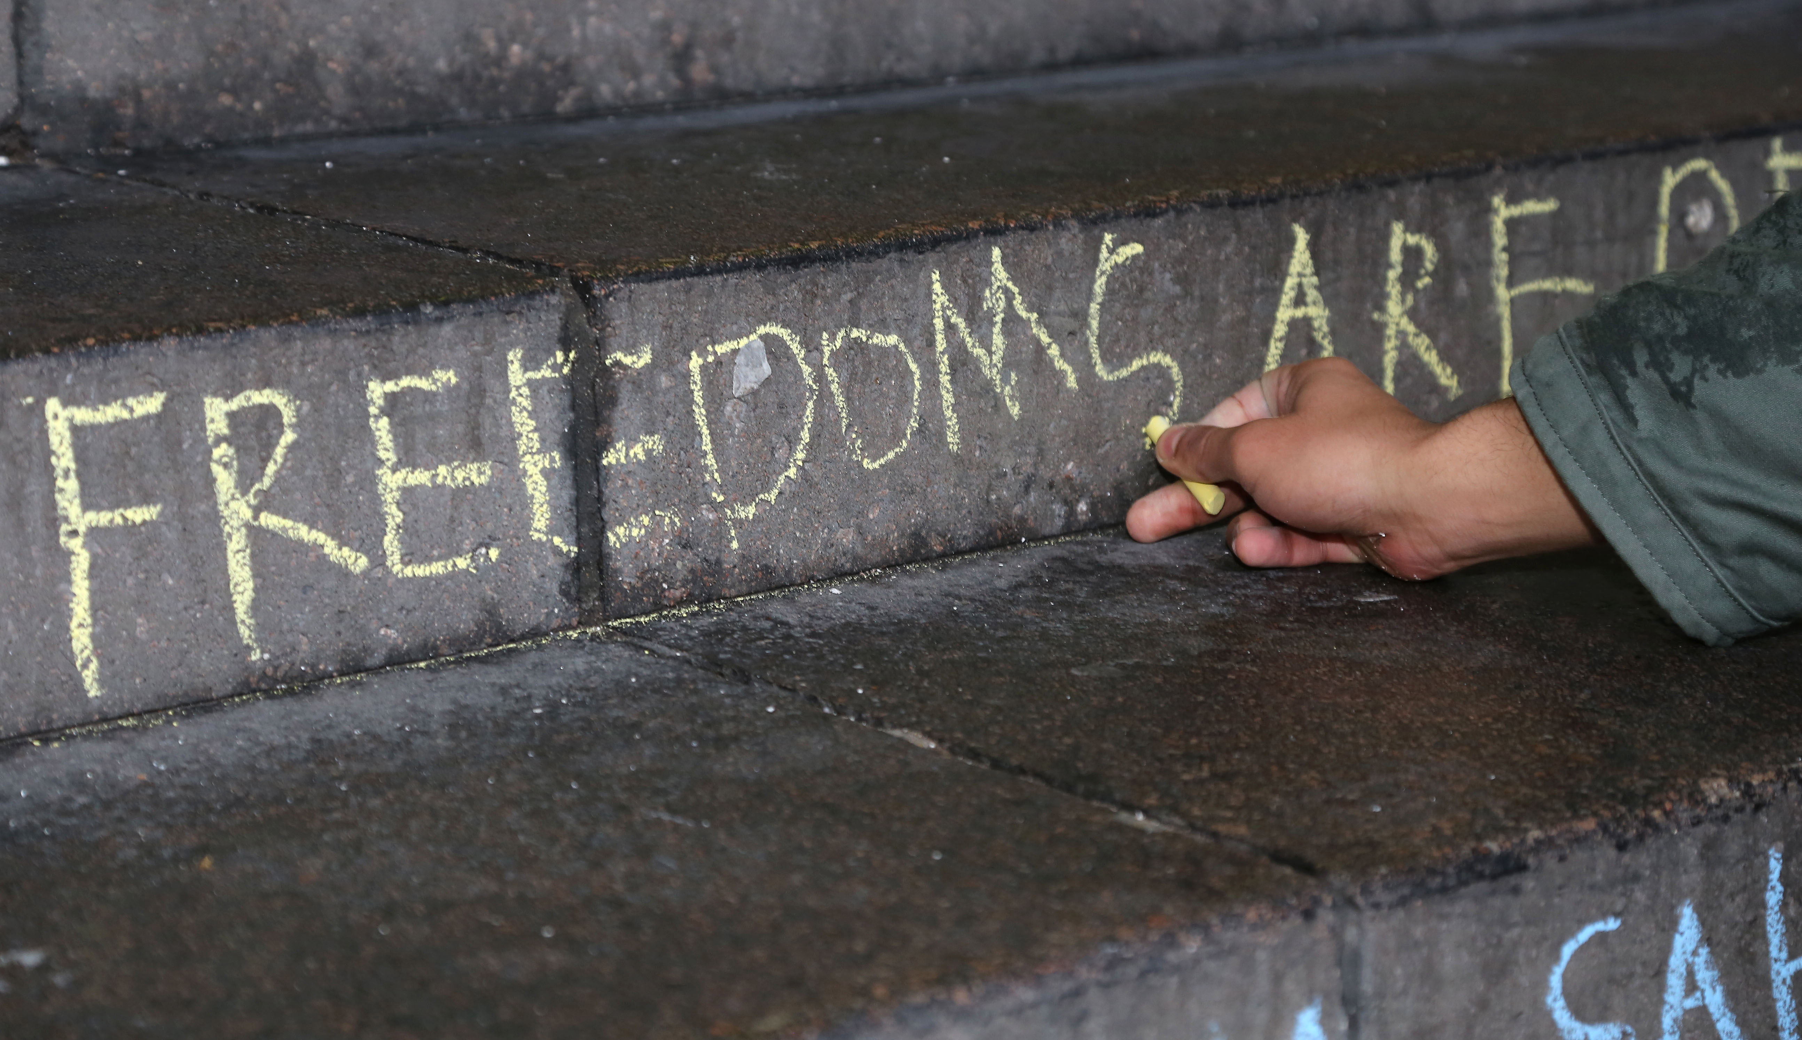

What are aspirations slide 2 of 2
Why should we try to be aspirational?
It is important that we have aspirations to help us reach our full potential
If we can aspire to do or be something, it can help us to work out what steps we need to take to get there
It can also help to keep us motivated when things don’t go according to plan
Aspirations help us to develop ways to overcome these obstacles
Notes:
Supporting notes:
Continue the discussion and ask the students what they think.
Why do you think aspirations are important?
Can you give some examples of aspirations?
Activity One, part B: Working in groups again, students can share and record their answers on flip chart and their supporting super stars workbook.

Slide 6
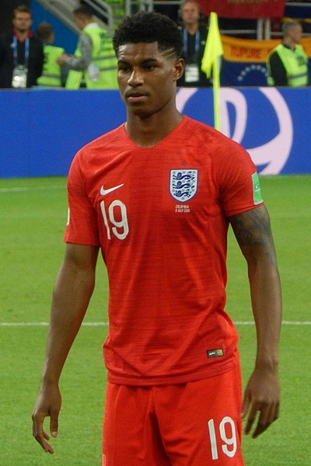
Aspirational people slide 1 of 2
Who are some aspirational people?
How did they achieve their goals?
Marcus Rashford is a successful professional footballer. However, when he was a child, his family relied on free school meals and the kindness of others to keep them fed, despite his mum working extremely hard to support them.
Marcus worked hard on his training to become a footballer, joining the academy system at just seven years old.
During the COVID-19 pandemic, he successfully persuaded the UK government to continue to provide food vouchers to children during the summer holidays.
In addition, he is leading a taskforce (together with supermarkets and food manufacturers) to help reduce child food poverty, ensuring that fewer children go hungry.
Author: Oleg Bkhambri
This photo was taken from B103 block of Spartak Stadium, Row 1.
Licensing
Notes:
Supporting notes:
Explain that we are now going to look at two people who have shown great aspiration in their lives. Read and discuss the above slide on Marcus Rashford. Discuss with the students why they think he is aspirational and talk about the barriers that he faced when trying to achieve his goals.
Activity Two, part A:
Following the class discussion, the students can return to their work book and complete activity two, part A

Slide 7
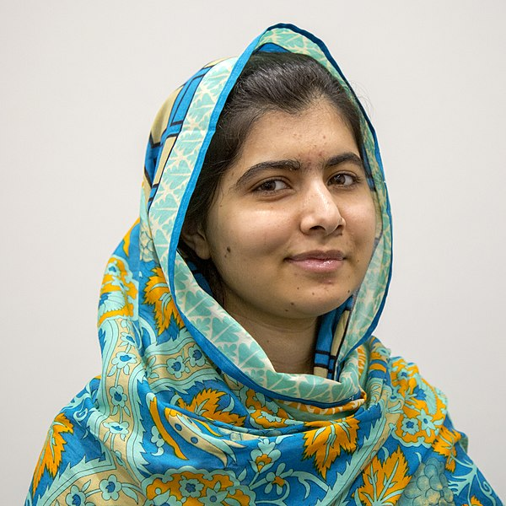
Inspirational people slide 2 of 2
Who are some aspirational people?
How did they achieve their goals?
Malala Yousafzai has been an activist for educational equality since a very young age. Born in Pakistan, her family dedicated their lives to the cause. Malala’s father was determined that Malala would have the same opportunities as boys had in Pakistan.
Malala would always be inspired by the activism in her father and this would lead her to live out an extraordinary life full of sacrifice.
Because of her beliefs on educational rights, Malala was targeted by the Taliban and was shot. This forced her and her family to leave Pakistan.
Her story touched the world and she continued with her studies and campaign, becoming the youngest ever winner of a Nobel Peace Prize.
Credit: Simon Davis/DFID
She has now studied at the University of Oxford, one of the most prestigious universities in the world and created the Malala Fund – Working for a world where every girl can learn and lead.
Notes:
Supporting notes:
Read and discuss the slide on Malala Yousafzai. Discuss with the students why they think she is aspirational and talk about the barriers that she faced when trying to achieve her goals.
Activity Two, part B:
Following the class discussion, the students can return to their work book and complete activity two, part B
Activity Two, part C - Can you think of any other people who you believe are aspirational? Remind the students that these can be people from the local communities – they do not have to be famous

Slide 8

How to achieve goals slide 1 of 1
How do aspirational people achieve their goals?
Think about the two examples that we have looked at. How did these people, or any other aspirational people that you thought of, achieve their goals?
They set their expectations high
They were resilient and kept going even when times were tough
They thought about the steps that they needed to take to get there
They used their influence and experience to further their cause
Notes:
Supporting notes:
Activity Three:
Ask the students to reflect on the two examples that we looked at and any others that they have thought of. What did these people do to help them achieve their dreams? Working back in their groups, ask them to write some of the students answers on the flipchart paper and then compare with the answers on the slide. Share and discuss responses with the rest of the group.

Slide 9

What are your aspirations activity slide 1 of 1
What are your aspirations?
How could you achieve them?
What do you aspire to do? Perhaps you want to join a certain career, excel in a particular sport or become really good at a hobby?
Find out who inspires our University students
Share your aspirations with the person next to you.
Now, think about how you could realise your aspirations and what steps you would need to take.
Notes:
Supporting notes:
Watch and listen to university students talk about their own aspirations for the future. Find out who inspires and motivates them and why.. (click hyper link to watch video)
Ask the students if any of them would like to share their aspirations for the future with the rest of the group and discuss
Activity Four:
Ask students to complete the Bridge to the Future activity resource

Slide 10

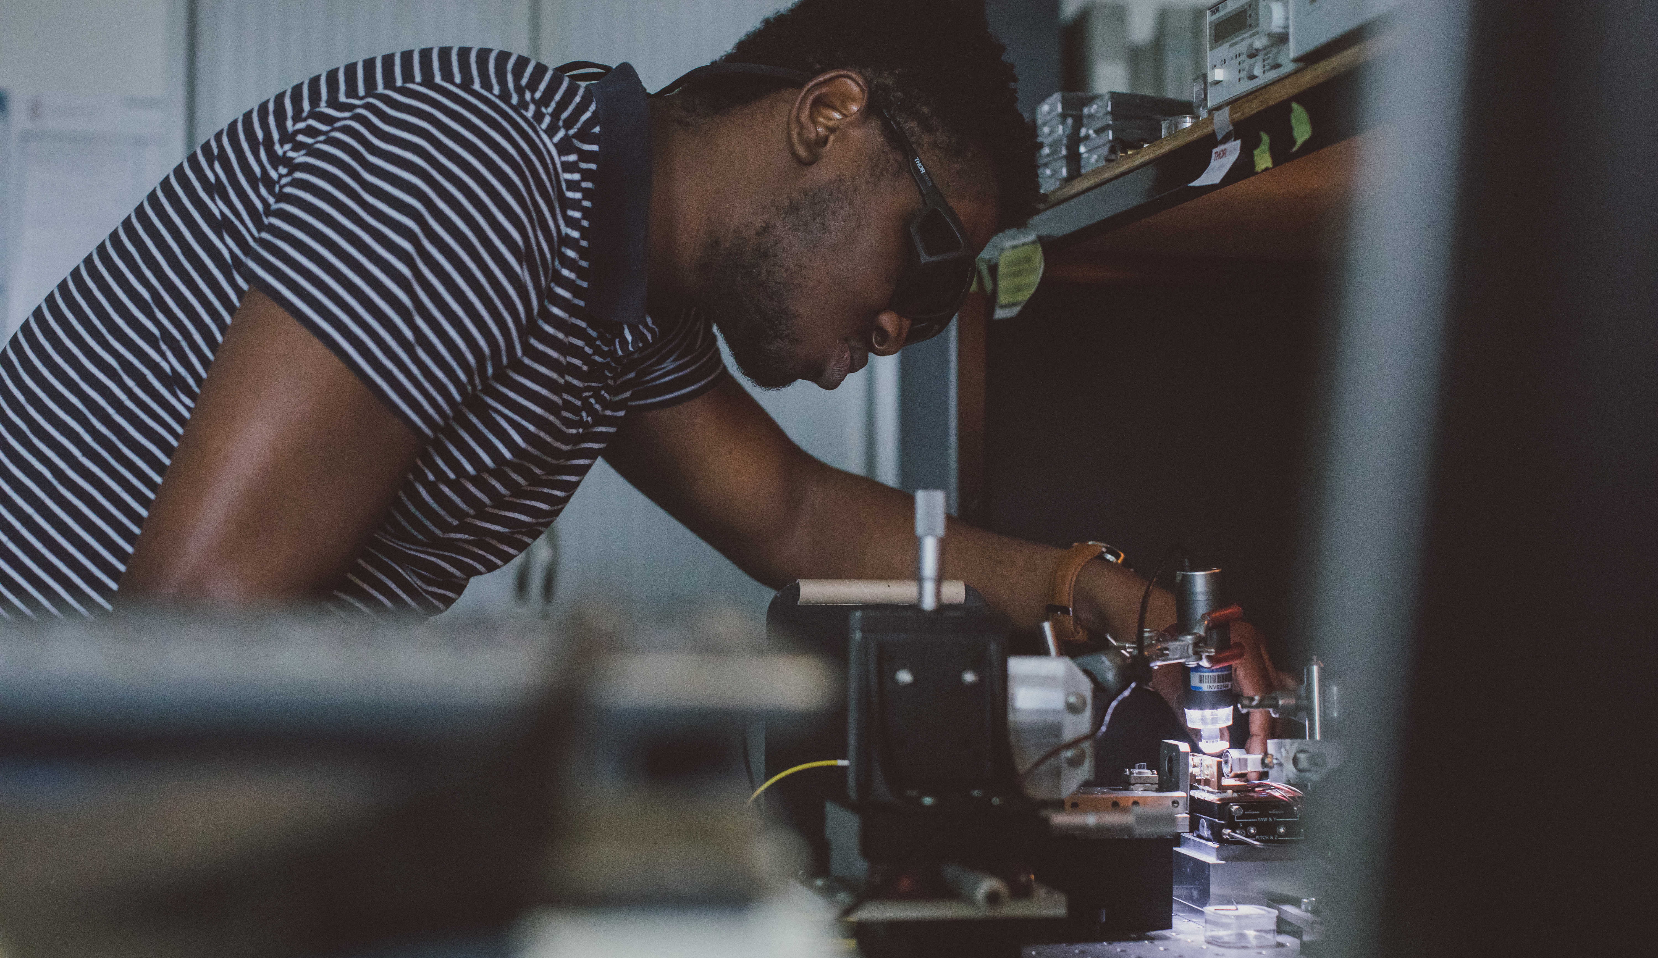
Take away points slide 1 of 1
Don’t forget…!
Remember to aim high to reach your full potential
Put in time and effort to achieve your goals
Dream big and picture yourself succeeding

