Slide 1
Super Stars
A bright and brilliant future
Session three – The origins of the superhero

Slide 2
Session aims slide 1 of 1
Session aims
To identify our individual skills and qualities
To identify the difference between a hero and a superhero
To introduce a brief history of the superhero genre

Slide 3
Defining skills and qualities slide 1 of 1
Skills and qualities
Skills and qualities are two aspects of a person that makes them well-rounded and unique
Skills are things that a person can do effectively that they may have learnt through school or work - for example, reading, writing, listening and communicating etc.
Qualities are aspects of a person's personality that are natural to that person - for example, kindness, generosity, patience and motivational etc.
Notes:
Supporting notes:
Discuss the definitions and ask students to complete activity one, Part A and B in their Super Stars workbook.

Slide 4
Meet Dr Miriam slide 1 of 1
Meet Dr Miriam Kent
Dr Miriam Kent, is a lecturer at the University and knows a lot about superheroes! She'd like to share with you a bit about her life and how superheroes has majorly influenced her career.
Watch Dr Miriam Kent's introductory video here.
Notes:
Supporting notes:
Watch Dr Miriam Kent's introductory video to find out more about her, her work and how she's been influenced by superheroes.

Slide 5
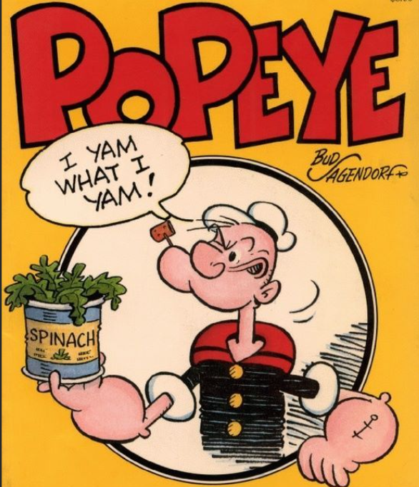
Comic books slide 1 of 1
The beginning of comic books…
Comic books were first released in the 1920s as a form of entertainment and they contained fun characters who went on adventures in exciting places. The characters in these comics were not known as superheroes even though they managed to do things that everyday people couldn’t do.
Popeye, created by Elzie Segar, was one of the first characters used in comics, and although he got super human strength from eating spinach, he wouldn’t really be considered a superhero.
0f2e004e108174a50496d95694bdfe2d.jpg (553×647) (pinimg.com)l
Notes:
Supporting notes:
The next 4 slides are a brief introduction to the superhero. Superhero's first made their debut in comic books and newspaper strips in the 1920’s.
There are heroes and then there are superheroes. For an individual to be considered “super” they would have to be something exceptional. A hero is good but a superhero is extra good. They should possess abilities that are more grand, more powerful than others, most of the time even impossible for a normal person. Their actions through these abilities would exceed normal human levels, or limits. Their personality traits and characteristics are of the highest moral standards.
Most importantly, a superhero not only helps anyone in trouble but also teaches everyone important life lessons about how to be a good person through example.

Slide 6
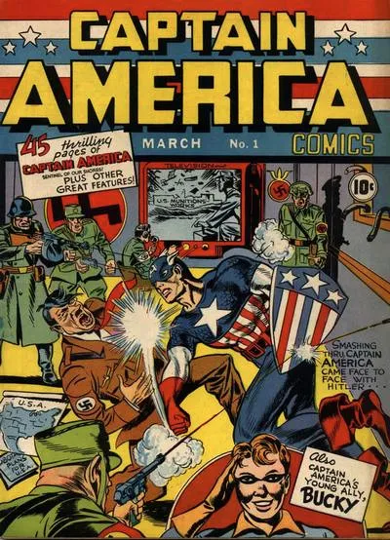
Origins of superheroes slide 1 of 1
…and the origins of the superhero
Superheroes were first introduced in comic books in the 1930s. The first, featured a man with a red cape and a blue costume.
This is known as the Golden Age of comic books and Superman became known as the first superhero! The Golden Age also saw the creation of Batman, Wonder Woman, The Flash and Green Lantern.
The Second World War hugely influenced the Golden Age. Comic books were a cheap form of entertainment with the main theme of good triumphing over evil.
https://gocollect.com/comic/captain-america-comics-1
Notes:
Supporting notes:
Superheroes are present all across the world and have evolved throughout the decades. They often tell us something about modern-day life in nearly every society on the planet at the time they are written.
They enable us to express our identities, our empowerment or disempowerment, our understanding of politics, violence, sexuality, race and national identities.

Slide 7
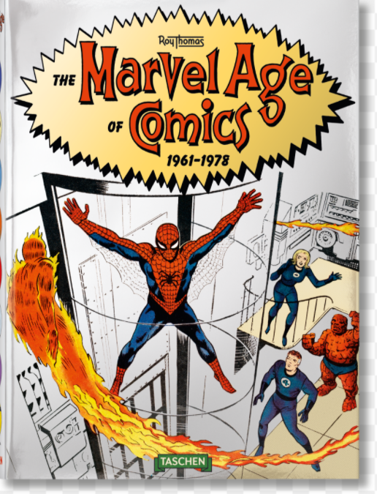
Comics timeline slide 1 of 2
Comics through the decades
Golden Age 1938 – 1950
You could easily tell the difference between good and evil. Characters were either good or bad
Silver Age 1950 – 1971
With lots of space travel, the sci-fi/fantasy genres were broadening
Bronze Age 1971 – 1980
Villains became tougher and storylines often included darker elements of the reality of living in urban environments
The Marvel Age of Comics 1961–1978 - TASCHEN Books
Notes:
Supporting notes:
Golden age:
During the Golden Age, comic books contained stories where the reader could easily tell the difference between good and evil. Characters were either good or bad. They had no inner turmoil or a dark past to hide. In these stories the superheroes always fought evil and always won. The superheroes had a variety of superpowers and they managed to overcome the evil characters without much effort.
Silver age:
During the Silver Age people started wanting comic books that reflected reality. This meant that storylines and characters started being aimed at a more adult audience. The most popular theme explored by publishers and writers during this time was that of horror. These comics often contained gruesome tales.
Bronze age:
The Bronze Age saw a change in the comics that were produced. Villains became tougher and storylines often included the darker elements of the reality of living in a urban environment. During this age the public fought for the censorship of comics to be stopped which in turn lead to even darker storylines to be explored.

Slide 8
Comics timeline slide 2 of 2
Comics through the decades
Dark Age 1980 – 1993
Writers begin to show that the heroes could be just as dark and as complicated as the villains
Comics began to reflect reality. This meant that storylines and characters started to be aimed at more adult audiences
Today
Comics are more accessible that ever, for example through online platforms, resulting in readers all over the world!
The Marvel Age of Comics 1961–1978 - TASCHEN Books
Notes:
Supporting notes:
Dark Age:
During this age writers began to show that the heroes could be just as dark and complicated as the villains and that the line separating the two was not always clear. Characters with psychological faults, like the Joker, were introduced. It was also a time when writers explored the themes of disasters happening that no superhero would be able to prevent
The Ageless age:
With the internet and online applications becoming the most common form of media, artists are no longer forced to work with a major publishing house, which means that there are no rules holding them back. Freelance comic book artists are releasing work on almost every imaginable topic. Comics no longer are just about heroes and villains. Anything goes!

Slide 9
Favourite superhero activity slide 1 of 1
Who is your favourite superhero, why?
Black Panther
Wonder Woman
Batman
Iron Man
Notes:
Supporting notes:
Activity Two: Look at the images on the screen of some superheroes. (your favourite superhero might not feature but you are welcome to still use them. Those shown are just examples)
Who is your favourite?
Why do you like them?
What qualities do you think they possess?
Why do you think they are so successful?

Slide 10
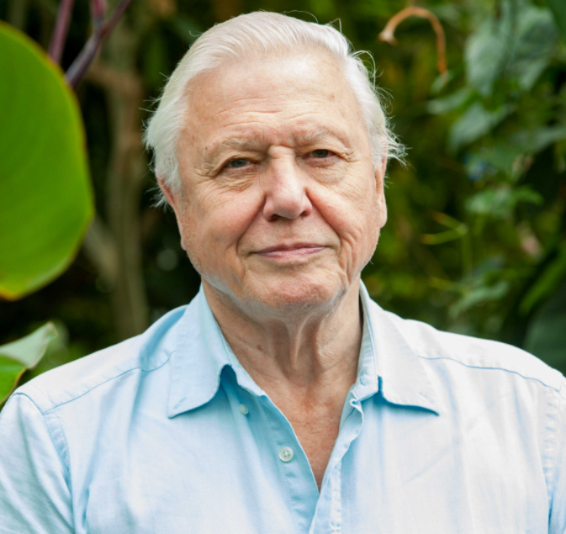
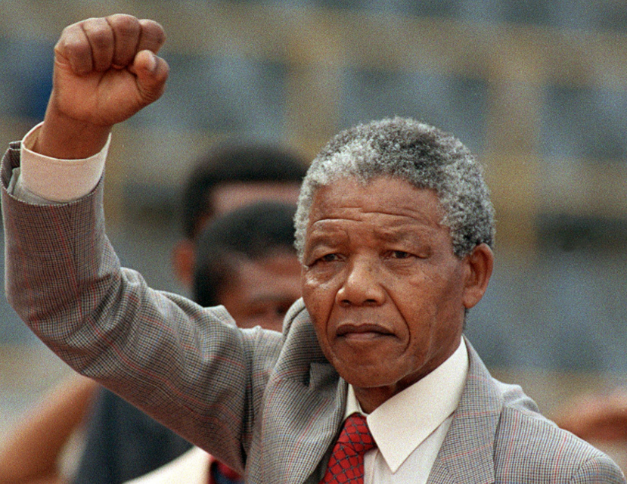
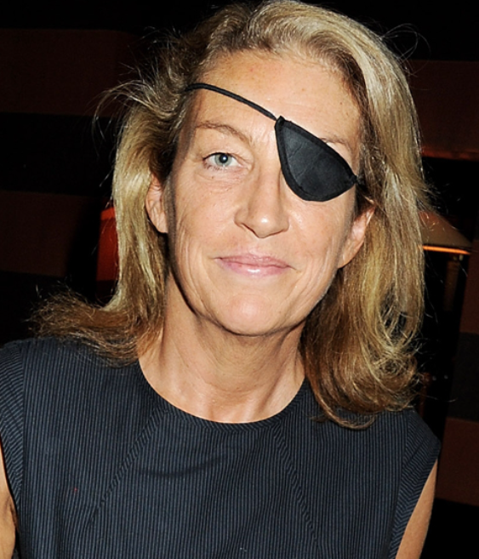
Favourite hero activity slide 1 of 1
Who is your favourite hero, why?
David Attenborough - Naturalist
Nelson Mandela - Leader
Marie Colvin – War Journalist
Emmeline Pankhurst – political Activist
Notes:
Supporting notes:
Activity Two: Look at the images on the screen – Some of these individuals can be labelled as heroes. Some faces you will recognise, others you will not.
All of them have similar superhero characteristics – They are fighting for a good cause or are striving to make a positive difference in the world and to people lives.
Who is your favourite?
Why do you like them?
What qualities do you think they possess?
Why do you think they are so successful?

Slide 11
What makes someone a hero slide 1 of 1
What makes someone a hero?
Each table has been given 2 images:
Superhero
Hero
Spend some time looking at each image and the description of them. Answer the following questions:
What sort of heroic qualities does this person possess?
What skills might this person have?
Use the skills and qualities cards to support your group discussion and match them to the hero/superhero.
Notes:
Supporting Notes:
Activity Three:
In groups, give the students 5 minutes per image to discuss their hero/superhero. They will need to choose from the skills and qualities cards which attributes best serve each person. The students can write down their answers on the image sheets given.

Slide 12
Real heroes Vs Superheroes
Real hero vs superhero activity slide 1 of 1
Real Hero
Superhero
Notes:
Activity Four – Choose a real hero and a superhero from those we have just looked at in activity three. In your Super Stars workbook, write down why they are similar and why they are different
The learning outcome here is that real life heroes possess similar attributes to superheroes (minus the Super powers!)
All heroes and superheroes have:
Courage – when facing daunting odds, they charge fearlessly and prevail
Selflessness – other peoples needs come before their own
Humility – They remain modest
Commitment – commit themselves to the cause
Compassionate – Have a sense of concern and kindness for others. Their actions are intended to improve the lives of others
Express enjoyment in their mission – Bring a message of hope and goodness through positive action

Slide 13
Quotes slide 1 of 1
“Heroes are made by the path they choose, not the powers they are graced with”
- Iron Man
“With great power, comes great responsibility”
- Spiderman

