Slide 1
Super Stars
A bright and brilliant future
Session one – An introduction to university and beyond

Slide 2
Welcome
Watch our Welcome video about the Super Stars programme!

Slide 3
Aims of the session slide 1 of 1
Session aims
To introduce students to the concept of higher education
Familiarise students with the terminologies used within universities

Slide 4
Objectives of the session slide 1 of 1
Session objectives
Understand the journey to higher education
Identify unique features of a university e.g. lecture theatre
Understand what students do when they go to university
Virtually meet a student ambassador

Slide 5
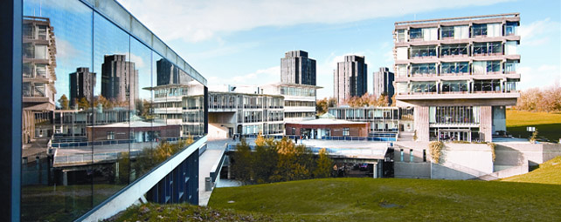
How to get to the university slide 1 of 1
So what is a university and how do I get there?
Notes:
Supporting notes:
This slide is a visual representation of the student journey to university. It is an opportunity to talk about the journey from primary school in preparation and readiness for secondary school, GCSE’s, then on to Sixth form or College at 16 and then to university.
* As an additional learning theme you might like to consider adding in the alternate pathways to accessing higher education such as degree apprenticeships but for ease we are only detailing here the traditional pathway to university.
University is where you go (should you wish) once you have completed school and college/sixth form and have gained your GSCE’S and A-Levels or equivalent.
A university is like a school but for adults. You can apply to go to university from the age of 18, but there is no upper age limit so you could be age 70 if you still the passion and energy to learn!
You work towards a qualification known as a degree. By the time you are eligible to go to university you would have achieved other qualifications such as GCSE’s, A-Levels, NVQ’s, T-Levels to name a few.
Qualifications help you to achieve a greater understanding of different subject areas and will help you towards building your career.
Most students go to university for a minimum of 3 years, some longer, depending on the degree.
If and when you go to university, some students move away from home and will live with their friends whilst they are at university.

Slide 6
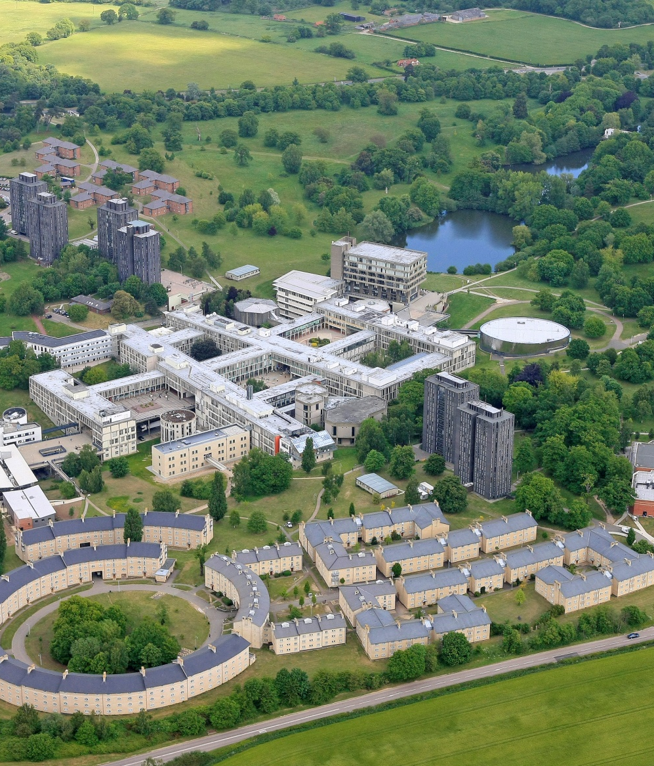
University of Essex slide 1 of 1
What does a University look like?
University of Essex, Colchester Campus
This is the University of Essex, Colchester Campus
The University has three different campuses, Colchester, Southend Campus and Loughton Campus
The University has over 15,000 students studying with them from over 140 different countries – it is very international
Come and take a look…
Notes:
Supporting notes:
The university of Essex is very big and has plenty of fun things to keep you occupied whilst you are studying there! If you can see all of the little squares (point them out) There are lots of shops, restaurants, library and sports facilities – there is also a GP surgery, a hairdressers and beauty salon, a theatre, a launderette and arts gallery!
The campus has lots of park land for playing on, a lake (with plenty of ducks!), BBQ areas, heaps of wildlife! Some of our students have even been known to go sledging down the campus hills at Christmas!
You will be able to see from the picture that there are 6 towers and some houses in the shape of a circle. These are what are called ‘Halls of Residence’ this is accommodation for students who have decided to live on campus during their studies.
You do not have to live here, some students live in the local town and some students stay at their home and travel in each day (if it is not too far). You can decide whether or not you would like to live in halls of residence. The majority of students do live in ‘Halls’ or other types of student accommodation as it is a fantastic way of meeting new people from all across the world and making new friends.
Activity One – Take the virtual campus tour quiz! Answers can be recorded under activity one of the student workbook.
Please click the hyper link to be taken on an interactive tour of our Colchester campus (come and take a look)
Activity One – Answers to quiz questions
What is the name of the campus that Katie is giving you a virtual tour of? – Colchester Campus
What can you do by the lakes? – play Frisbee, go for a walk, eat your lunch
Can you give an example of a subject that a student can study at the university? all our subjects offered at the University can be found here https://www.essex.ac.uk/subjects
What is the name of our theatre? Lakeside Theatre
How many books are there in the library? Over a million!
What is the name of one of our lecture theatres? Ivor Crewe Lecture Hall
Tell me one thing that you can do on square 3. Eat and drink, go to the market and purchase fresh fruit/veg
What activities can you take part in at our sports arena? Basketball, football
Can you live at the university? Yes!
What is the annual graduation ceremony? A big celebration event to celebrate students’ finishing their degrees.
Does the campus look amazing?! Yes!

Slide 7
Reasons to go to the university slide 1 of 1
A University is a place to grown and learn!
Deciding to go to university is a choice. You do not have to go if you do not want to
Specific career areas will require you to have a degree qualification, such as a teacher or doctor
It is an amazing opportunity to learn about your favourite subject
It is an opportunity to learn from the best academics there is. Your lecturer may have even written a book or two
It is a place for you to grow and develop your knowledge and skills and help you decide upon your future career path
Notes:
Supporting notes:
University is a choice, you do not have to go here if you do not want to, or your job/career path doesn’t require for you to do so. Lots of people decide to go to university to further their learning and knowledge of certain subject areas.
At university your teacher is also known as an academic, professor or lecturer. These are all commonly used terms within a university. Academics are experts in their subject area. They would have studied their subject for many, many years.
Teacher – you may like to at this point, share your journey to teaching. Did you go to university, what did you study, for how long, where did you study?
Teacher – Create a discussion and ask the students if they have any older siblings, family members who have gone to university – could they share any of their stories?
A university is a place for you to grow and develop as a person. You will have the opportunity to learn new skills, develop your knowledge and grow your ambitions for the future.

Slide 8
What can you study slide 1 of 1
A place to study your favourite subject!
There are over 50,000 different courses available to study at university and over. There are some weird and wonderful subject areas to choose from including:
Surf Science and Technology
Contemporary Circus and Physical Theatre
Fantasy Literature: Harry Potter
Activity Two
There is a subject for every letter in the alphabet. In groups of 2 or 3, think about a subject for every letter in the alphabet!
You will find a worksheet in the booklet. Write down your answers and share them with the rest of the class.
Notes:
Supporting notes:
Explain that there are over 50,000 different subjects for you to study.. One for every letter of the alphabet
Activity two – In groups of 2/3 pupils, think about a subjects that students can learn beginning with each letter of the alphabet. students can use activity two within their workbook to complete this task.
Teacher - Answers can be found using the following link (UK University degree course search - Complete University Guide (thecompleteuniversityguide.co.uk))

Slide 9
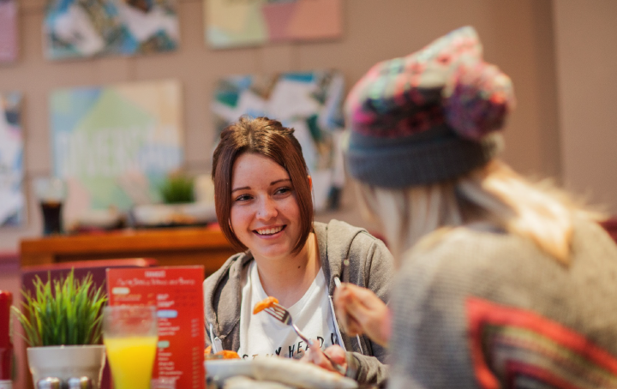
What can you gain or do at university slide 1 of 2
A place to make new friends
Universities are hugely diverse and international places. The University of Essex has students studying from 140 different countries!
You make friends in a variety of different ways. You can meet people on your course, in your accommodation or at any sports clubs or societies you may join.
Come and listen to current students talking about their university experience here.
Want to find out more? Our student ambassadors answered questions from year six pupils. Find out their responses!
Notes:
Supporting notes:
Universities are incredibly diverse places with international and global communities. The University of Essex has students studying from around 140 different countries.
There are many opportunities for you to make friends. You can form new and interesting friendships with the people you live with and the course you study on. Often these friendships last a lifetime. Imagine all of the interesting things you will learn from meeting people from all across the world! New languages, food and cultures to experience!
Universities provide opportunities for students to flourish and grow in their independence. There are lots of ways for you to connect with like minded people who have the same interests as you such as Art, music, theatre, sports!
A big difference between school and university is that university campuses are much bigger which can be a little bit daunting when you first arrive but there is plenty of support available for students and they work hard to ensure that you are happy and healthy. They are very supportive places and help you to become the best you can be!
Follow the link on the presentation to listen to current undergraduate student experiences

Slide 10
What can you gain or do at university slide 2 of 2
A chance to pursue hobbies and learn new skills at university clubs and societies!
There are a wide range of activities to suit everyone
Continue a hobby you had before university
Try out something new
Make lots of friends that have the same interests as you
Staying fit and healthy
Add experience to help you to land your dream job
Notes:
Supporting notes:
Universities have what we call clubs and societies. These are places where students go to learn a new skill, continue with a hobby or interest or to learn a new one! Clubs and societies are hugely popular amongst students and a great way to socialise.
Clubs and societies can be weird and wonderful! Some are very traditional such as sports clubs – football, swimming, rugby, netball etc. Some are rather unusual like the Mario Kart society, the Curry Appreciation Society

Slide 11
Why do you want to go to university activity slide 1 of 1
Your Why
St
Activity Three
Use the diamond to prioritise the reasons you think are most important in going to university
Learning a new skill
Meeting new people
Notes:
Supporting notes:
To conclude session one, we will complete activity three. Session two will focus on students future aspirations, inspirational people, the skills and qualities they possess and how these linked to different career and degree areas.
Activity Three:
Here we will prioritise the reasons you think are most important in progressing on to university. You will find this template in the pupils workbook under session one, activity three.
Ask students to prioritise using the set benefits/reasons on slide 11, students can also include a reason of their own for going on to university.
Talk about how everyone may have completed their prioritisation differently. Some students may feel improving their job prospects is the most important benefit of going to university, whilst someone else may feel studying something they’re passionate is most important to them.
Students can do this task alone and then ask them to discuss with the person sat next to them, or share their prioritisation as a class discussion. It would be great for the teacher to also share their ‘why’.

Slide 12
Benefits of going to the University slide 1 of 1
Your Why
Gain a qualification that is recognised and respected worldwide
Improve your job prospects
Learn new skills
Study something you enjoy
Meet new people
Have new experiences
Grow your independence
Have a great time
Help you to achieve your ambitions and aspirations for the future

Slide 13
outreach@essex.ac.uk

