Slide 1
Super Stars
A bright and brilliant future
Session five – You can achieve anything!

Slide 2
Session aims slide 1 of 1
Session aims
Students can identify and discuss opportunities that may become available to them in the future, how they might benefit from them and are aware of how to make the most of them
Students can understand how people learn new things and achieve certain goals
Students can discuss educational and career opportunities that may be available to them in the future

Slide 3
Learning slide 1 of 3
Learning as we grow
As a year six student you will have learnt a lot already during your time at school. There will be things that almost everyone has learnt and other things that are unique to you. As we grow up and move through school, college, university and to our future careers, we will continue to learn and pick up new skills and interests along the way.
With the person sat next to you complete Session Five - Activity One in your Super Stars workbook.
Notes:
Supporting notes:
Session Five - Activity one – students to complete Learning as we grow activity
Ask the students to read through the statements in their workbook and highlight any that apply to them. They are all things students their age might have learnt to do since starting school. They will be a combination of interests from their school and home lives. Ask the students to share their responses to create discussion and to find out some new and interesting facts about one another – particularly those that they are happy to share that you may not have known about!

Slide 4
Learning slide 2 of 3
Attitudes and behaviours for learning
On the next slide we are going to see some statements. Some of the statements are things which can help us to learn something new, while others are things that would hinder our learning.
All the skills you have achieved since starting school were not achieved by luck.
Think about how you achieved these skills. Were there certain things you needed to do in order to learn a new skill?
As each one appears, show me with a thumbs up or a thumbs down whether the attitude or behaviour is a help to learning or a hindrance.

Slide 5
Learning slide 3 of 3
Attitudes and Behaviours for Learning
Watching others and copying them
Giving up if it is too hard
Getting someone else to do it for you
Practising the skill lots of times
Following instructions
Trying a different strategy or technique
Being afraid to make mistakes
Asking for help or advice
Getting feedback on how to improve
Sticking with things you find easy
Expecting to get something right first time

Slide 6
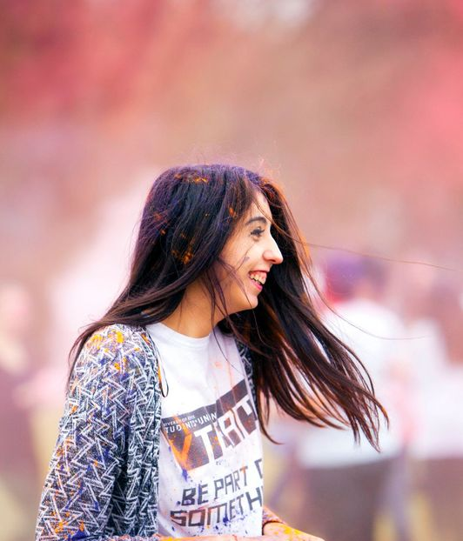
Strengths game slide 1 of 2
Strengths and interests
Let’s play a game to demonstrate how different we all are when it comes to our individual strengths and interests.
Everybody needs to start by standing at the back of the room and ensure that there is enough space in front of you.
When I read a statement that applies to you, take one step forward.
Try not to copy your friends, this is about you. The aim of this activity is to show that we are all individuals with our own interests and strengths. Think back to your superheroes. They all have different strengths and interests – just like you!
Notes:
Supporting notes
This activity is to simply show that as we end up in all different places, how different we all are in terms of the things we are interested in and the things we do well at.

Slide 7
Strengths game slide 2 of 2
Strengths and interests
I am a confident speaker
I love animals
I love reading
I am good with numbers
I can solve problems
I can make up stories
I enjoy drawing
I sing really well
I am good at caring for others
I enjoy team games
I like to cook
I am a good swimmer
I love being outdoors
I love learning about space
I am good at making other people laugh
I am good at playing a musical instrument
I love being active
I love helping others
I am very patient
I am interested in history

Slide 8
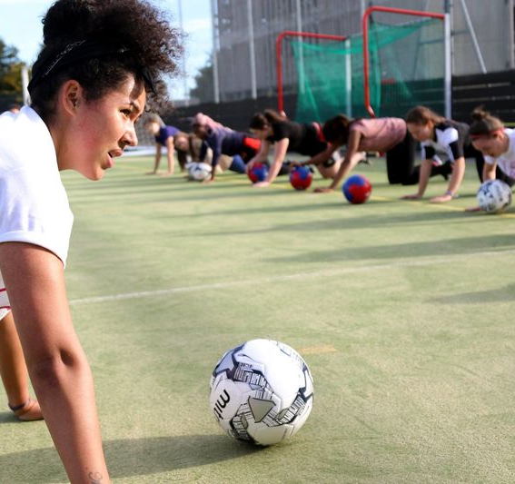
Interests summary slide 1 of 1
Strengths and interests
We are all so different! We learn in different ways, find different things challenging and have different strengths and interests.
The one thing we all have in common is that perseverance, effort and a positive attitude enable us to take on new challenges and learn new skills.
When we use our different strengths to achieve things, our sense of self-worth is increased. This means that we feel good about ourselves when we work hard at something and then we can see our own success.

Slide 9
Workbook activity slide 1 of 2
How I learn best
It is really helpful to get to know ourselves – the things we like, the way we learn, our particular skills and environments that we learn best in. This will help us to shape our learning journeys and excel in different subject areas.
When you are old enough to start thinking about whether you would like to go to university, you will likely ask yourselves the same questions…
What is my favourite subject and can I pursue a job/career in this area?
How do I like to learn? Do I like reading? Conducting experiments? Using a computer?
Do I enjoy taking tests?
Do I enjoy taking part in big discussions and debates?
Questions like these help students to make important decisions about the careers and jobs they would like to pursue in the future.
Notes:
Supporting notes
Session Five - Activity two – How I Learn Best
Ask students to refer to the ‘How I Learn Best’ in their Super Stars Workbook

Slide 10
Activity Three – To University And Beyond
Workbook activity slide 2 of 2
Notes:
Supporting notes
Session Five – Activity Three: To University and Beyond!
Now that you have spent some time thinking about your students learning preferences and sharing their interests, skills and strengths, lets take a look at different types of university degree’s that compliment those skills and the different types of careers that they lend themselves well to.
Ask the students to work in groups and give each group a set of Degree Profiles and a set of career Profile cards. The students will need to take a look at the degree profiles, discuss the interests, skills and study preferences and then try to match the career profile to the degree.
Encourage them to discuss their reasons and share their findings with the rest of the class at the end of the activity.
This activity is aimed at demonstrating that as we move through our school career and ultimately through to our professional careers, students should play to their strengths, nurture and develop their skill set and interests to help them to reach their full potential and future aspirations.
As we make decisions about future choices, always consider whether you enjoy what it is you are hoping to study, does your skill set compliment the subject, can you see yourself having a happy and fulfilling career/job in that area?
All doctors, vets, architects, astronauts, teachers, lawyers all started their learning journeys at primary school, we all aspire to be something.. Even SUPERHEROES!
To infinity and beyond…

Slide 11
3
Congratulations!
Notes:
Concluding notes:
This session was aimed at demonstrating that as we move through our school career and ultimately through to our professional careers, students should stay focused and play to their strengths, nurture and develop their skill sets, pursue interests to help them to reach their full potential and future aspirations.

Slide 12
Final few words slide 1 of 1
Congratulations!
Congratulations Super Stars on completing this programme! We hope that you feel inspired to continue pursuing your hopes and dreams for a bright and brilliant future!
Dr Miriam has a final few words for you...
Notes:
Concluding notes:
This session was aimed at demonstrating that as we move through our school career and ultimately through to our professional careers, students should stay focused and play to their strengths, nurture and develop their skill sets, pursue interests to help them to reach their full potential and future aspirations.

Slide 13
For more resources, events and activities for students and teachers, please take a look at our web pages or to get in touch with The University of Essex Outreach Team via outreach@essex.ac.uk

