Slide 1
Super Stars
A bright and brilliant future
Session four – Creating a Superhero

Slide 2
Aims of session slide 1 of 1
Session aims
Reflect on the learning throughout the Super Stars programme to design a superhero
To build a character profile of the students' superheroes

Slide 3
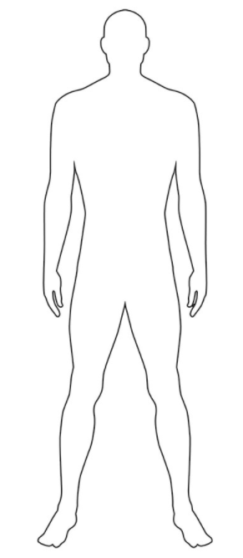
Create your superhero activity slide 1 of 1
Design time!
In this session we would like you to create your own fictional superhero.
We would like you to reflect on all that you have learnt throughout this programme to create a poster and build a character profile.
Use your imagination to bring your character to life!
On your tables you will have a instruction sheet of all of the different themes you will need to include.
Notes:
Supporting notes:
Activity One:
This session is an opportunity for the students to use their creativity and reflect on their learning to produce their own fictional super hero. The activity will encourage them to think about the different themes we have discussed, skills, qualities, aspirations for the future.
We would like the posters to be created A3 in size to allow the students to get creative with what their heroes may look like but to also write various descriptions about them.
We have provided templates that you can print off for the pupils to work from that would provide some structure for the students to complete the task.

Slide 4
Superheroes picture
Notes:
Supporting notes:
We have included some images of various superheroes over the decades for creative inspiration for the students

Slide 5
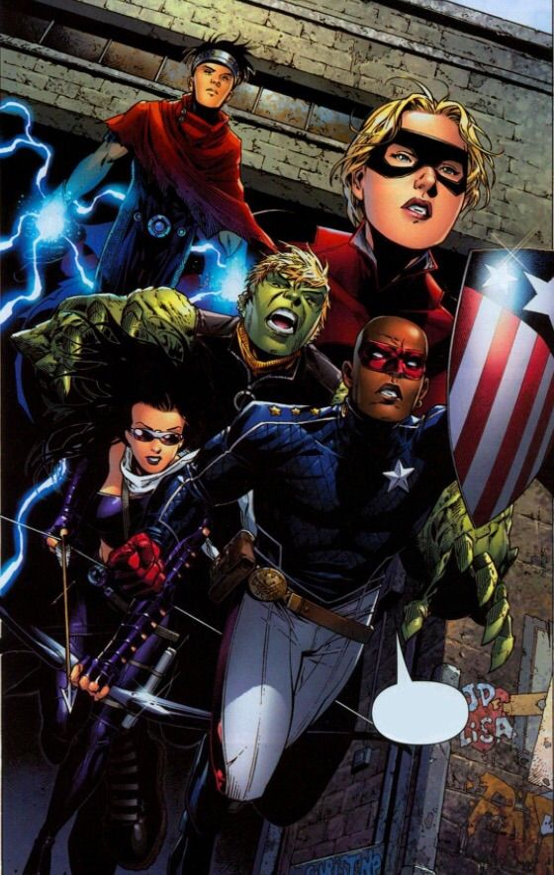
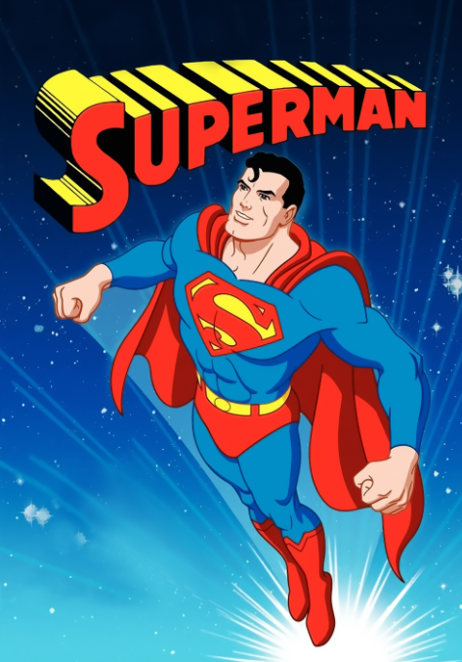
Superheroes picture
Notes:
Supporting notes:
We have included some images of various superheroes over the decades for creative inspiration for the students

