Slide 1
Remote international opportunities summer 2020
Summer plans suspended due to COVID-19? Essex Abroad are partnered with a variety of providers who are all running remote programmes for summer 2020. All the providers offer something slightly different – details below:
Online Summer schools
To see our range of summer schools please use our exchange finder – just select “summer schools” under programme type. There are currently 6 summer schools on offer covering a range of interests with some even being offered on a fee free basis.
Remote International Internships
Think Pacific
Our Fiji based volunteering partner have worked with the Fijian government to create remote internships that are based around sustainable development and social impact. You will complete a 100 hour project (which can be over 4 or 8 weeks) and have a choice of 100 projects. Programmes start from 29 June 2020 and the fee to take part is £495 – if you then decide to take part in a future in-person project you will receive £150 off the programme fee. Find out more here https://thinkpacific.com/our-expeditions/virtual-internships/
Absolute Internship
20 – 30 flexible hours per week for between 4 and 16 weeks. Remote internships are offered in a range of industries and countries. There are 10 scholarships available for this summer, head to https://info.absoluteinternship.com/remote-internship-program to find out more.
Pagoda Projects
Full time remote internship programme running over 8 weeks from July in China, Vietnam and Mexico. This programme includes networking events, language and fitness as well as a cultural mentor. Pagoda projects have offered a £500 discount for Essex students – their programme fee is reduced to £995. Learn more here https://pagodaprojects.com/Essex
The Intern Group
Remote international internships all over the world from 4 – 12 weeks with flexible start dates. Programme highlights including keynote speakers, 10% discount for all Essex students and further discount if you are in receipt of a maintenance loan. Learn more here: https://bit.ly/EssexAndTIG
www.essex.ac.uk/study-abroad
stpabroad@essex.ac.uk

Slide 2
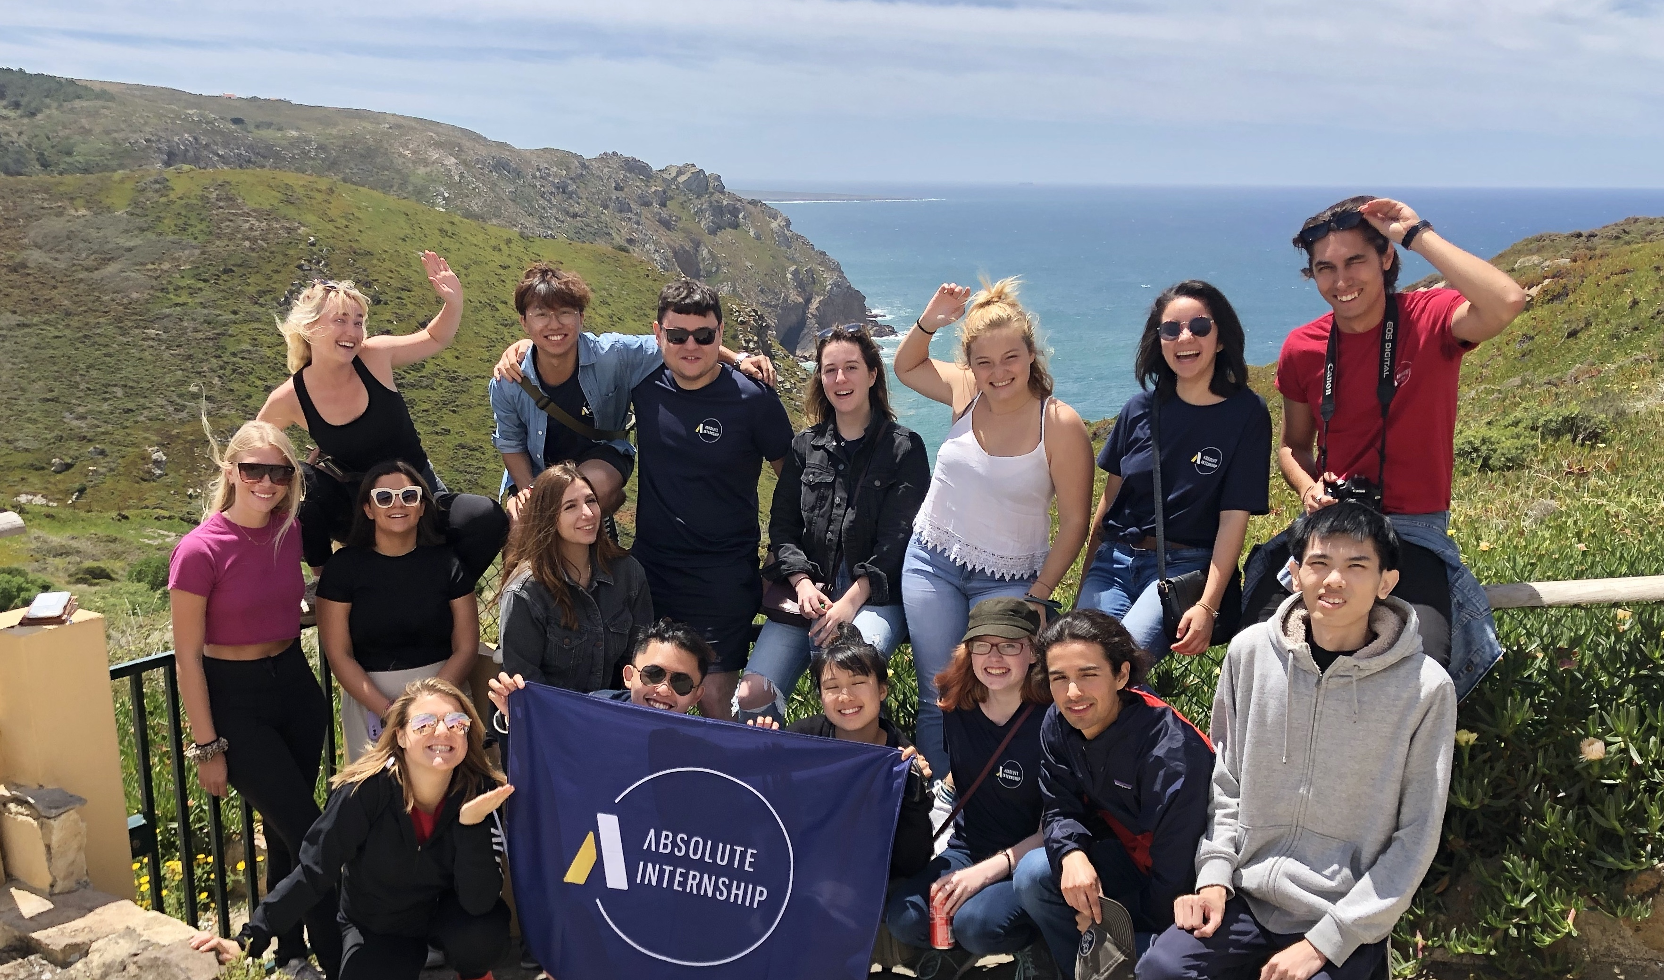
CRCC Asia
1 to 3 month programme with a chance to intern for 20 – 30 hours per week. Internships are hosted in China, India, Japan, South Korea and Vietnam. Highlights from this programme include access to a careers coach and language lessons for your host country. Learn more here https://www.crccasia.com/internship/locations/remote-online/
Archipelagos Institute of Marine Conservation
Remote internships in marine ecology research, marine mammal research, environmental law and mixed media. These internships are 100 or 250 hours with a fee starting at €870. Students will take part in data analysis and produce a mini research report. Find out more here https://archipelago.gr/en/remote-multidisciplinary-internships-on-applied-marine-conservation/
Further information
Please be aware that all international internship opportunities are unpaid internships and there is a fee to take part in the programme. This is due to visa restrictions in different countries. If you are interested in a paid internship programme, then you may like to explore Essex Interns (this is overseen by the careers service team within the University) https://www1.essex.ac.uk/careers/internships/
If you need help funding your remote internship, you could use CLICK crowdfunding. The University of Essex will give you up to £250 per project. Get in touch: click@essex.ac.uk
All of the programmes are eligible for the Big Essex Award – to sign up for the award and find out more visit https://www1.essex.ac.uk/careers/bige/
Please contact the providers directly should you require any specific programme information. You can also sign up for our Essex Abroad newsletter here or explore other Essex Abroad opportunities via our website.
www.essex.ac.uk/study-abroad
stpabroad@essex.ac.uk

