Slide 1


RIS
Publications Guide
September 2026

Slide 2
ABOUT THE RIS
The Research Information System delivers important benefits which include:
The automatic searching of publications from a range of external sources and a simple process to deposit them into the Research Repository.
A single place where researchers can manage grants, professional activities, teaching responsibilities and supervision, publications and impact.
A way to manage and edit external web profiles.
A platform in which REF submission and internal research monitoring can be managed with minimal re-keying of data or completing of forms.

Slide 3
ABOUT THIS GUIDE
This guide describes how to manage publications in the RIS.
By the end of the guide you should be able to:
Login to the System
Review your Home page summary
View your Publications
Claim publications that belong to you
Create new items manually
Revise the search settings
Add Scopus IDs and ORCID to your Data Source Searches

Slide 4
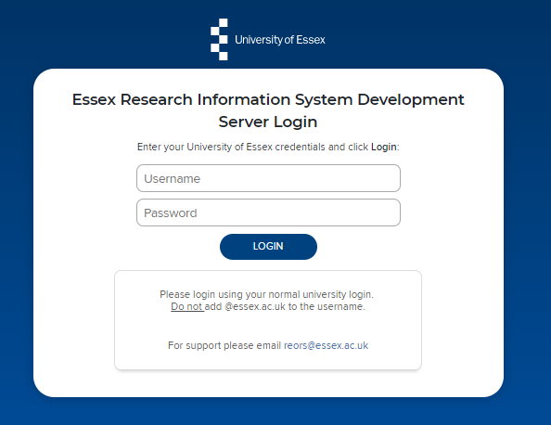
Log In
Login at: https://ris.essex.ac.uk
Your normal university login is all you need.
You don’t need the VPN to access the RIS. It works from anywhere with an internet connection and in most browsers (Microsoft Edge, Chrome, Firefox, Safari).

Slide 5
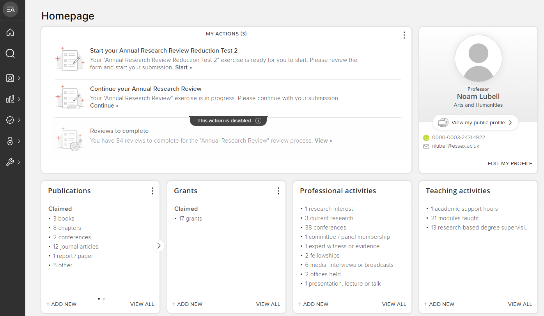
Home Page
When you first log in the Home Page will be displayed, looking something like this.

Slide 6
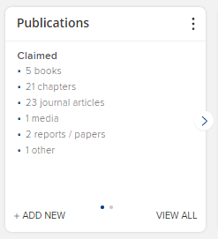
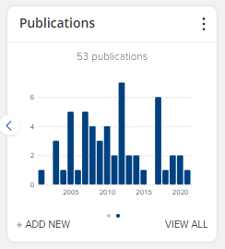
My Summary
A summary of Publications is shown on the Publications tile.
The graph shows (claimed) publications by year.
Note: the graph and data in the summary update every 24hrs.
Claimed and any unclaimed (Pending) publications are indicated

Slide 7
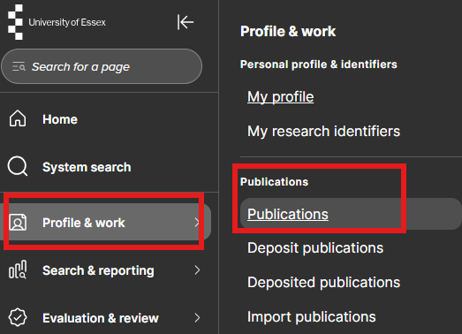
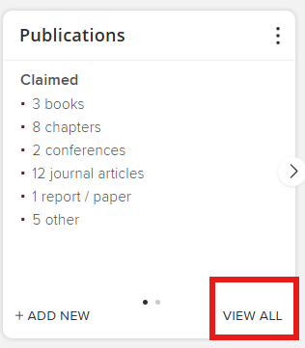
My Publications
You can access your Publications either from the menu (Menu > Profile & Work > Publications > Publications) or by clicking on the View All button area on the home screen tile.

Slide 8
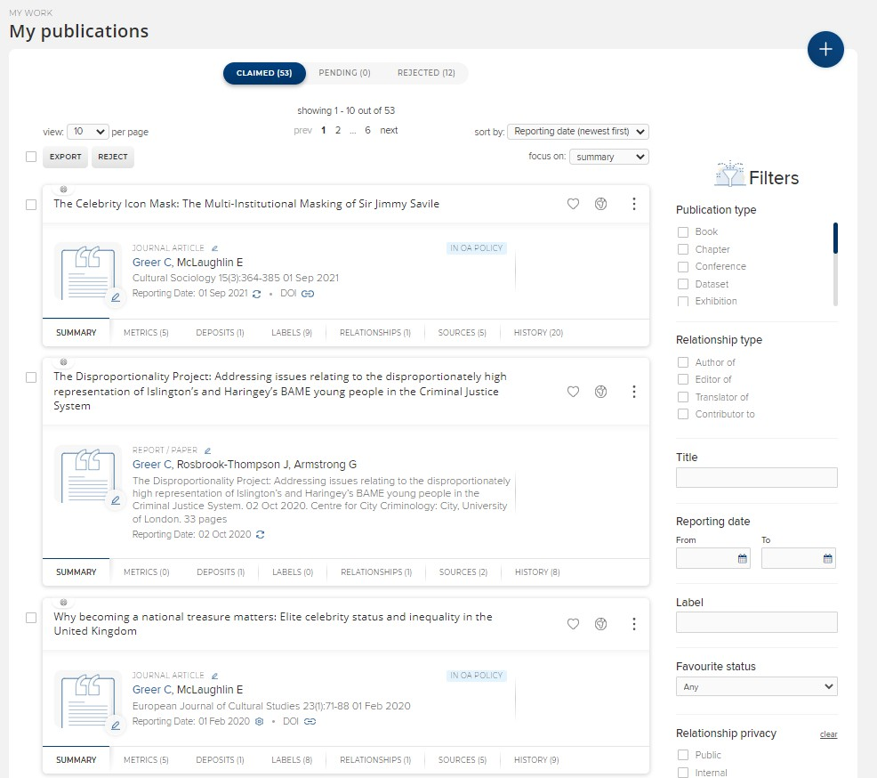
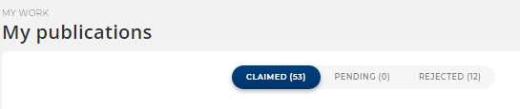
My Publications
Your publications appear in a list. The list can be paged, sorted and exported using the controls at the top of the page.
You can filter the publications using the Filters on the right hand side of the screen.
You can switch between Claimed, Pending (Unclaimed) and Rejected publications.

Slide 9
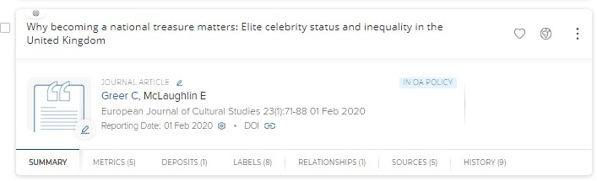
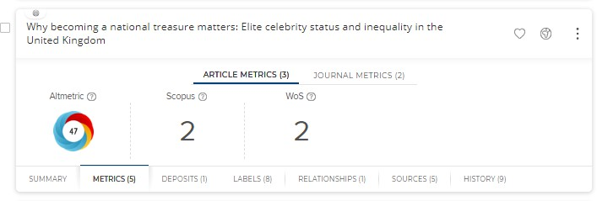
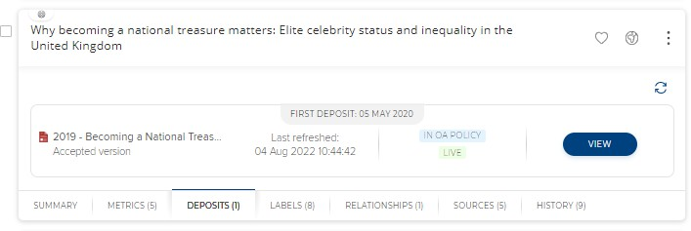
Manage Publications
You can see more detail about the Publication and edit it by clicking the title.
The tabs for each record display a wealth of information about the publication including:
Metrics – citations from several external data sources including Scopus and Altmetric
Deposits - Status of deposit in the Essex Research Repository
cont….

Slide 10
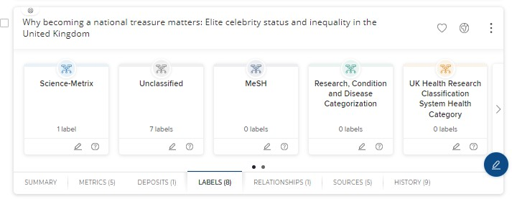
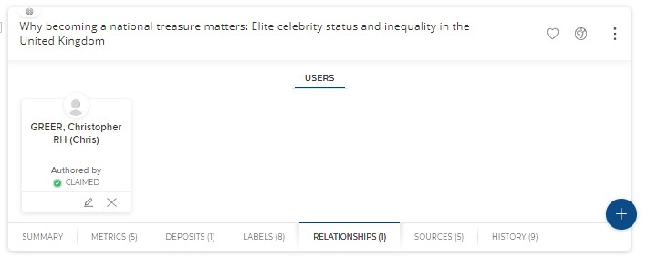
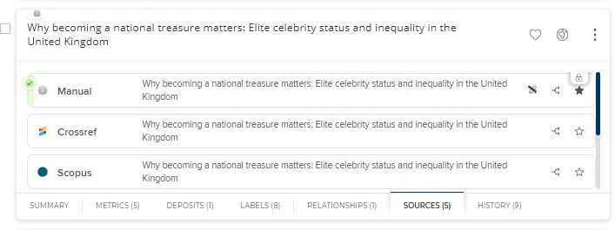
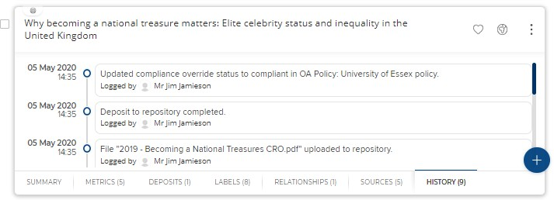
Manage Publications
Labels from both assigned source such as MeSH and Science-Metric and manually assigned ones at Essex.
Relationship – To Essex Co-authors, Grants and Impact etc.
Sources – Metadata may be sources from a number of bibliographic sources including those created at Essex and form external databases like Scopus and Web of Science
History – any updates made to the record both automatic and by Essex staff.

Slide 11
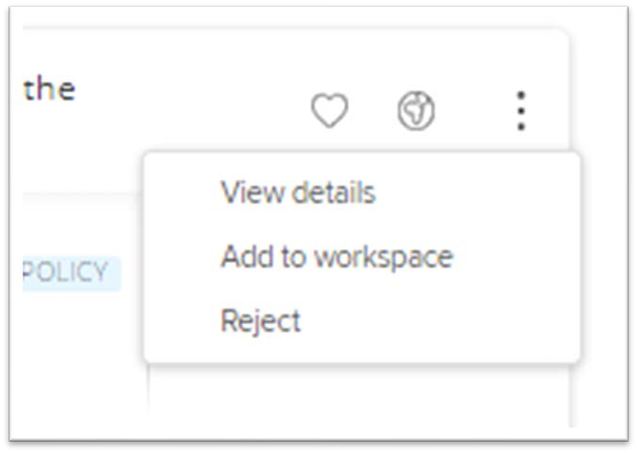
Manage Publications
Controls at the top allow you ‘Favourite’ a publication, control the privacy settings and the ellipses gives access to the detailed view, the ability to reject the publication from your list or add it to you workspace.

Slide 12
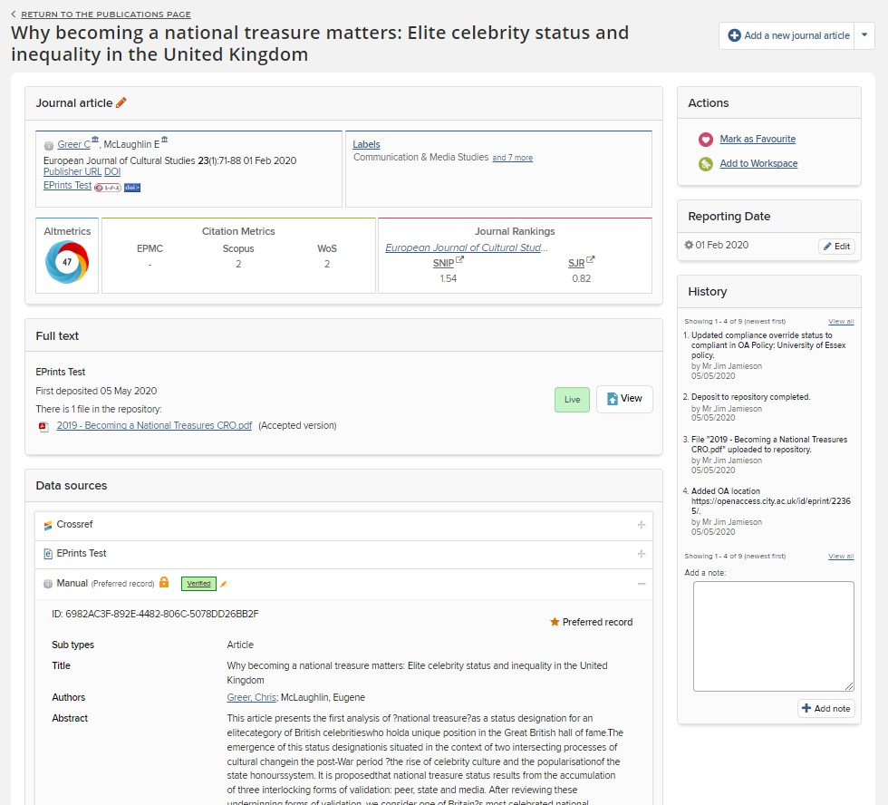
Manage Publications
Accessing the detailed view provides an alternative layout to the tabbed list view with all the information on a single page.

Slide 13
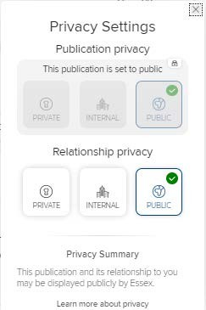
About Publication Privacy
By default all Publications in the RIS are Public as the data is predominantly public domain and this cannot be changed. This applies to the publication record but not your relationship to it.
The Relationship privacy can be set by you.
Setting it to Public (the default) means that your publication will be displayed on the external web profile and on the internal RIS profile
Setting it to Internal means that your relationship to the publication will only be displayed on the internal RIS profile
Setting it to Private means that your relationship to the publication will only be visible to you.

Slide 14
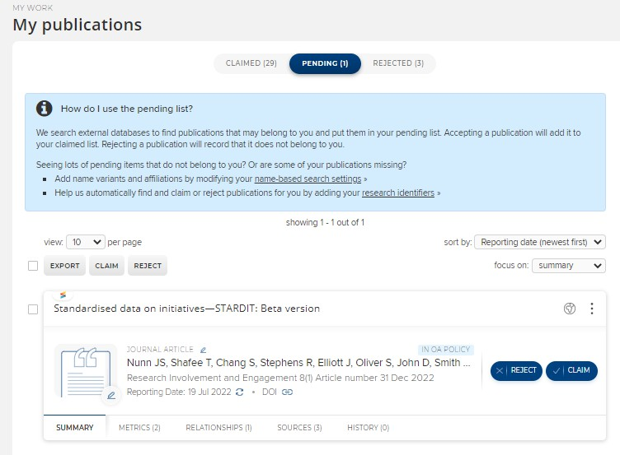
Claim Publications
Your publications list is built from a variety of external sources including Web of Science, Scopus and PubMed as well as discipline specific sources like REPEC, MLA and SSRN.
On the Pending tab you can claim or reject publications that have been identified as yours from external data sources.
Simply click Claim or Reject
Publications that are rejected go on to the Rejected list but can still be claimed in the future.

Slide 15
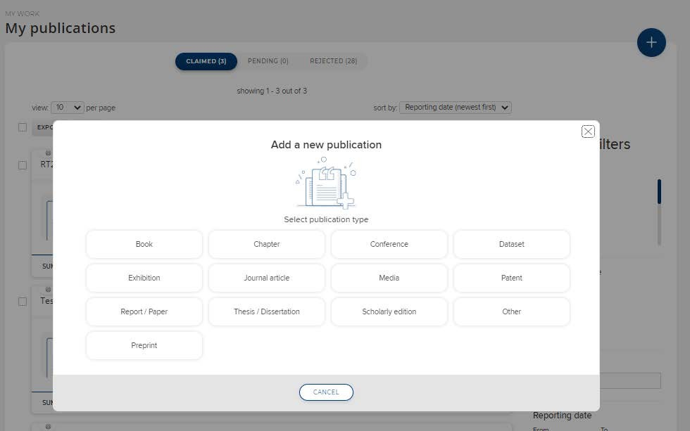
Create new items
If the publication is new and has not been indexed from an external data source you’ll need to add it to the RIS first.
Click Add a New Publication (+ top right) and choose a publication type

Slide 16
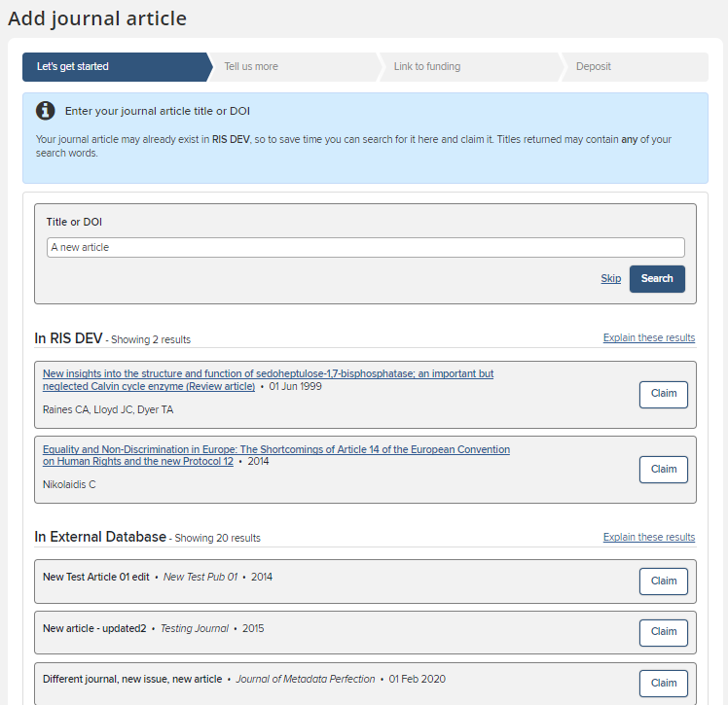
Create new items
You’ll be asked first for the publication title, DOI or ISBN.
The RIS will check it’s not a duplicate and that it is not already deposited. You can Claim it if an existing record matches (it may have been added by a co-author or already exist in an external database), otherwise Skip to the next screen.

Slide 17
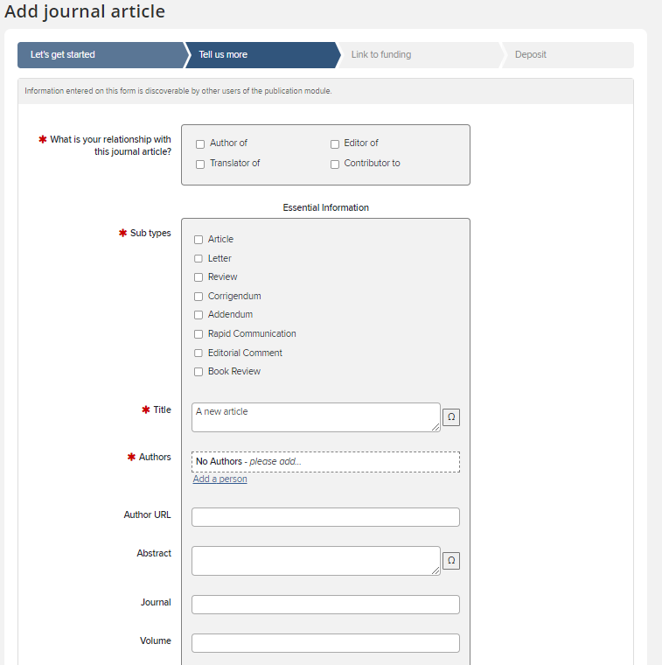
Create new items
You can then give more detail about the publication
There are different forms depending on the publication type you are adding (Article, Conference Paper, Book etc.) As a minimum complete the red starred mandatory fields but please add as much detail as possible to create a complete reference.
When complete, click Save at the bottom of the page.

Slide 18
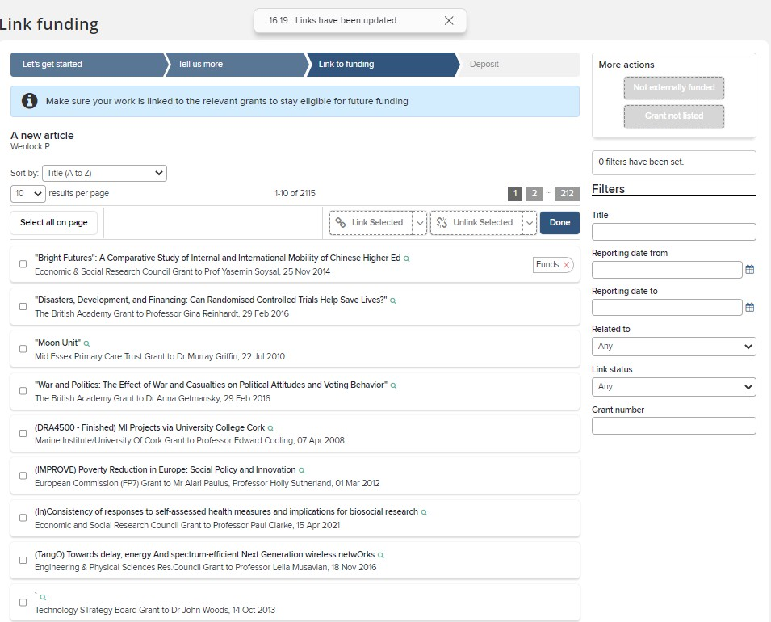
Create new items
The option to link to funding is available.
Award data is automatically loaded in to the RIS, so your supporting grant should be available.
Tick the correct grant(s) and click Link Selected then click Done. You may also choose Not Externally Funded or Grant not listed if this applies.

Slide 19
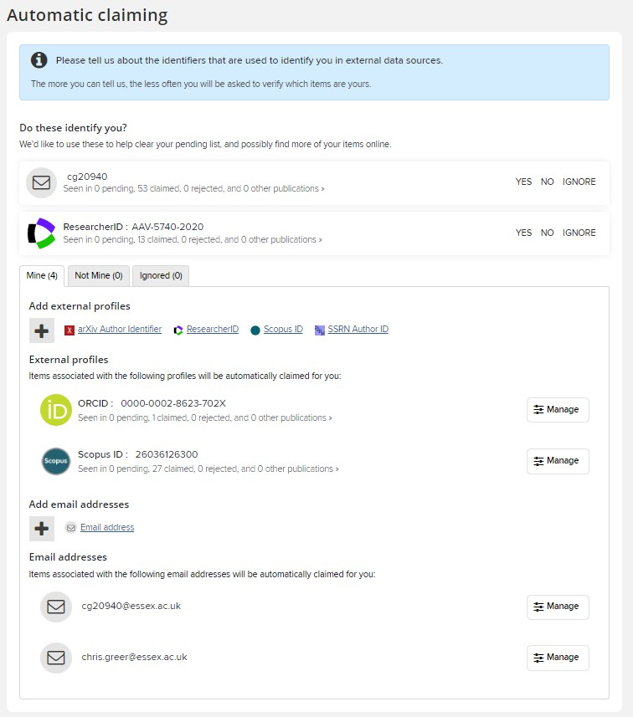
Automatic Claiming
Automatic claiming speeds up the process of clearing your Pending list and of picking up future publication data
You can access your Automatic claiming Settings from Menu > My Profile > Settings > Automatic Claiming
You can also access it from the Pending page

Slide 20
Automatic Claiming
When you go to the Automatic claiming page, you may see a list of data sources under the section Do these identify you? The RIS has found these identifiers from external data sources.
Click on the Yes, No or Ignore beside each identifier to update your search profile. Ignored identifiers will not be offered again, (but the identifier will not be used to exclude publications). Clicking No will exclude all publications using that identifier.

Slide 21
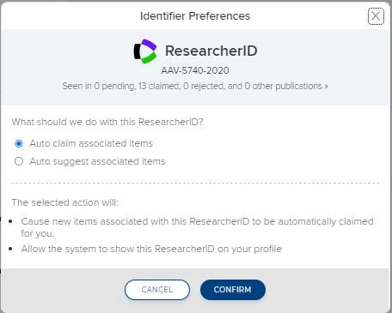
Automatic Claiming
Clicking the Yes button for the identifier will present a confirmation screen that explains exactly what will be done with the identifier if accepted.
The default option is to Auto claim publications which means publications with the author identifier will be automatically added to the claimed list. The other option is to ask the RIS to Auto suggest publications, which places the publications into the Pending list.
The newly verified identifier will be added to the list of External profiles further down the page.

Slide 22
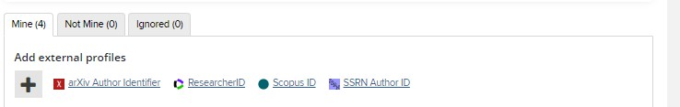
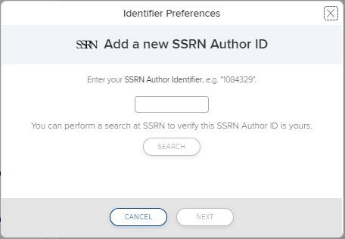
Automatic Claiming
If a known identifier is not listed in the suggestions, click on the database name which will open a dialogue box where the identifier can be entered.
If the identifier is recognized, the RIS will retrieve a sample set of articles from the database. Click the Verify button and RIS will retrieve all of the items associated with the identifier.

Slide 23
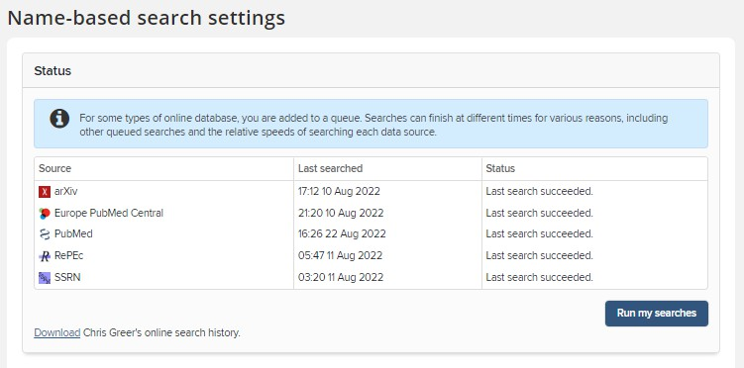
Name Based Search
You can access additional Publications Search Settings from Menu > My Profile > Settings > Name-based Search
The status area shows the last time your data sources were automatically searched. The search runs automatically every 2 weeks. By default all users have PubMed, Scopus and Web of Science turned on. Some departments have additional sources.
You can force the search to run immediately by clicking “Run My Searches”. Note: It takes a few minutes to update depending on how busy the system is.

Slide 24
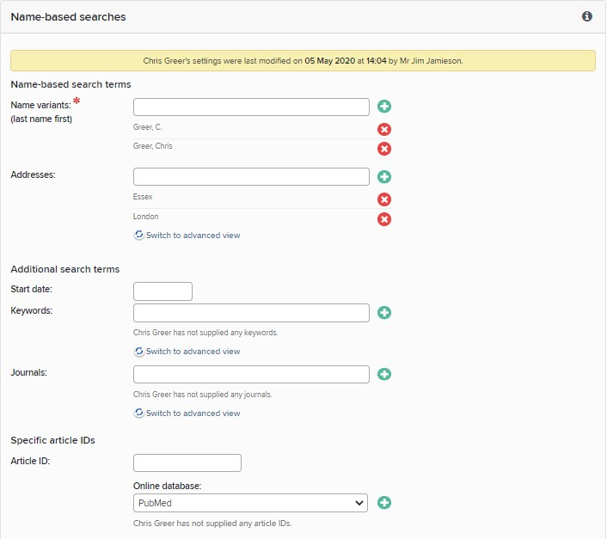
Name Based Search
Settings allows you to customise the publications searches that don’t use Identifiers . In particular make sure that you add the version (or versions) of your name that you publish under. It may be different to the Initials
+ Surname format that is the default
Careful! Additional search terms are restrictive. If you add Keywords or Journals, then the RIS will only retrieve articles that include those keywords or are published in those journals.

Slide 25
Need help?
Contact REO Research Systems
reors@essex.ac.uk www.essex.ac.uk/staff/research-systems

