Slide 1


RIS
RIS Profile Guide
September 2026

Slide 2
About the RIS
The Research Information System delivers important benefits which include:
The automatic searching of publications from a range of external sources and a simple process to deposit them into the Research Repository.
A single place where researchers can manage grants, professional activities, teaching responsibilities and supervision, publications and impact.
A way to manage and edit external web profiles.
A platform in which REF submission and internal research monitoring can be managed with minimal re-keying of data or completing of forms.

Slide 3
About this guide
This guide describes the process of managing your profile and biographical information in the RIS.
By the end of the guide you should be able to:
Login to the System
Update your biographical and profile details
Create and Edit new Professional Activities
Control which information is displayed on you public profile

Slide 4
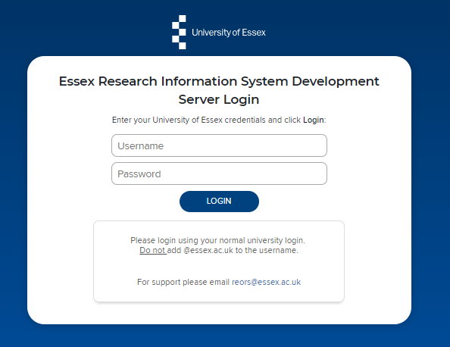
Log In
Login at: ris.essex.ac.uk
Your normal university login is all you need.
You don’t need the VPN to access the RIS. It works from anywhere with an internet connection and in most browsers (Microsoft Edge, Chrome, Firefox, Safari).

Slide 5
Your RIS Profile
Your Profile can be viewed by other users in the RIS. It contains your email address, an overview statement, your co-authors at Essex, experience, and a list of your Publications, Grants, Teaching and Professional Activities
Some parts of this profile data are used on your public facing web profile:
Some categories in the About area (covered in this guide)
Publications (covered in the separate Publications Guide)
Grants (covered in this guide)
Some Types of Professional Activities (covered in this guide)
All Types of Teaching Activities (covered in this guide)
Note: In nearly all areas you can control visibility of items on your internally available RIS profile and your externally available web profile by using the Relationship Privacy controls.

Slide 6
Your external web profile
All members of academic staff have an external web profile managed using the RIS
View the web profile: When you are editing your RIS profile you can jump directly to your external web profile by clicking the ‘View public profile’ button in the top right of the screen.
How the Web Profile is updated: Changes made in the RIS are not immediately visible on the external Web Profile. They update overnight. That means changes you make on any given day will be visible on your external web profile the next morning by approximately 06:00.
Photos: These cannot be added or updated via the RIS. If you have a photo you wish to use on the external web profile, please send it the Communications Office comms@essex.ac.uk who will resize your photo to the correct size before uploading it. Your staff profile photo needs to be professionally-taken, feature your head and shoulders and be high-resolution. If you don't have a photo to upload the
Communications Office arrange regular photo shoots for staff profiles. All staff are encouraged to include a photo with their profile, but it is not compulsory.
You can find more details about profiles at: https://www.essex.ac.uk/staff/web-support/editing-your-staff-profile
Slide 6

Slide 7
About
Your About information can be viewed by other users in the system. It contains your email address, an overview statement and details of qualifications, appointments, training and language competencies.
Some parts of this profile data is used on your public facing web profile:
Overview
Experience: Essex Appointments
Experience : Academic appointments
Experience : Non-academic employment
Education: Degrees
Web addresses (includes blogs, twitter, LinkedIn etc.)

Slide 8
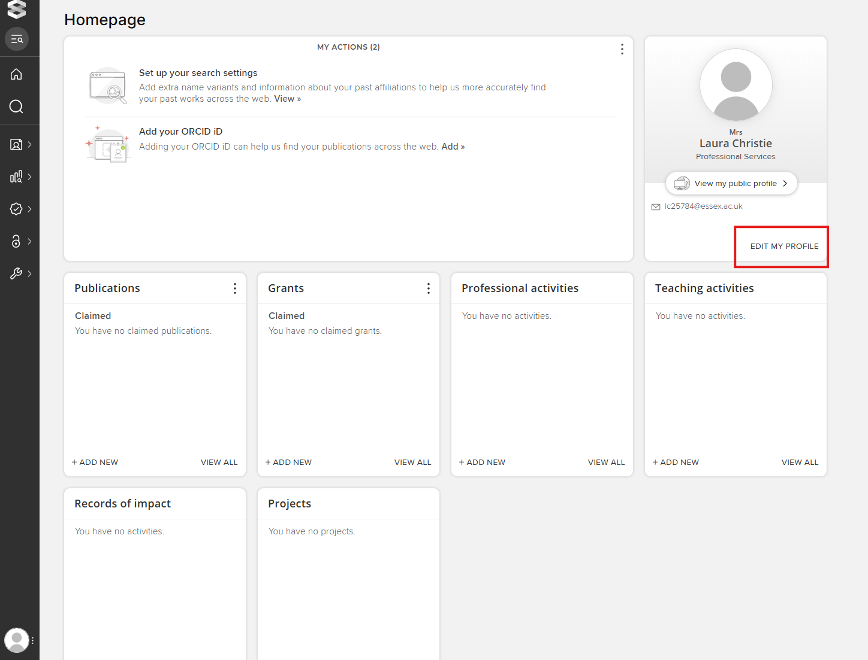
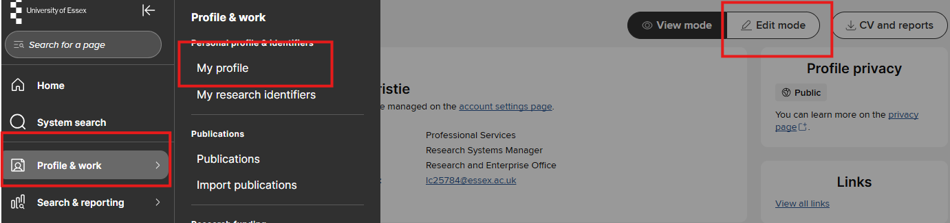
Edit your About
To begin editing your profile Click the Edit My Profile button from the Homepage or Navigate: Menu > Profile & Work> My Profile > Edit mode

Slide 9
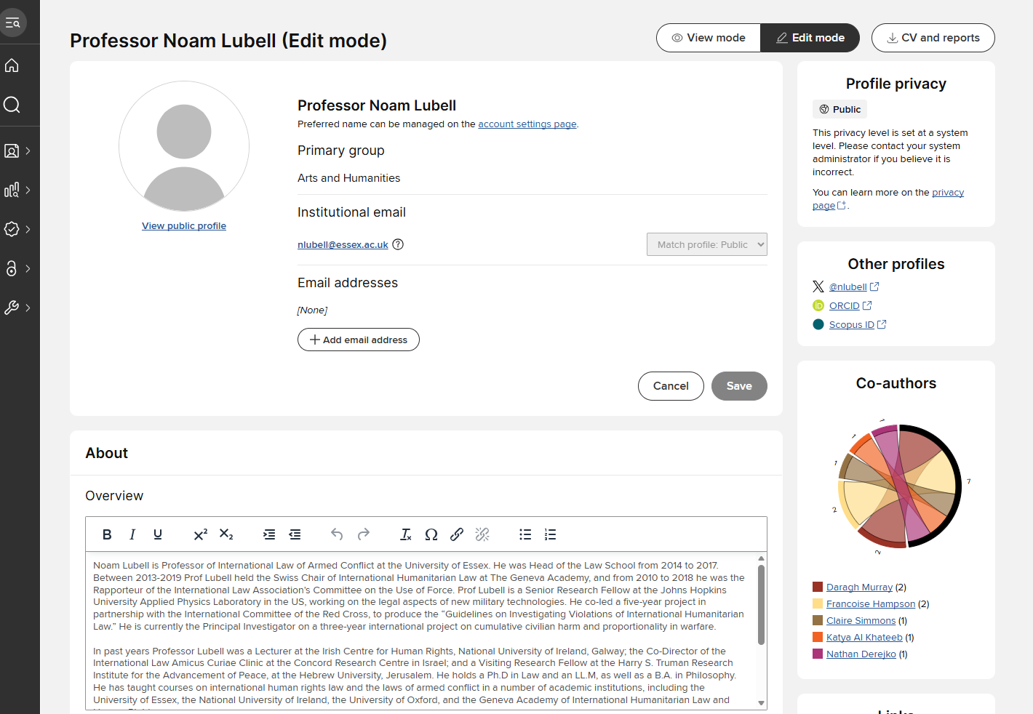
Edit your About
From the edit view you can see a summary of information, click to view your external profile, export you RIS profile to an editable MS Word CV documents, search for colleagues in the RIS and edit sections of the profile.

Slide 10
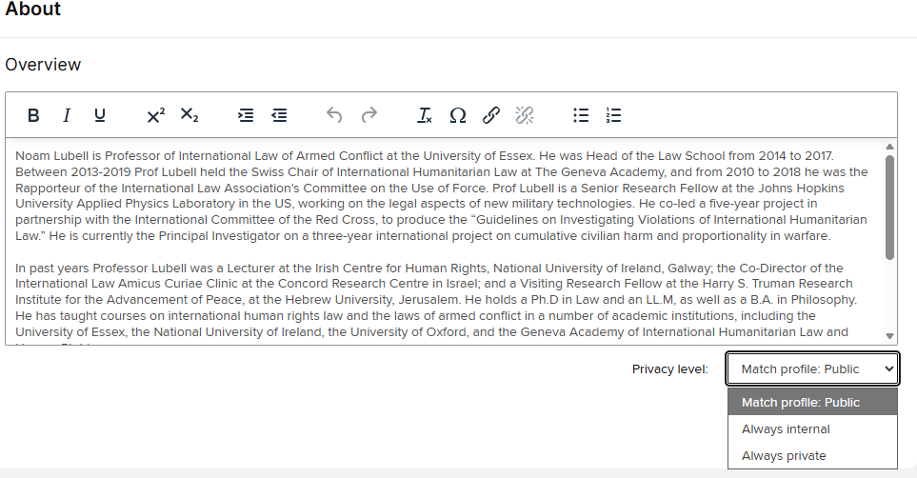
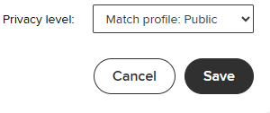
Edit your About
You can edit any area by clicking in the overview box. When you have finished editing, click Save.
You can also adjust the privacy level to hide this information from the internal and external profiles
Note: The Overview area does not support links, formatting or HTML. Please add links in the Addresses section.

Slide 11
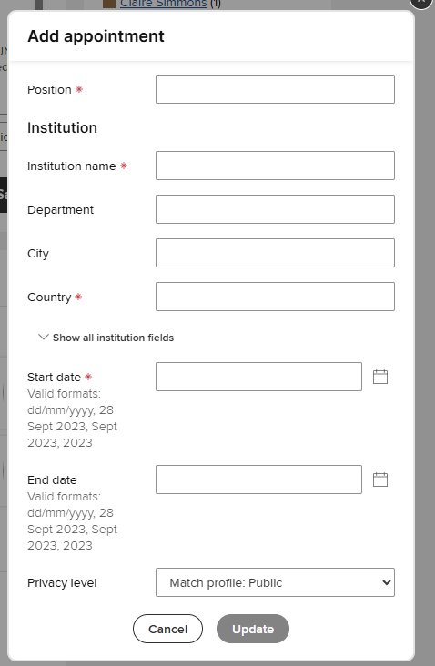
Edit your About
For entries in other About sections including the Experience and Education areas you can Add and also Delete entries.
When adding entries to these section note that red starred * fields a mandatory and must be completed to save the record.

Slide 12
Professional Activities
Professional Activities are part of your profile. You can add a variety of types including: Research Interests, Current Research, Conference Participations, Media, Interviews or Broadcast, Consulting / Advisories, Committee / Panel memberships, Editorships, Expert witness, Journal reviewing / refereeing, Professional Memberships, Offices held and Fellowships
Some of this profile is used on your public facing web profile:
Research Interests (these are also used in the Research Finder)
Current Research
Conferences and Events

Slide 13
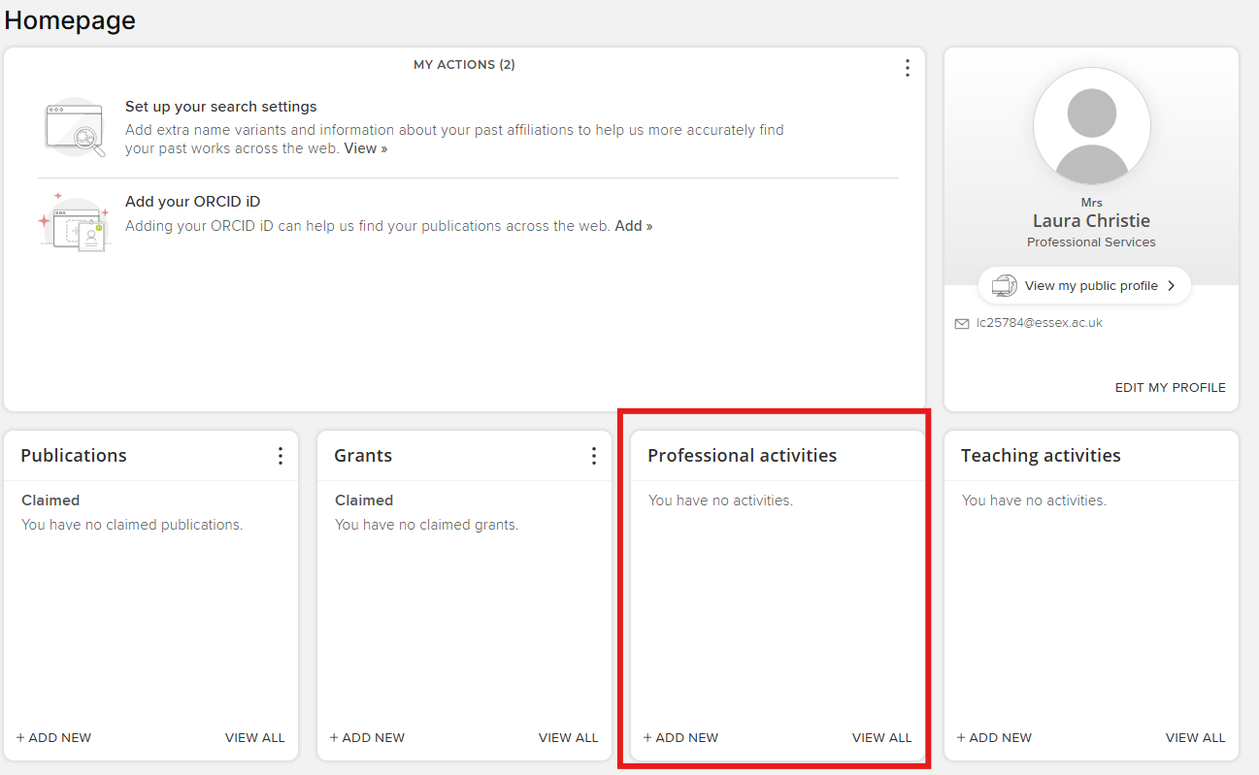
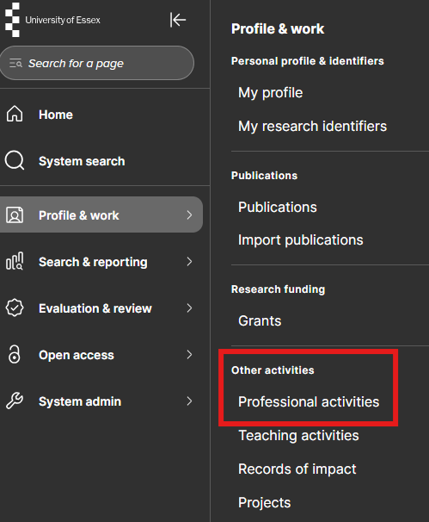
Your Professional Activities
To begin viewing or editing your Professional Activities click View All from the Homepage tile or Navigate: Menu > Profile & Work > Other activities > Professional Activities

Slide 14
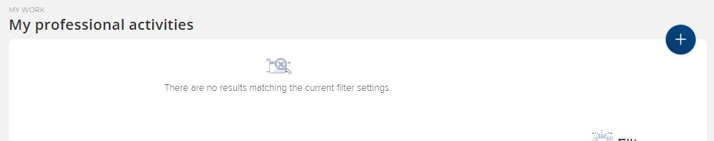
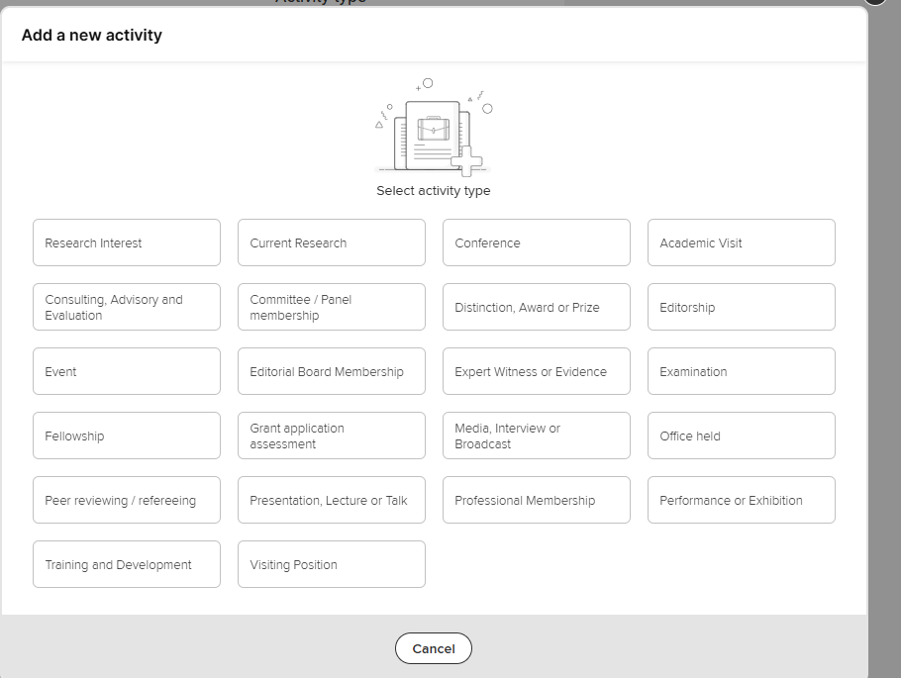
New Professional Activities
To add new Professional Activities Click + Add New from the Homepage tile or the Add button from the My Professional Activities page.

Slide 15
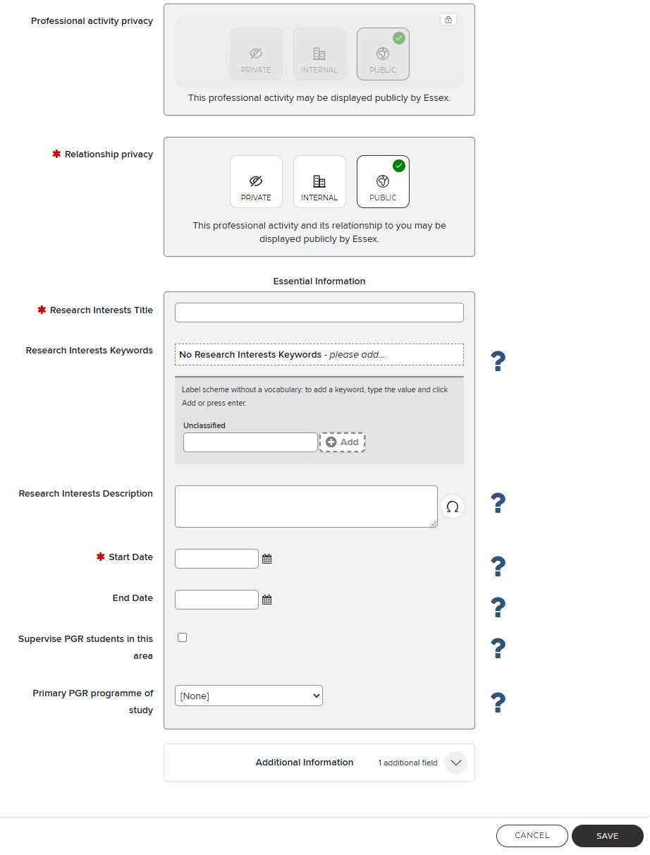
New Professional Activities
Each Professional Activities type will have a different data entry form.
They all work in the same way: Red Star * fields must be completed in order to save. Other details are optional but as much details as possible is encouraged.
Add start and end dates where appropriate. (If current, no end date is needed.)

Slide 16
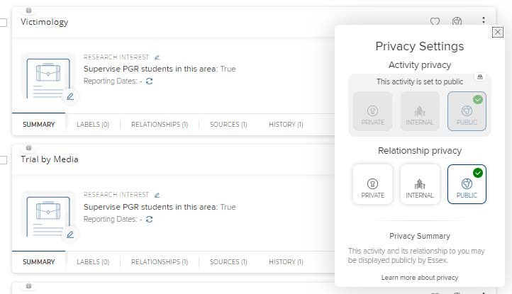
Manage Professional Activities
By default all Professional Activities are visible internally and externally if it is a type used on the external web profile. You can manage your relationship privacy to an item by clicking the privacy settings icon from the My Professional Activities page.

Slide 17
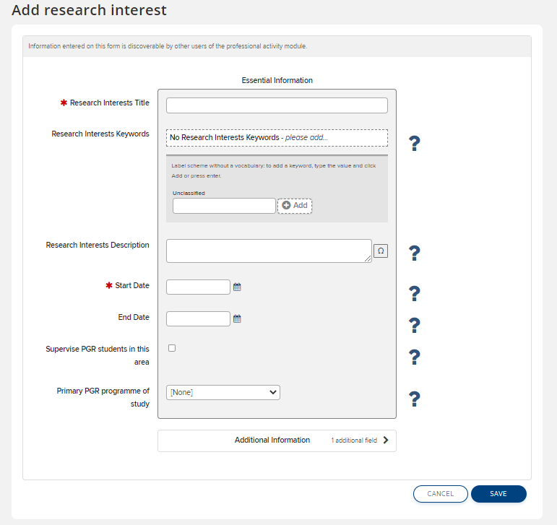
Manage Professional Activities – Research Interests
When adding Research Interest you can manage how you appear in the Research Finder for Potential PGR Students. Check the box to indicate you are open to supervise Postgraduate Students for this research interest and all keywords associated with the research interest.
Matching your research interest to a programme of study will help prospective PGR students when they are searching for this research interest
If there is more than one programme that matches add them in the Additional Information section.

Slide 18
Teaching Activities
Teaching Activities are part of your profile. You can manually add Academic Support Hours. Modules Taught and Post Graduate Supervisions are added automatically.
All of this data is used on your public facing web profile:
Academic Support Hours (Manually added – Just one entry required)
Modules Taught (Automatically Added, the current academic year displayed on the web)
Post Graduate Supervision (Automatically Added, Current and past Supervisions shown on the web)
What to do if Teaching Activity Data is wrong?
Academic Support Hours are easily corrected in the system.
Modules Taught are fed from the timetabling system – speak to your department Undergraduate Administrator to check what is recorded.
Post Graduate Supervision is fed from the student records system. Speak to your department Post Graduate Administrator to check what is recorded.

Slide 19
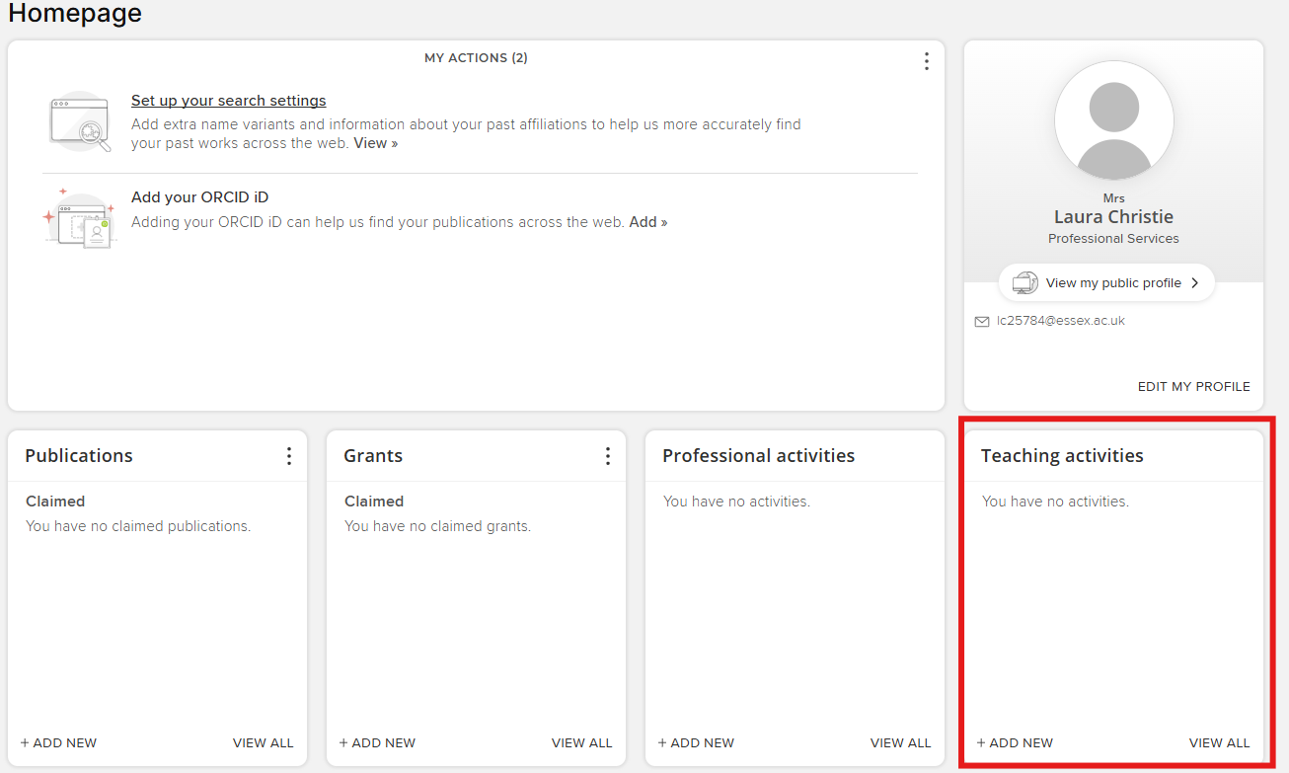
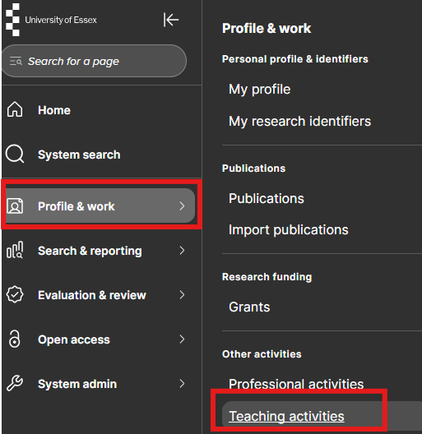
Your Teaching Activities
To begin viewing or editing your Teaching Activities click View All from the Homepage tile or Navigate: Menu > Profile & Work > Other activities > Teaching Activities

Slide 20
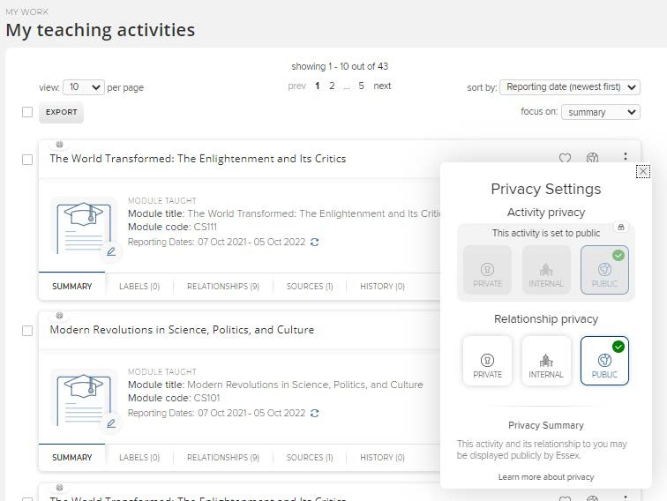
Manage Teaching Activities
By default all Teaching Activities are visible internally and externally. You can manage your relationship privacy to an item by clicking the privacy settings icon form the My Teaching Activities page.

Slide 21
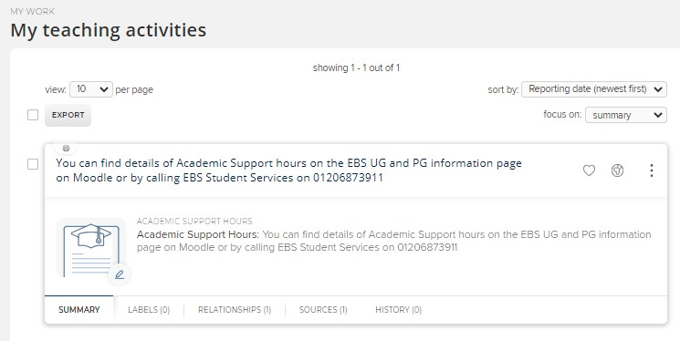
Manage Teaching Activities
Note that for the Academic Support Hours type you only need one entry and you can simply edit the old record.
Don’t create multiple versions of this type, just edit the existing one if the details need updating.

Slide 22
Grants
Grants are part of your profile that are added automatically from the Award Management system (Unit 4 RCP).
This data is used on your public facing web profile:
Grants (only the Year, Project Title and Funder name are displayed externally)
What to do if Grants Data is wrong?
Only Grants awarded at or transferred to Essex are displayed
If a grant is missing it may be because it has not completed financial setup with he REO Post Award or Enterprise Teams. This must happened before it appears in the RIS.
If you’ve received an Award Announcement and Cost Code and the grant is still not appearing in RIS then please email REO Research Systems reors@essex.ac.uk

Slide 23
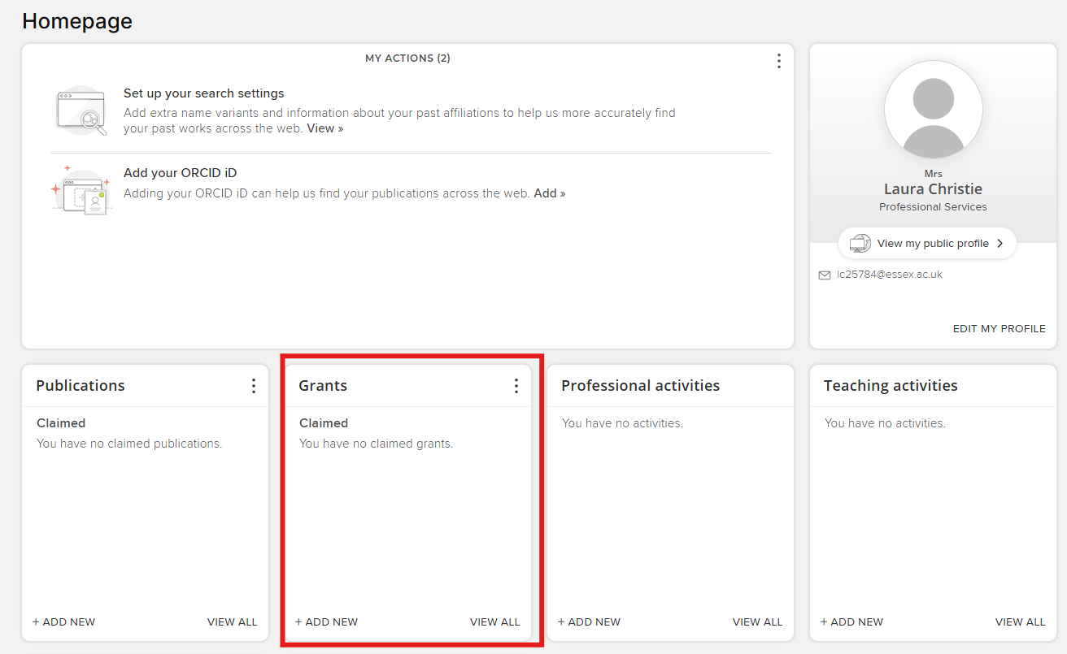
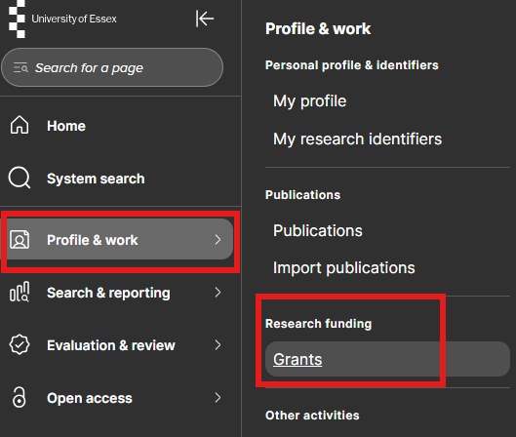
Grants
To begin viewing or editing your Grants click View All from the Homepage tile or Navigate: Menu > Profile & Work > Research funding > Grants

Slide 24
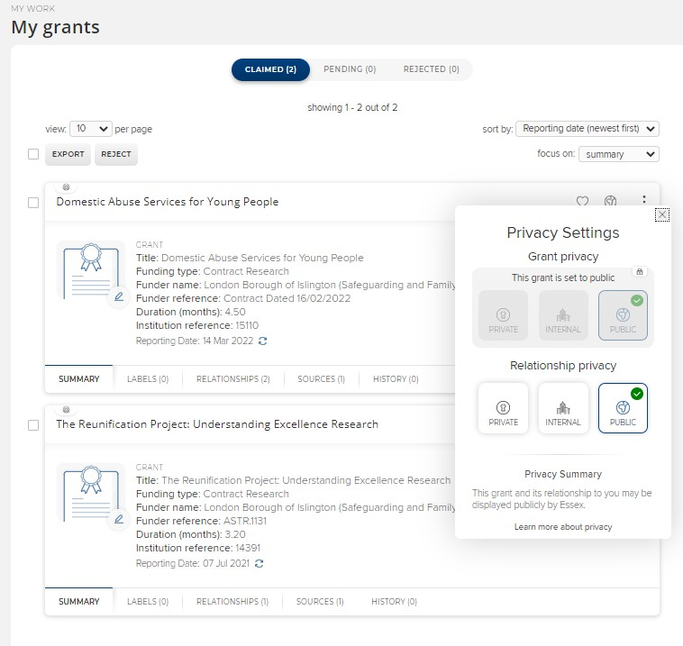
Manage Grants
By default all Grants are visible internally and externally. You can manage your relationship privacy to an item by clicking the privacy settings icon from the My Grants page.

Slide 25
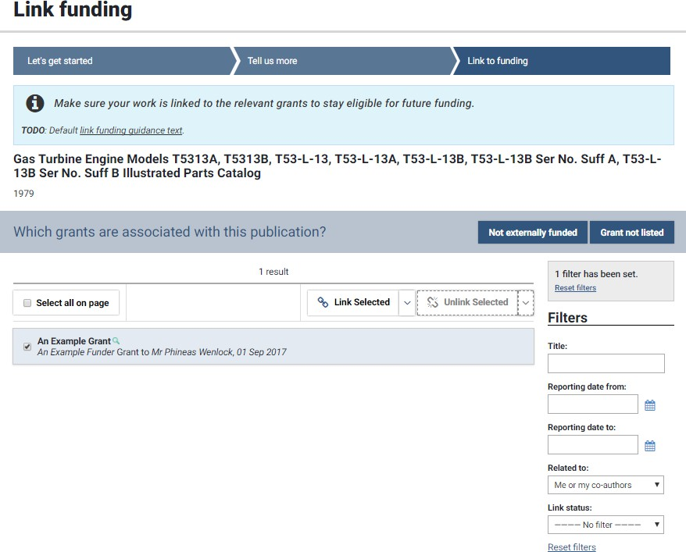
Linking Grants
Linking is a key feature of the RIS which we encourage you to use with grants.
When you add a new record of another type in the RIS you can now link it to the funding that supported it. You can even link one grant to another grant.
Linking grants is part of the process of adding new Publications and Impact records, so look out for this when you are using other parts of the RIS.

Slide 26
Need help?
Contact REO Research Systems
reors@essex.ac.uk www.essex.ac.uk/staff/research-systems

