Slide 1


RIS
Repository Deposit Guide
September 2026

Slide 2
ABOUT THE RIS
The Research Information System delivers important benefits which include:
The automatic searching of publications from a range of external sources and a simple process to deposit them into the Research Repository.
A single place where researchers can manage grants, professional activities, teaching responsibilities and supervision, publications and impact.
A way to manage and edit external web profiles.
A platform in which REF submission and internal research monitoring can be managed with minimal re-keying of data or completing of forms.

Slide 3
ABOUT THIS GUIDE
This guide describes the process of depositing your work in the Essex Research Repository from the RIS.
By the end of the guide you should be able to:
Login to the System
Deposit your existing work
Create new publication records and deposit them

Slide 4
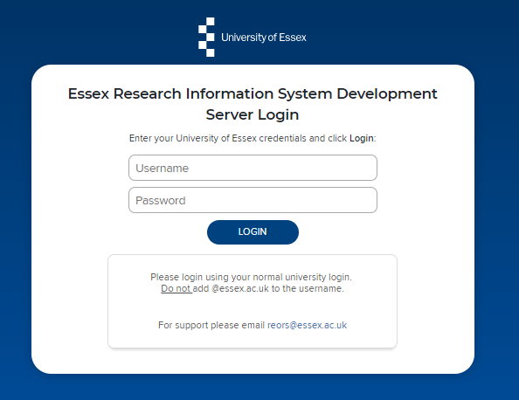
Log In
Login at: ris.essex.ac.uk
Your normal university login is all you need.
You don’t need the VPN to access the RIS. It works from anywhere with an internet connection and in most browsers (Microsoft Edge, Chrome, Firefox, Safari).

Slide 5
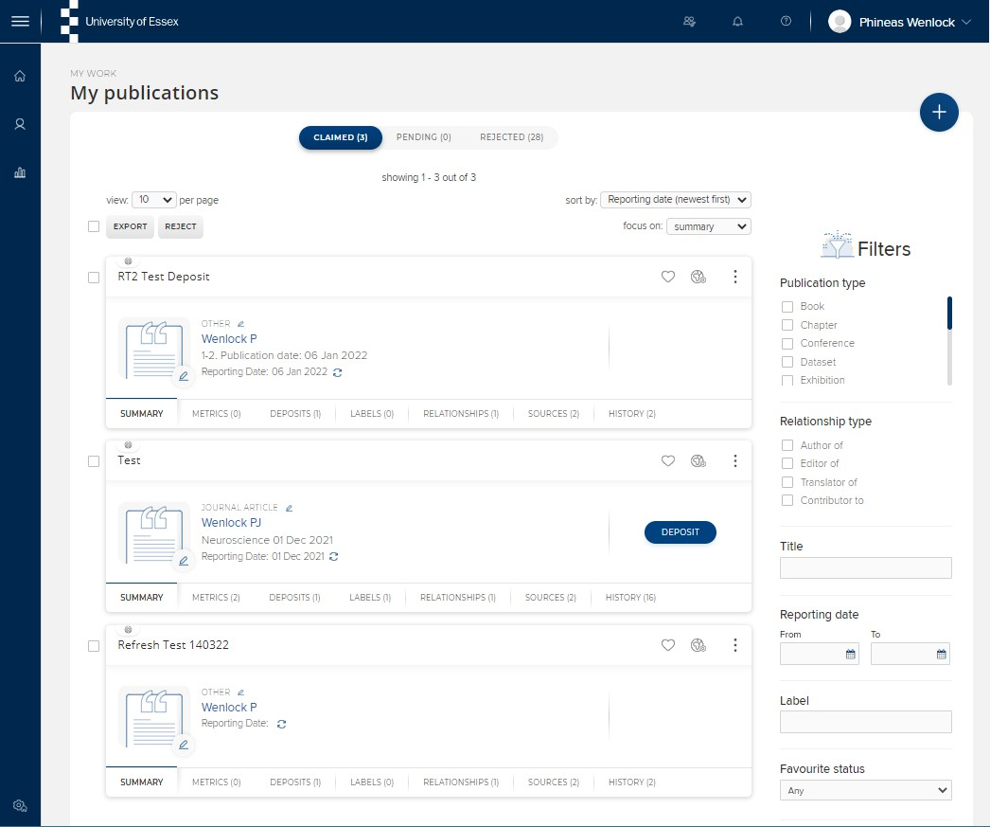
Deposit existing items
Navigate: Menu > Profile & Work > Publications > Publications
Publications you have previously claimed or added can be deposited simply by clicking the deposit button

Slide 6
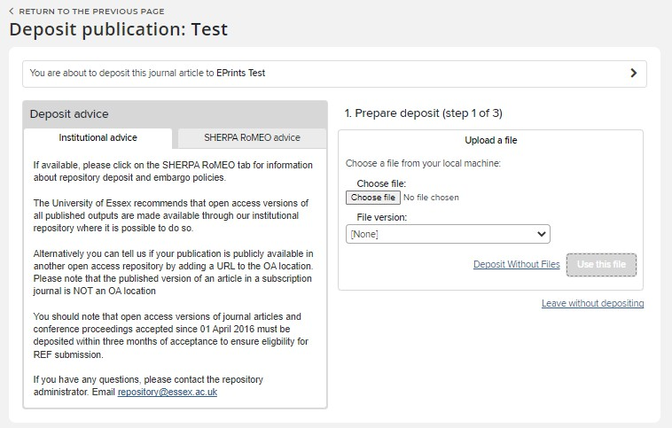
Deposit existing items
The RIS will tell you if the publication has been previously deposited.
If it hasn't, you’ll be offered the deposit screen with deposit advice based on the Essex deposit policy.

Slide 7
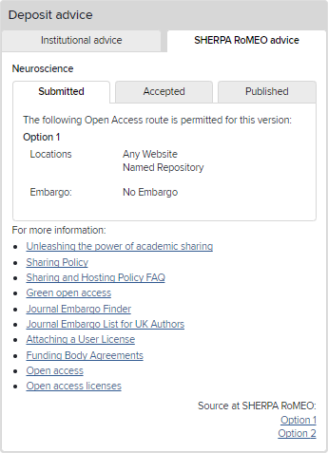
Deposit existing items
There is also advice from the SHERPA / RoMEO service
This gives you specific and detailed advice on what version the publisher will allow you to deposit.

Slide 8
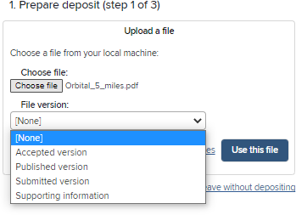
Deposit existing items
To add the full text version, choose the file and say which version it is (Accepted, Published etc.) Click Use this file
You can also deposit without a file.

Slide 9
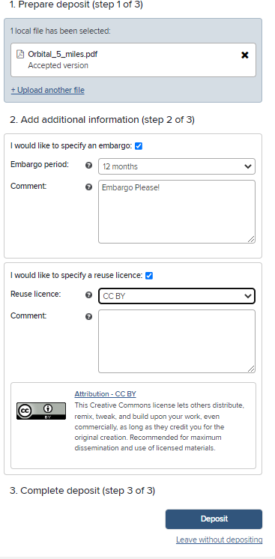
Deposit existing items
Once the file has uploaded you can add further information
Add an Embargo Period and notes for the Repository Manager
Specify a licence for reuse. The RIS will provide guidance on common re-use licences. You can also add notes for the Repository Manager.
Finally click Deposit

Slide 10
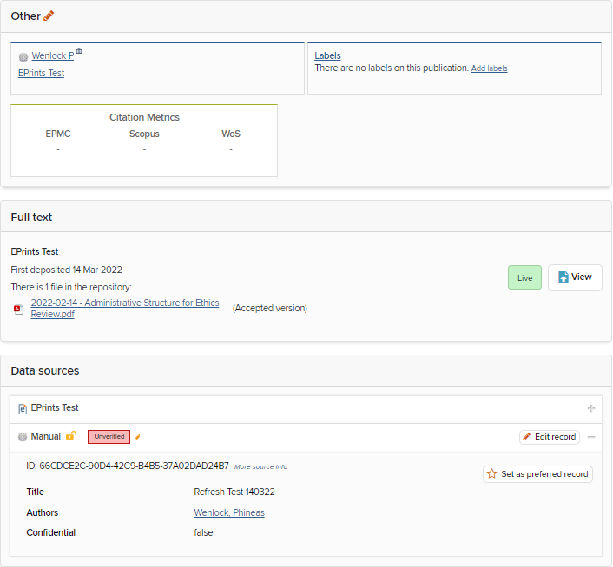
Deposit existing items
Once deposited, the item will initially show as “In review”.
Once it has been reviewed by the Repository Manager and accepted it will show as “Live” and be publicly accessible from https://repository.essex.ac.uk/

Slide 11
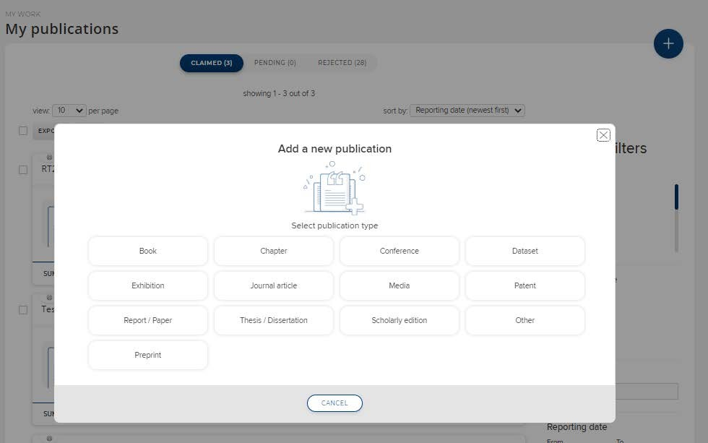
Create new items
If the publication is new and has not been indexed from an external data source you’ll need to add it to the RIS first.
Click Add a New Publication (+ top right) and choose a publication type

Slide 12
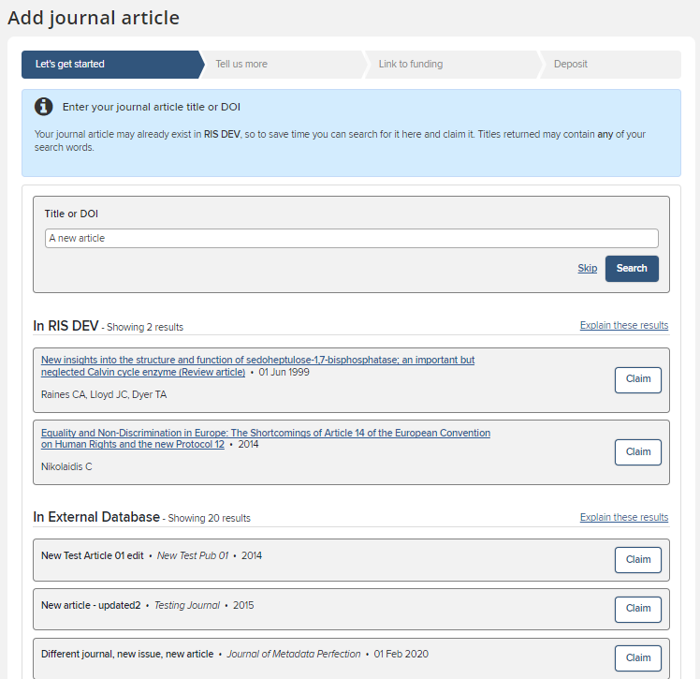
Create new items
You’ll be asked first for the publication title, DOI or ISBN.
The RIS will check it’s not a duplicate and that it is not already deposited. You can claim it if an existing record matches (it may have been added by a co-author or already exist in an external database), otherwise skip.

Slide 13
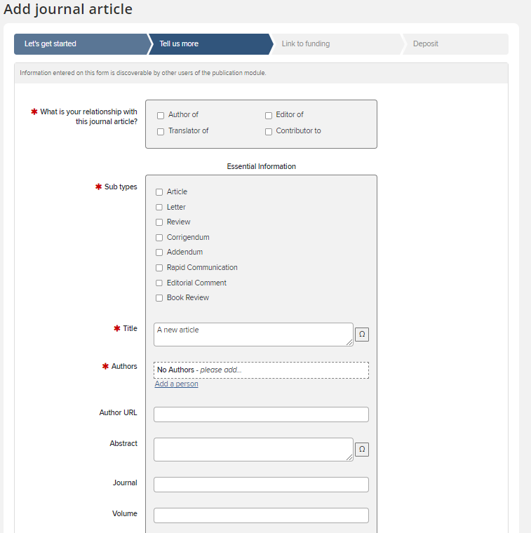
Create new items
You can then give more detail about the publication
There are different forms depending on the publication type you are adding (Article, conference paper etc.)
As a minimum complete the red starred mandatory fields but please add as much detail as possible to create a complete reference.
When complete click Save at the bottom of the page.

Slide 14
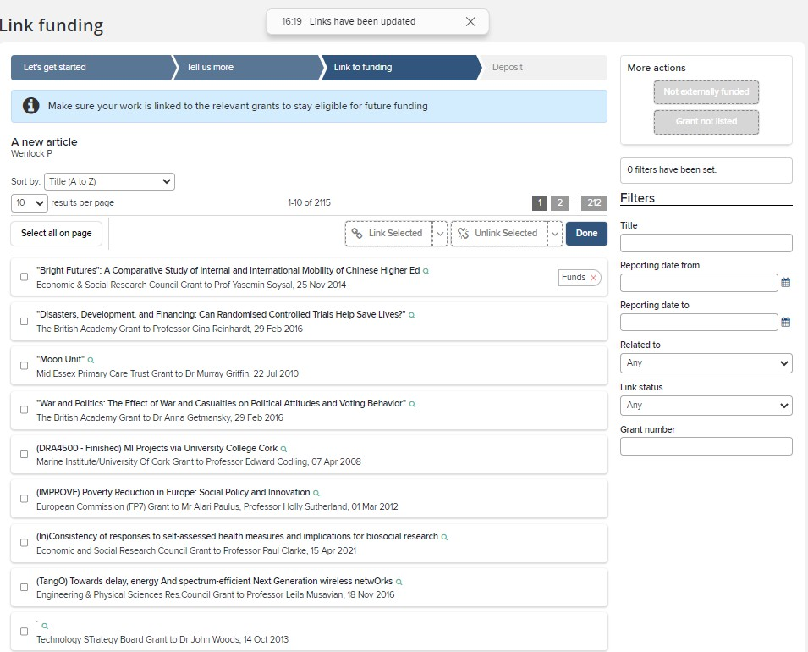
Create new items
The option to link to funding is available.
Award data is automatically loaded in to the RIS, so your supporting grant should be available.
Tick the correct grant(s) and clcik Link Selected then click Done. You may also choose Not Externally Funded or Grant not listed if this applies.

Slide 15
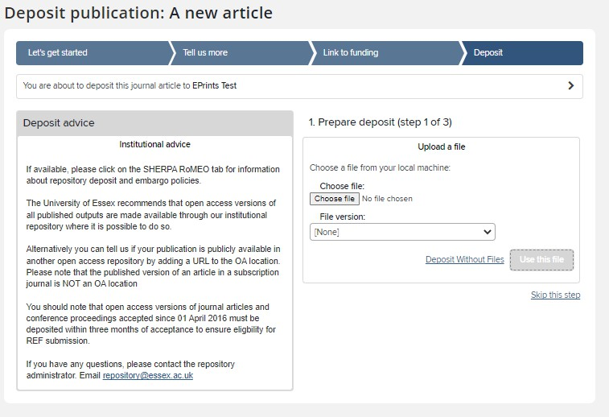
Deposit new item
Finally you’ll be asked to deposit your new record
The process is the same as for existing items as detailed at the start of this guide.

Slide 16
Need help?
Contact REO Research Systems
reors@essex.ac.uk www.essex.ac.uk/staff/research-systems

