Slide 1
RIS
Recording Professional Activities
September 2026

Slide 2
About this guide
This guide describes the process of adding professional activities to your profile.
By the end of the guide you should be able to:
Login to the System
Add your Professional Activities
Review your Professional Activities on Tableau.

Slide 3
About the RIS
The Research Information System delivers important benefits which include:
A single place where researchers can manage grants, professional activities, teaching responsibilities and supervision, publications and impact.
A platform in which our REF submission can be managed with minimal re-keying of data or completing of forms.
A way to manage and edit external web profiles.
The automatic searching of publications from a range of external sources and a simple process to deposit them into the Research Repository.

Slide 4
Why should I add my Professional Activities to RIS?
Ensure that the full breadth of your excellent academic and research contributions is visible and recognised.
Help us create an up-to-date evidence-base to enable the writing of our Institutional-level and Unit-level Strategy, People, and Research Environment statements for REF 2029 (referred to as Environment in REF 2021).
For REF 2029 we are expected to use evidence between 1 August 2020 and 31 July 2028.

Slide 5
When should I add my Professional Activities to RIS?
You can add Professional Activities to RIS at any time (as is the case with research outputs).
It is best to record activities as soon as possible after they occur, while details and contributions are still fresh in your mind. This will ensure the record is captured as accurately and as comprehensively as possible.

Slide 6
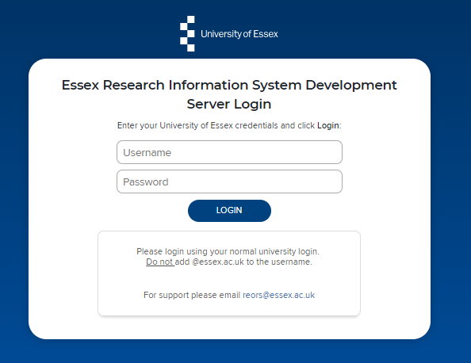
Log In
Login at: https://ris.essex.ac.uk
Your normal university login is all you need.
You do not need the VPN to access the RIS. It works from anywhere with an internet connection and in most browsers (Microsoft Edge, Chrome, Firefox, Safari).

Slide 7
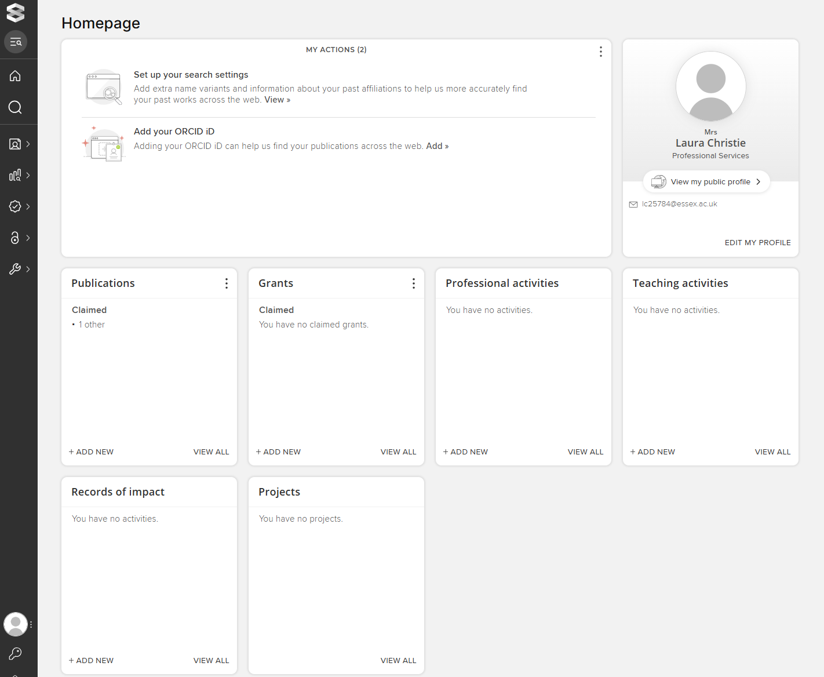
How to begin
On the homepage you will then have the option to ‘Add New’ or ‘View all’ Professional Activities

Slide 8
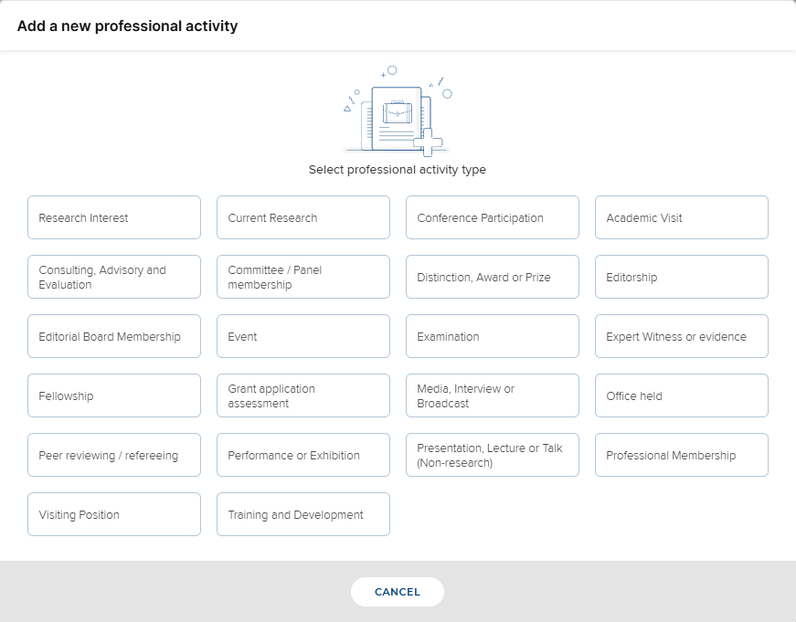
What activities should I include?
The RIS has the following pre-set professional activities.
Please note that not all of these will be relevant for your discipline. Please contact your departmental Director of Research, if you have any questions about which activities are most relevant to your research area.

Slide 9
Who can view my activities?
You can view your professional activities on your RIS profile and via Tableau reporting.
All your professional activities can also be viewed by your department’s Head of School/Department, Director of Research and Unit of Assessment leads (if different).
There are only three externally displayed categories on RIS (denoted in red). All other categories can only be viewed by RIS users with relevant permissions (as above).

Slide 10
All Activity Types
Click on the relevant activity type for more information
Research Interest | Current Research | Conference Participation | Academic Visit
Consulting, Advisory and Evaluation | Committee/Panel Membership | Distinction, Award or Prize | Editorship
Editorial Board Membership | Event | Examination | Expert Witness or Evidence
Fellowship | Grant application assessment | Media, Interview or Broadcast | Office held
Peer Reviewing/ Refereeing | Performance or Exhibition | Presentation, Lecture or Talk (non-research) | Professional Membership
Visiting Position | Training and Development

Slide 11
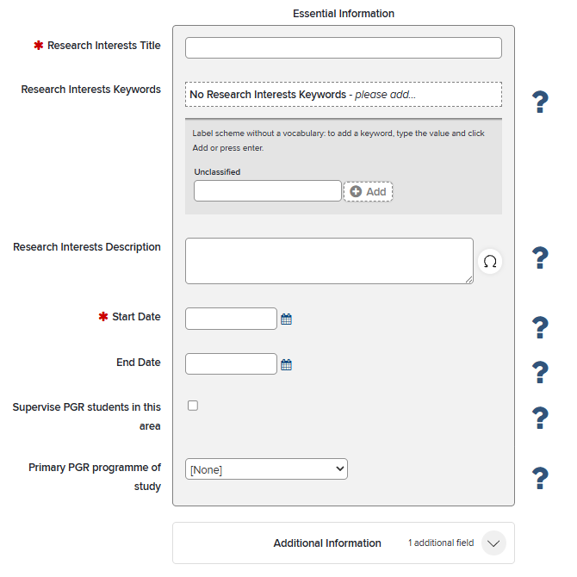
Research Interest
This is an externally visible category.
It appears on you own external web profile as well as department web pages and the ‘PGR Finder’ search for prospective Post Graduate students.

Slide 12
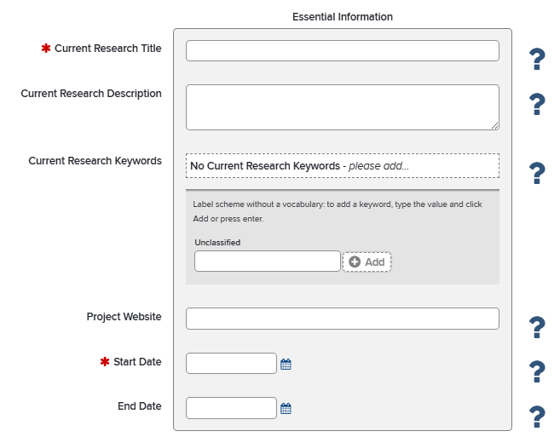
Current Research
This is an externally visible category
You can use it to show current projects with links to external websites on you external web profile.

Slide 13
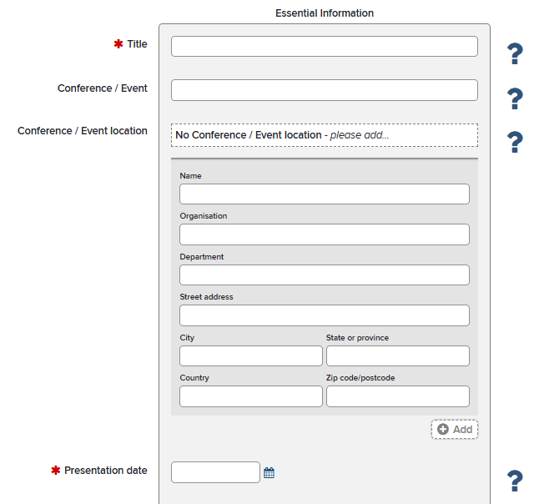
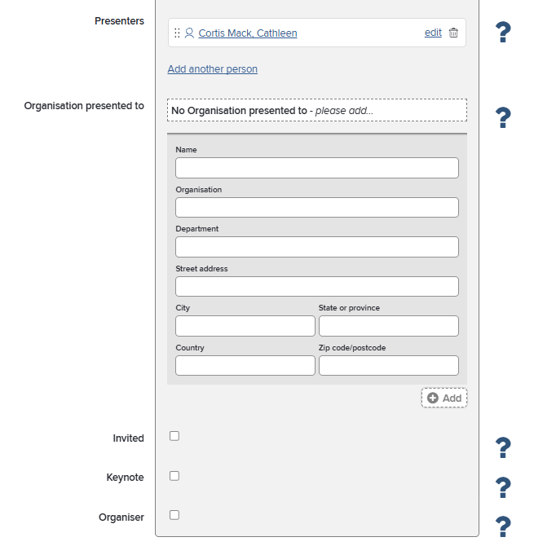
Conference Participation
This is an externally visible category
Use this category for:
  Conference presentation and organisation including invited and keynote talks

Slide 14
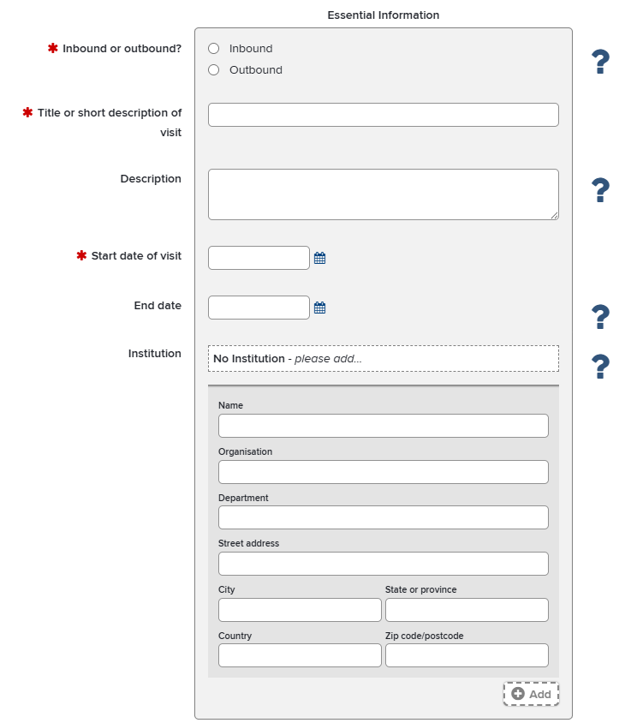
Academic Visit
Use this category for:
  Outbound visit (i.e. Essex academic visiting another organisation for research-related purposes)
  Inbound visit (i.e. non-Essex academic visiting Essex for research-related purposes)
Do not use this category for:
  Appointed visiting positions or those of an extended nature (see Visiting Positions category instead)

Slide 15
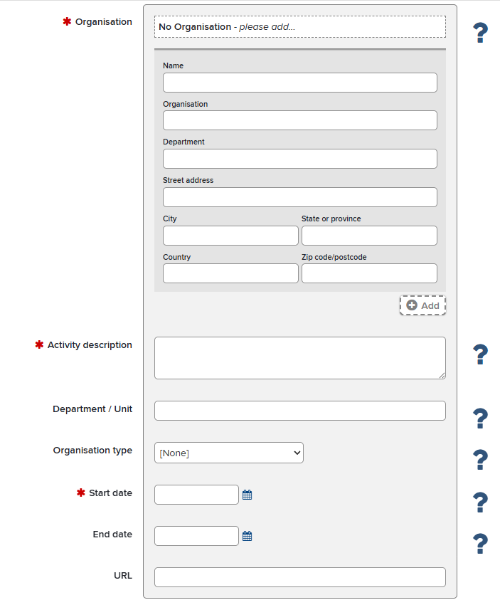
Consulting, Advisory and Evaluation
Use this category for:
  Consultancy services
  Advising and supporting organisations
  Informing policy or practice
  Independent assessment and specialist guidance

Slide 16
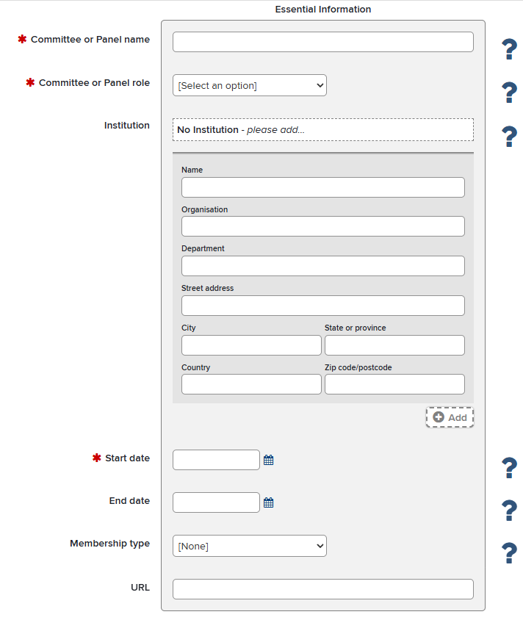
Committee/ Panel Membership
Use this category for:
  Memberships of national or international panels (e.g. REF panels or similar, government or policy advisory panels)
Do not use this category for:
  Membership of an editorial board
  Membership of Panels assessing funding applications
  Other professional memberships

Slide 17
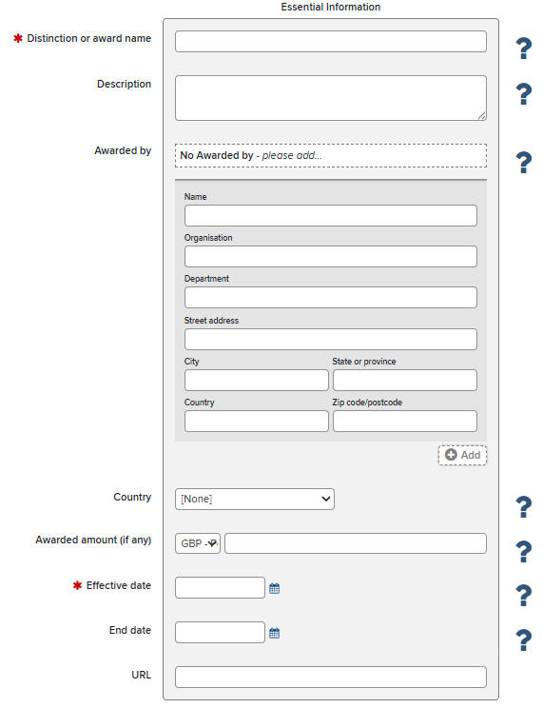
Distinction, Award or Prize
Use this category for:
  Distinction, Award or Prize relating to recognition of research and other research-related activities
Do not use this category for:
  Grant/funding award

Slide 18
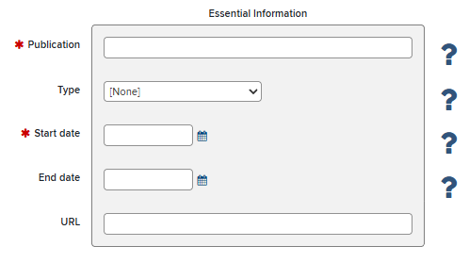
Editorship
Use this category for:
  Formal editorial leadership role for a journal, book series or a publication
Do not use this category for:
  Membership of an editorial board

Slide 19
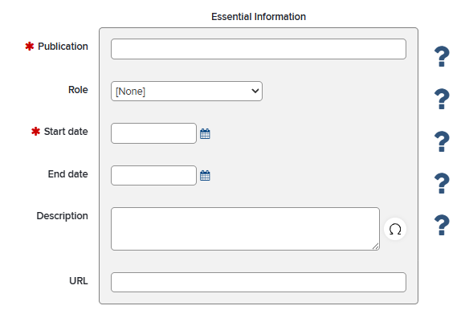
Editorial Board Membership
Use this category for:
  Membership of an editorial board for a journal, book series and other scholarly publications.
Do not use this category for:
  Formal editorial leadership role for a journal, book series or a publication
  Peer review or refereeing

Slide 20
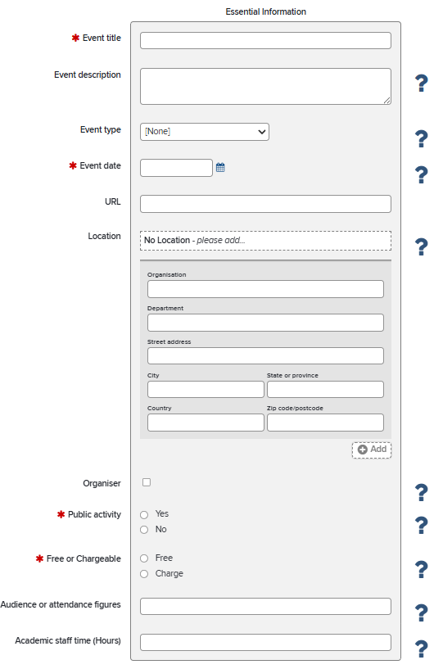
Event*
Use this category for:
  Networking events, product launch, symposiums, workshops, seminars, or similar.
Do not use this category for:
  Conferences
  Performance and Exhibitions
  Please indicate whether:
    You were the event organiser
    The event was public or not
    The event was free of charge or chargeable
*This data will also be used for HEBCI reporting

Slide 21
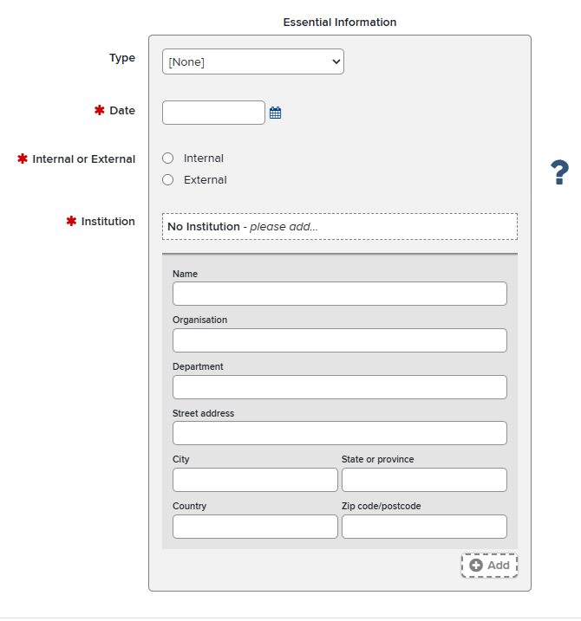
Examination
Use this category for:
  Doctoral Thesis
  Research Dissertation
  Course Syllabus or Curriculum
  Coursework or Exam Scripts
Record these for internal and external examination
  (provide institution details if external)

Slide 22
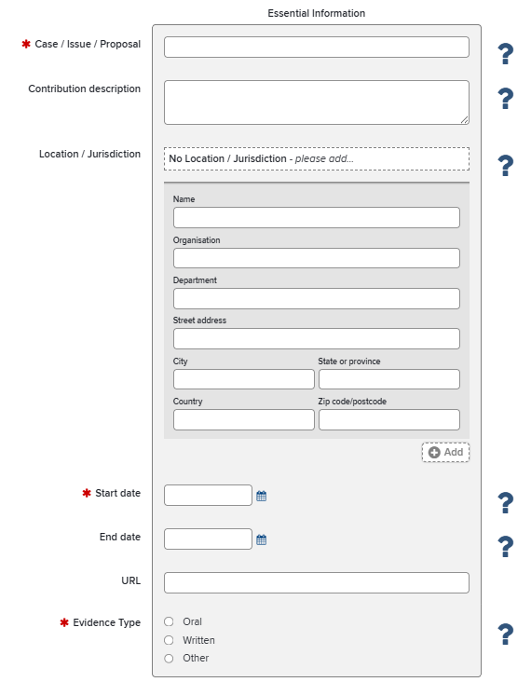
Expert Witness/ Evidence
Use this category for:
  Recording participation as an expert witness
  Giving evidence in parliamentary working groups, or committees or similar
  Please indicate the format of the given evidence

Slide 23
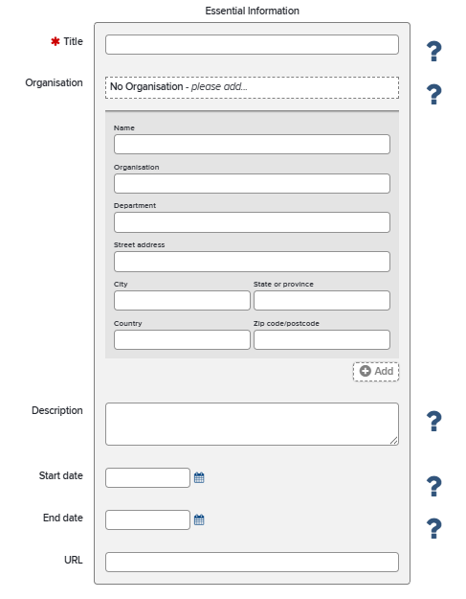
Fellowship
Use this category for:
  National and International fellowships (e.g., UKRI, Leverhulme Trust, British Academy, Royal Society, NIHR, Wellcome Trust, European Research Council)

Slide 24
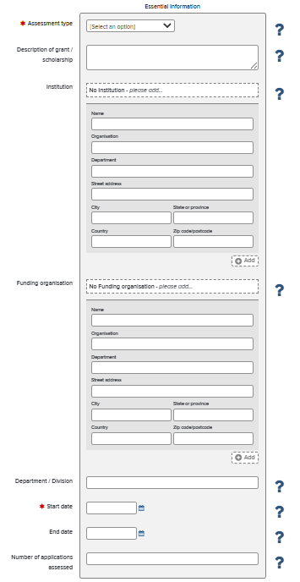
Grant Application Assessment
Use this category for:
  Peer-review or assessment of research funding and grant applications

Slide 25
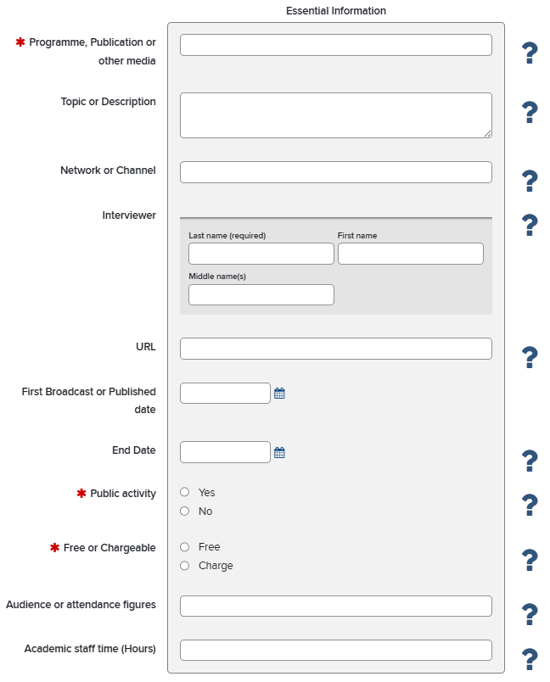
Media, Interview or Broadcast*
Use this category for:
  Media, interview or broadcast via television, radio, podcasts, newspapers, online media, public communication platforms etc.
  Please indicate whether:
    The event was public or not
    The event was free of charge or chargeable
*This data will also be used for HEBCI reporting

Slide 26
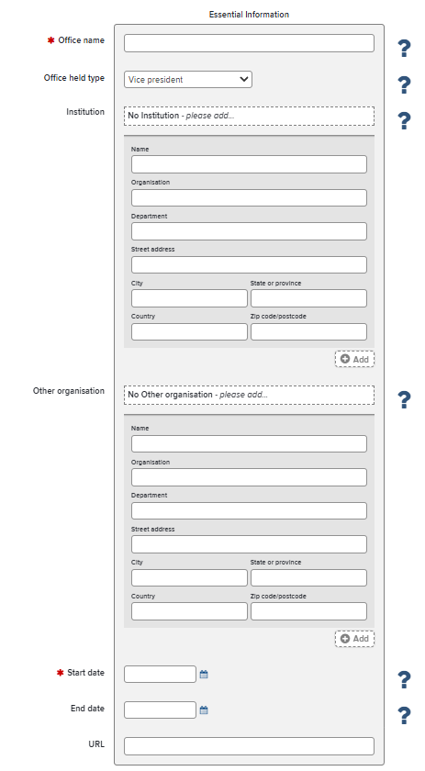
Office held
Use this category for:
  Formal leadership or representative roles within professional bodies, learned societies, or other research-related organisations.

Slide 27
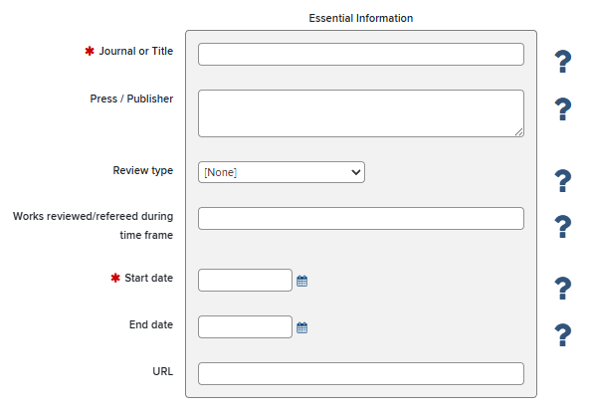
Peer Review/ Refereeing
Use this category for:
  Peer Review and Refereeing of research outputs (e.g., journal article, book)
Do not use this category for:
  Peer-review of research funding/grant applications

Slide 28
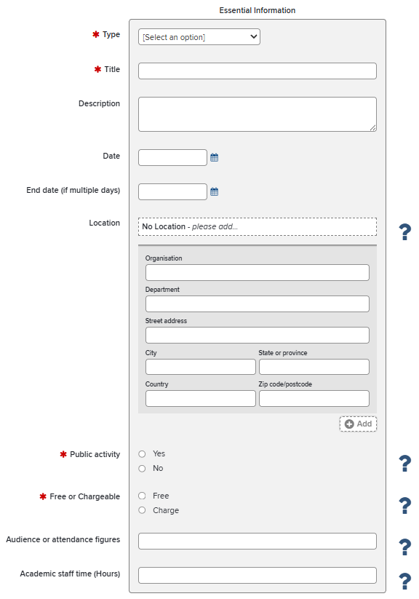
Performance or Exhibition*
Use this category for:
  Public or external performances of music, dance and drama
  Permanent and temporary exhibitions (e.g., at museums, galleries)
  Please indicate whether:
    The event was public or not
    The event was free of charge or chargeable
*This data will also be used for HEBCI reporting

Slide 29
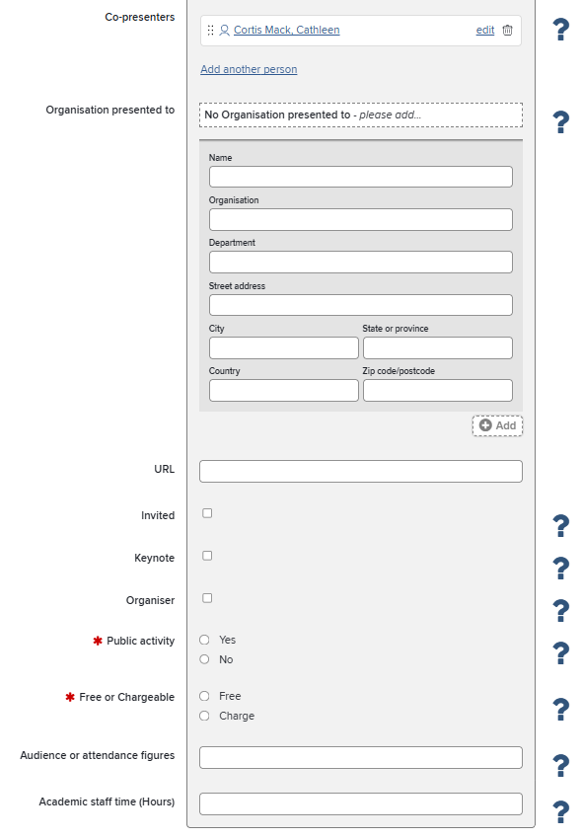
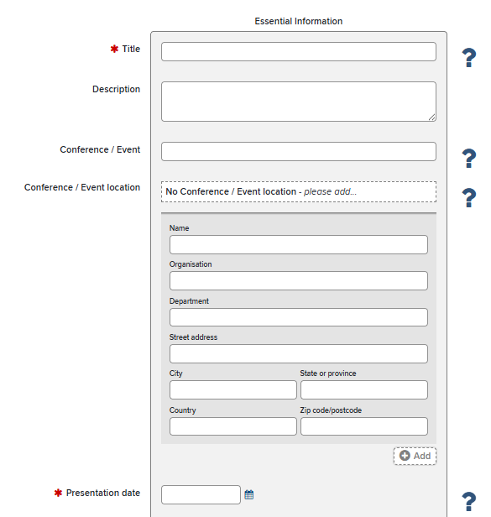
Presentation, lecture or talk (non-research)
Use this category for:
  Non-research presentations, lectures or talks
  that are intended for non-academic/research audiences or the general public
Do not use this category for:
  Conference talks and presentations that are aimed at academic audiences

Slide 30
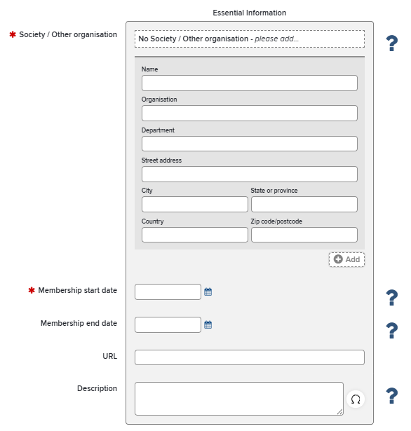
Professional Membership
Use this category for:
  Membership of learned societies (e.g., British Academy)
  Chartered or accredited professional memberships (e.g. BPS)

Slide 31
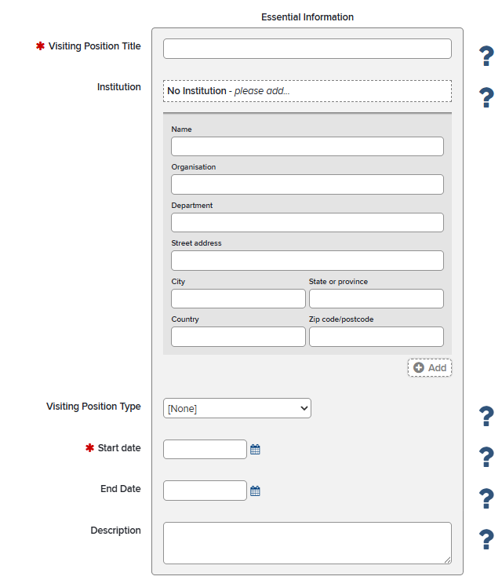
Visiting Position
Use this category for:
  Appointed visiting positions at external institutions
Do not use this category for:
  Short academic visits to other institutions

Slide 32
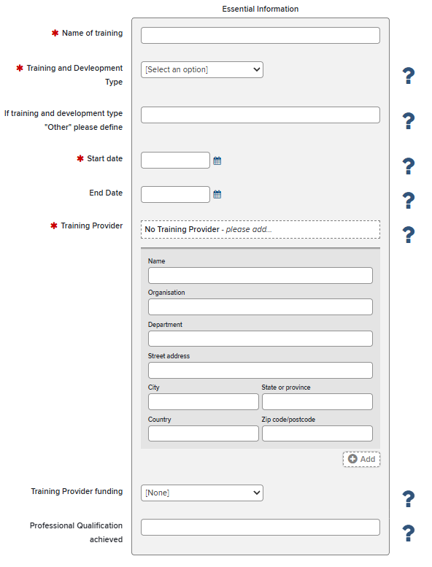
Training and Development
Use this category for:
  Internal training that goes beyond the Essential training (e.g. Open Research training).
  External training and Continuing Professional Development (CPD) opportunities.

Slide 33
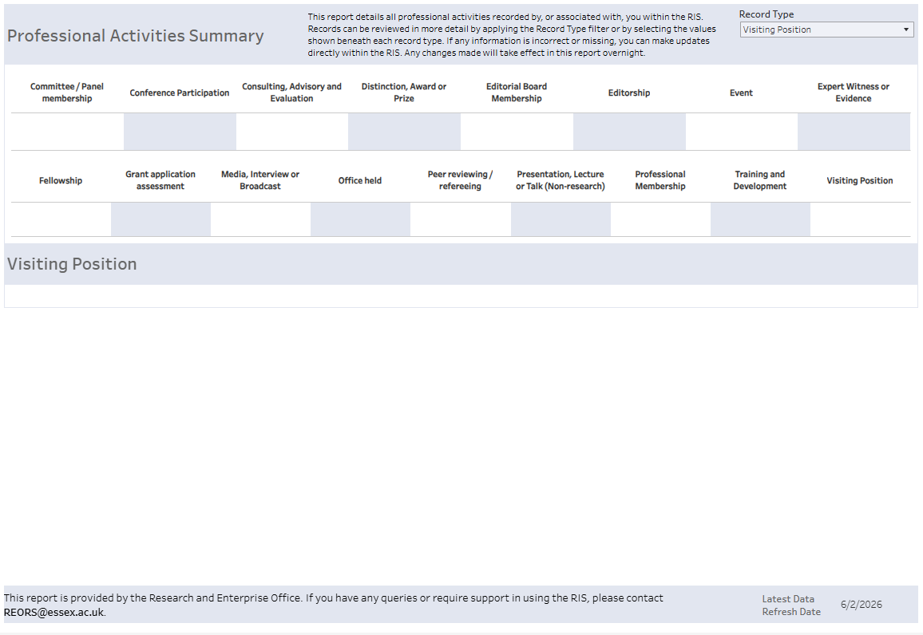
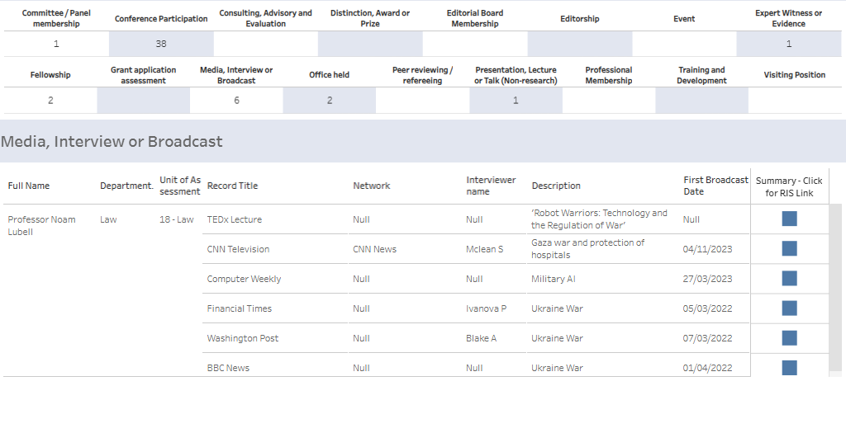
Using Tableau for reporting
All staff can view a summary of their own Professional Activities via Tableau.
All records are linked directly to RIS and can be clicked upon for more details or editing

Slide 34
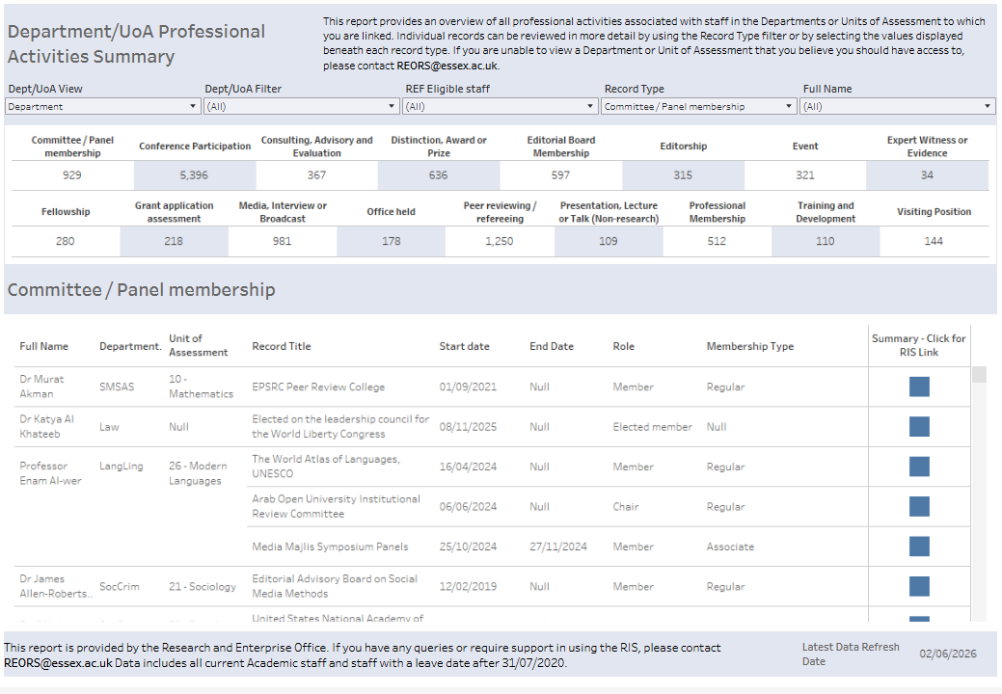
Using Tableau for reporting
Heads of Departments, departmental Directors of Research and Unit of Assessment leads can view a summary for their Department/Unit.

Slide 35
Need help?
Contact REO Research Systems
reors@essex.ac.uk
www.essex.ac.uk/staff/research-systems

