Slide 1
RIS
RIS Delegation and Impersonation Guide
September 2026

Slide 2
About the RIS
The Research Information System delivers important benefits which include:
The automatic searching of publications from a range of external sources and a simple process to deposit them into the Research Repository.
A single place where researchers can manage grants, professional activities, teaching responsibilities and supervision, publications and impact.
A way to manage and edit external web profiles.
A platform in which REF submission and internal research monitoring can be managed with minimal re-keying of data or completing of forms.

Slide 3
About this guide
This guide describes setting delegates in the Research Information System (RIS) and using impersonation.
Setting a delegate allows anther RIS user to ‘Impersonate’ you in the system and allows them to manage your records. This includes your biographical details, your publications, impact, teaching and grants.
Note: Delegation does not grant higher permissions in the system that you may have because of your role (a Head of Department or Research Director for example). These permissions cannot be delegated.
By the end of the guide you should be able to:
Login to the System
Manage delegates
Impersonate another user

Slide 4
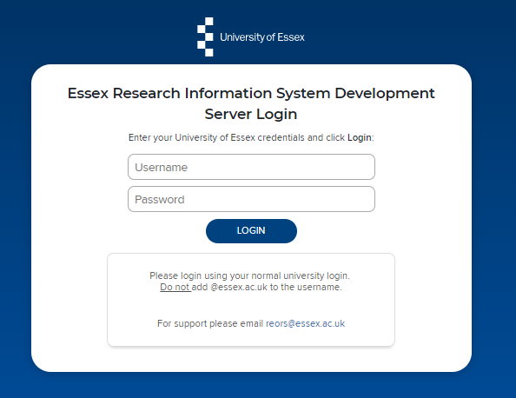
Log In
Login at: https://ris.essex.ac.uk
Your normal university login is all you need.
You don’t need the VPN to access the RIS. It works from anywhere with an internet connection and in most browsers (Microsoft Edge, Chrome, Firefox, Safari).

Slide 5
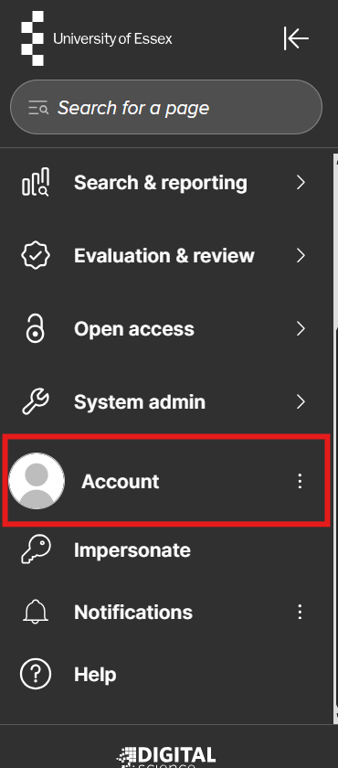
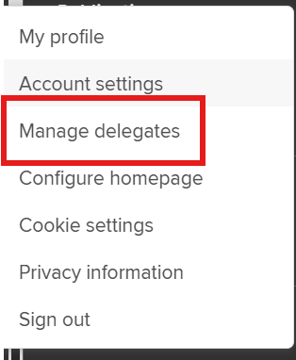
Manage Delegates
Navigate: Menu > Account > Manage Delegates

Slide 6
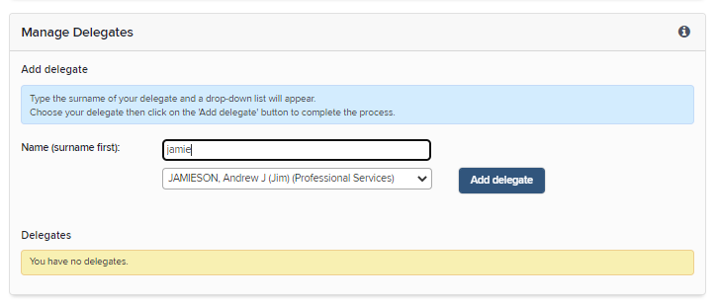
Add Delegates
Begin typing the surname in the box and then select the correct person.
Click Add delegate
The user can now act on your behalf in the RIS via ‘Impersonation’

Slide 7
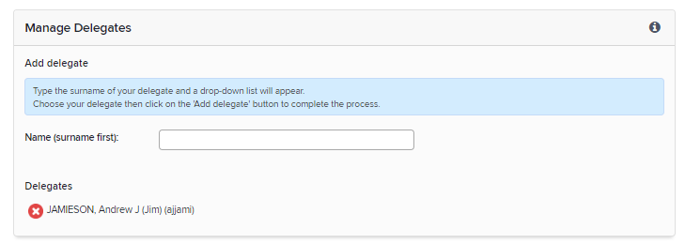
Remove Delegates
To remove delegate permission click on the red x next to the persons name.

Slide 8
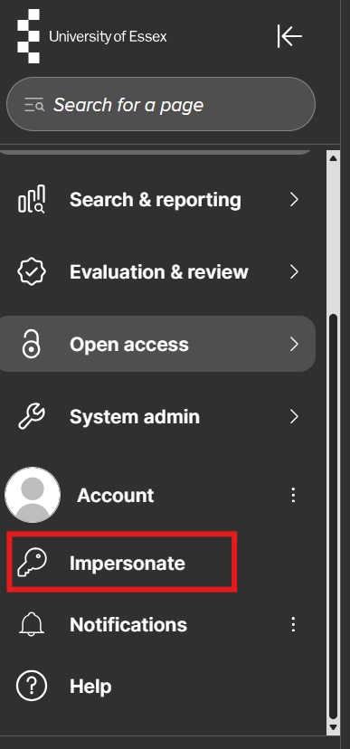
Impersonation
To Impersonate click the Impersonate icon on the menu bar under ‘Account’

Slide 9
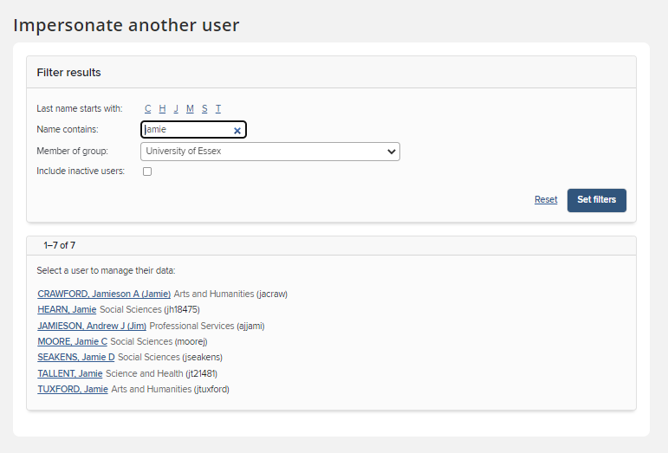
Impersonation
Type the name of the person in the Name contains box
Click Set filters
Select the user from the list
You will only be able to choose people you have delegated permissions for.

Slide 10
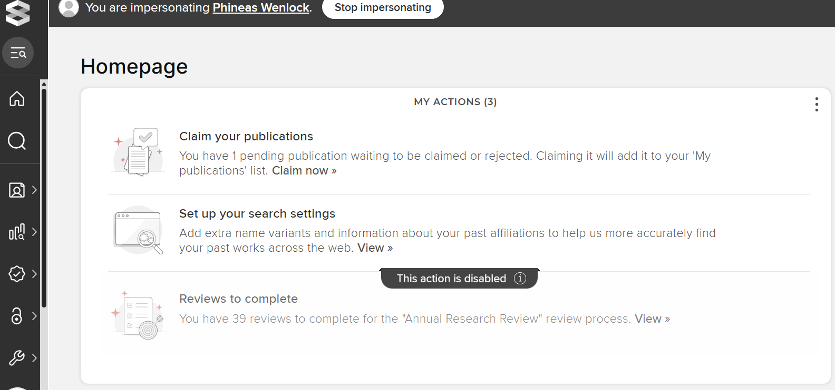
Impersonation
The person you are impersonating is indicated on the top bar
You can now manage their records. This includes biographical details, publications, impact, teaching and grants.
To stop impersonation, click the stop impersonating button next to their name or follow the impersonate instructions to impersonate another user.

Slide 11
Need help?
Contact REO Research Systems
reors@essex.ac.uk
www.essex.ac.uk/staff/research-systems

