Slide 1


Using RIS to track your engagement and impact
2025 - Research Impact Team

Slide 2


Making a difference to
society
Impact is an effect on, change or benefit to the economy, society, culture, public policy or services, health, the environment or quality of life, beyond academia.

Slide 3
About the RIS Impact Module
The Impact Module of the Research Information System (RIS-IM) is a secure confidential repository to store and track information about your engagement, knowledge exchange activities and the impact of your research outside of the academy.
The RIS-IM enables you to capture the entire research life cycle and over time, a portfolio of information is built, which can be used to create narratives or case studies of the measurable impact…
By linking the impact to related publications, grants or conference proceedings you can build links between research inputs (funding), outputs and outcomes (publications, conference proceedings), impact activities (engagement and knowledge exchange activities) and resulting impact.

Slide 4
Glossary and Resources
Impact The demonstrable contribution that excellent research makes to society and the economy, of benefit to individuals, organisations and nations (UKRI)
Engagement A two-way exchange of ideas between a researcher and a stakeholder for mutual benefit
Knowledge Exchange (KE) Activities facilitating a two-way exchange between researchers and stakeholders or research users to share ideas, research and expertise. At Essex, Knowledge Exchange will nearly always have an income generating element to it.
Routes/Pathways to Impact The activities through which your research could achieve impact i.e. the knowledge exchange or engagement activities
Impact Evidence Sources external to the University that provide corroboration of your impact claim
Further Resources
Research Impact Toolkit

Slide 5
About this guide
By the end of the guide you should be able to:
Login to the System
Create records to capture impact plans, engagement activities and impact
Upload evidence of impact and supporting documentation
Link records to publications and other records within RIS

Slide 6
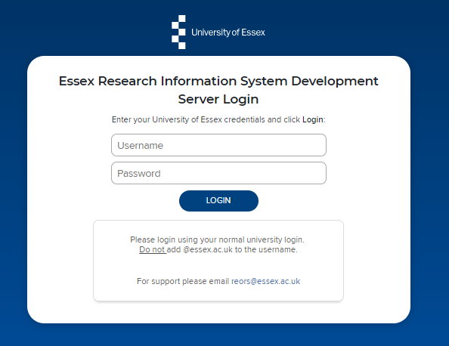
Logging In
Login at: https://ris.essex.ac.uk
You don’t need the VPN to access the RIS. It works from anywhere with an internet connection and in most browsers (Microsoft Edge, Chrome, Firefox, Safari)

Slide 7
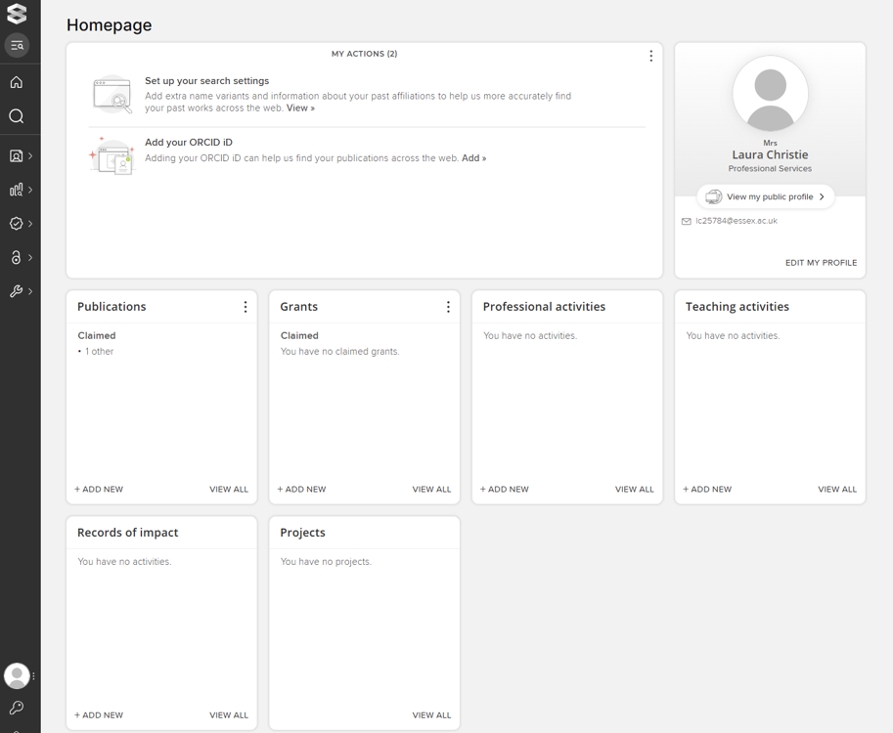
Your Homepage
When you first log in the Home Page will be displayed, looking something like this

Slide 8
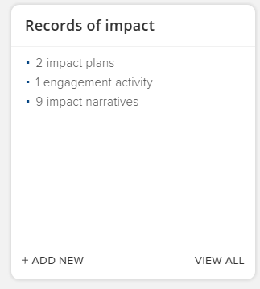
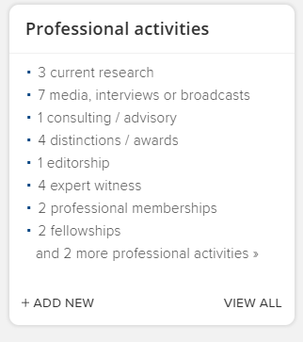
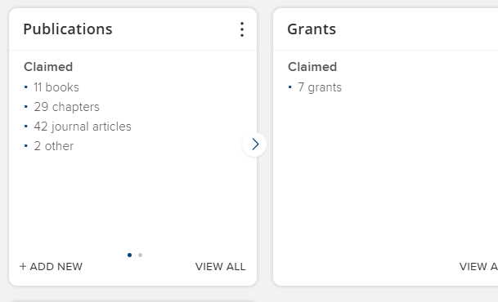
Where to save your engagement and impact and what to link to
Records of Impact
Professional activities
LINK your dissemination, engagement and impact to:
Consulting / advisory
Committee / panel membership
Expert witness
Office Held
Media, interview or broadcast
Impact plans
Engagement Activities
Impact narratives
Publications
Grants

Slide 9
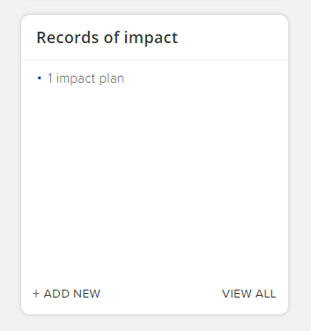
Viewing Impact Records
You can view your existing impact records on your Homepage by clicking ‘View all’ in the ‘Records of Impact’ box

Slide 10
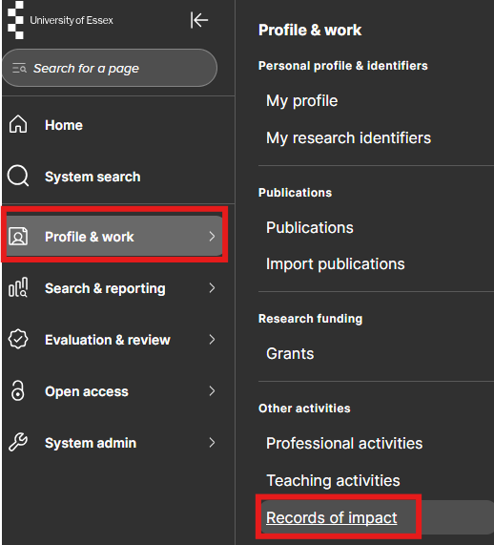
Viewing Impact Records
Alternatively, from your Homepage go to your Profile & work drop down and choose ‘Records of Impact’, under Other activities.

Slide 11
Types of Impact Record
Use these records as a diary briefly documenting your planning, activities and evidence:
Impact plan - Capture information about the intended impact of a piece of research and the activities planned to reach those goals.
Engagement activity - Record your engagement and knowledge exchange activities as they occur.
Impact narrative - Record a narrative of events describing the impact of a piece of research. Impact narratives may link to an impact plan and can link together multiple engagement activities.

Slide 12
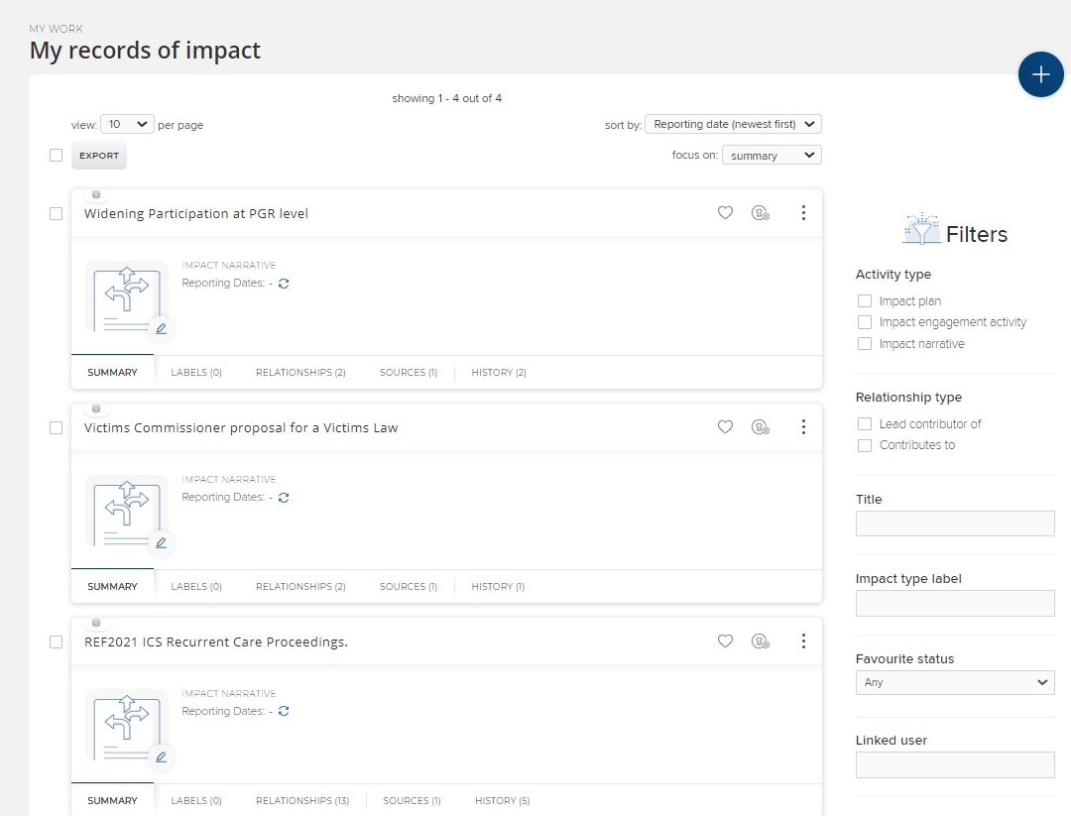
Add new record - 1
There are two ways that you can add an impact record to your profile:
1. In ‘my records of impact’ click on the + to ‘add a new activity’.

Slide 13
Add new record - 2
Alternatively, on your Homepage go to ‘Records of impact’ box and ‘Add new’ to start the impact workflow
Slide 2

Slide 14
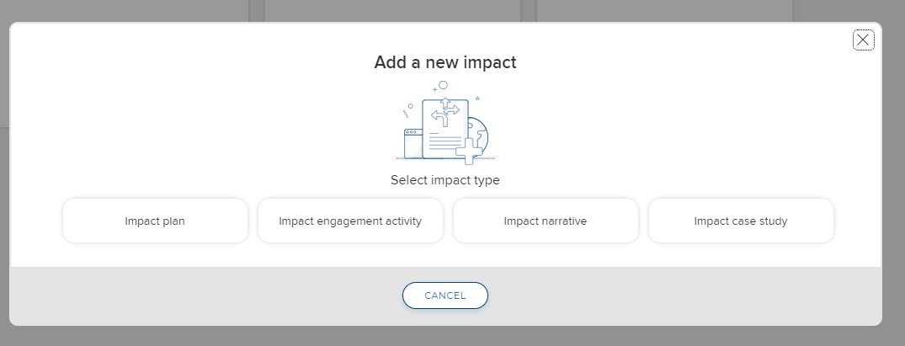
Choose impact record type
Whichever route you take to add a new record you will be taken to a window where you will need to choose the type of impact record that you’d like to add.
An outline of what you plan to do – can be useful for funding bids or a general reflection
A record of two-way engagement – e.g. workshops, responding to policy opportunities etc.
Recording any changes as they start to occur – i.e. change to policy or practice.
Slide 13

Slide 15
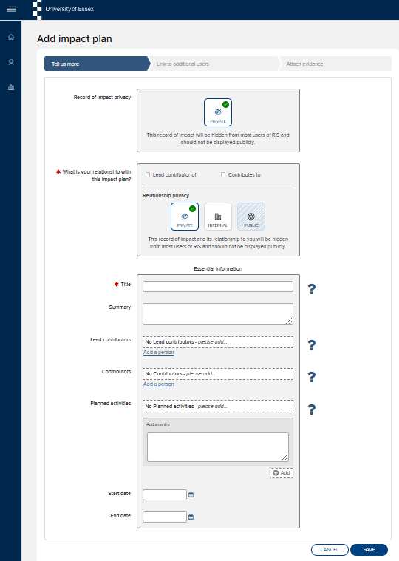
Add impact plan – create record
Sections marked * must be completed otherwise the record will not save:
*Lead contributor: tick to say if you are the lead contributor or contributing to the impact plan.
*Title: Add a title that will allow you to find this impact plan from within a longer list.
Lead Contributors/Contributors: Add the names of any other people contributing to this impact plan. Click ‘Add a person’ after each contributor.
Planned activities: Add an overview of steps in your impact plan. You can add further entries at any point.
▪ + Add to save.
‘Save’ to move to next step.
Access tools and resources to help you develop an impact plan in
the Research Impact Toolkit
Help for each section can be found by clicking on ?
Slide 15

Slide 16
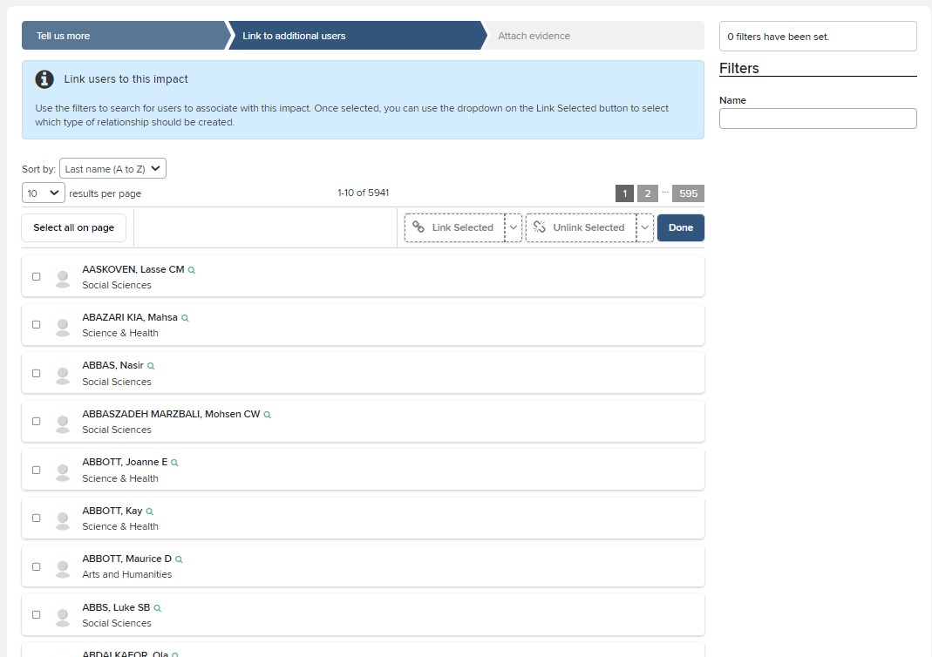
Add impact plan – link other users
NEXT: link other users that are associated with this impact plan. You can
use the ‘Filter’ at the side and enter the last name of the person.
When you have found the user you want to link, click the box next to their name and ‘Link Selected’ and choose the relationship the user has with your impact plan. This will result in the impact record being also shown on the other user’s profile.
Once you have finished linking users click
‘Done’ to go to the next step.
Slide 15

Slide 17
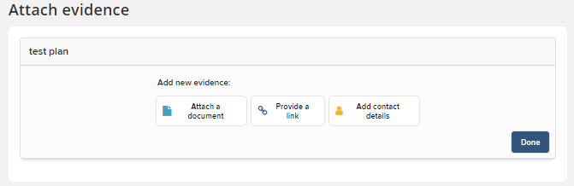
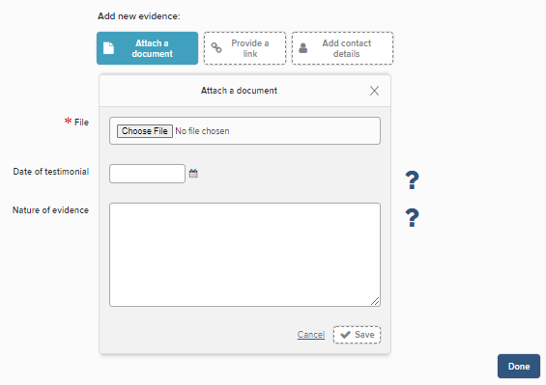
Add impact plan – attach supporting information
NEXT: attach ‘evidence/documentation’ here: documents, links to webpages, and contact details. At the planning stage this will not be evidence of impact per se, but you can use this section to attach supporting information related to your impact plan.
To upload a document ‘Attach a document’, then ‘Choose File’ and choose your document in Windows Explorer.
To provide a web link ‘Provide a link’ and add the URL. There is also an option to add a file, which could be a screenshot of the webpage or a pdf copy of the webpage (in case the link breaks).
‘Add contact details’ will enable you to record contact details of individuals and their relationship to the ‘evidence’ (may not be required for impact plan record).
For each of these different types of evidence entries you should add:
Date of testimonial: Add a date for the document if relevant.
Nature of evidence: Details about the document and ‘Save’.
Once you have completed this page click ‘Done’.

Slide 18
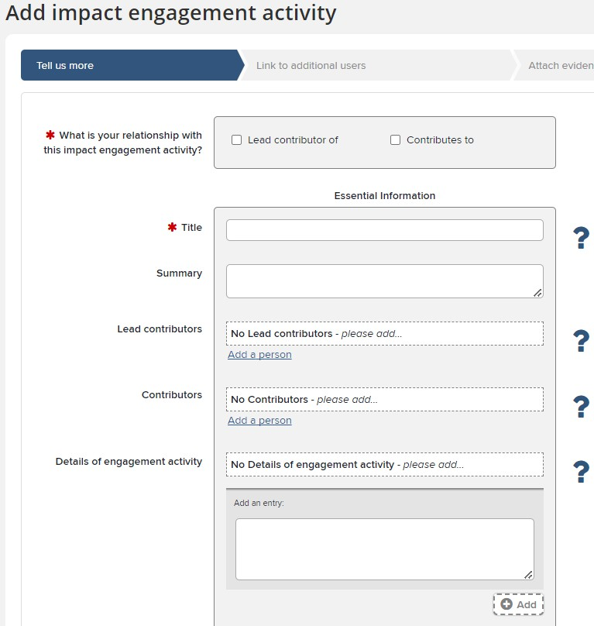
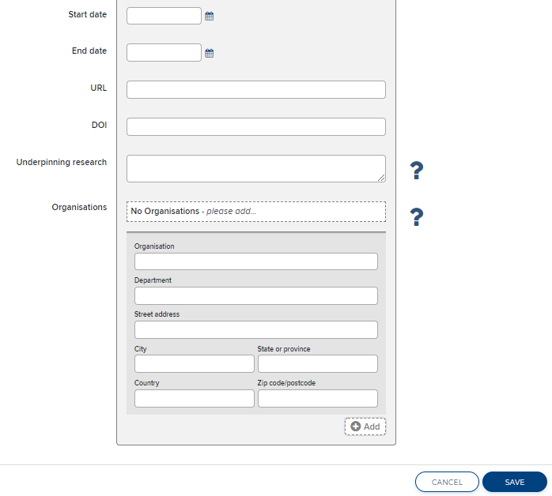
Add impact engagement activity – create record
Title: Add a memorable and descriptive title
Lead Contributors/Contributors: Add the names of the people contributing to this engagement/ KE activity. ‘Add a person’ after each contributor.
Details of engagement activity: Give details of your engagement/KE activity (eg. who’s involved, what the aim of the activity is etc.). You can add further entries at any point.
+ Add to save.
Underpinning Research: Outline the key research or insights that this engagement/KE activity is linked to or draws upon, if appropriate.
Organisations: Add details of organisations involved with this activity. + Add to save.
Next step - Link other users/add evidence
‘Save’ to move to next step.
Access tools and resources to learn more about different types of engagement and knowledge exchange activities in the Research Impact Toolkit

Slide 19
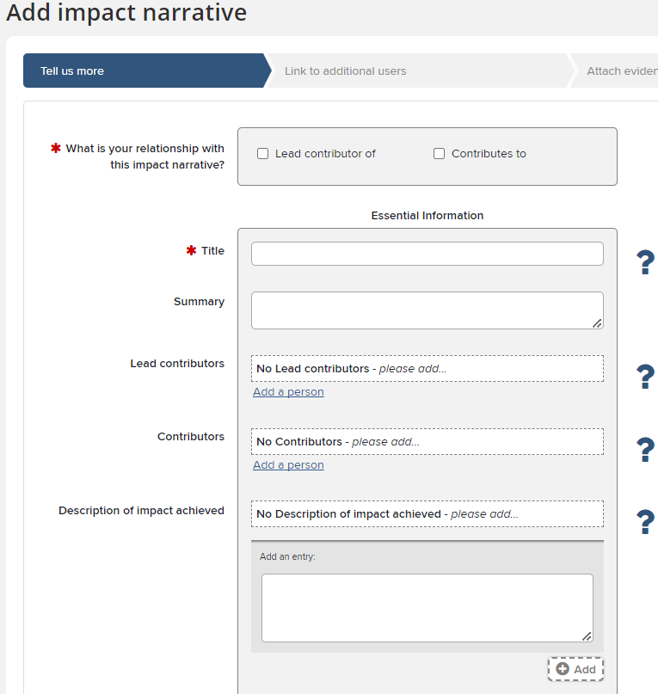
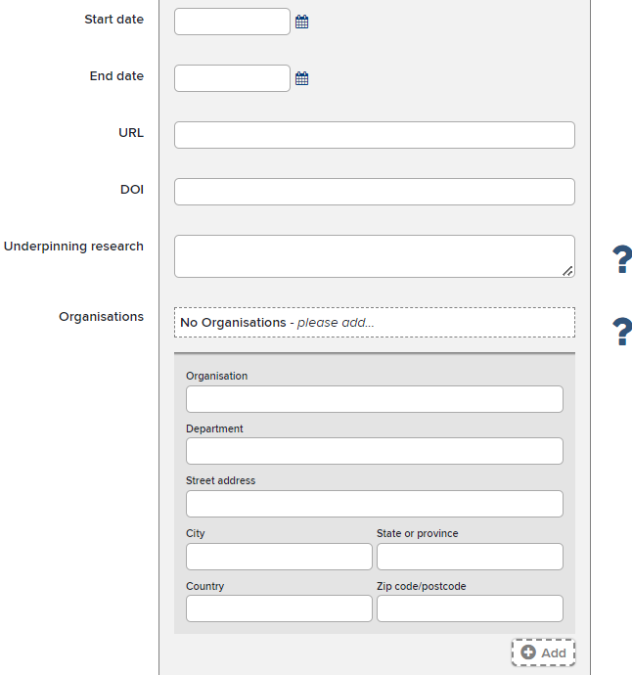
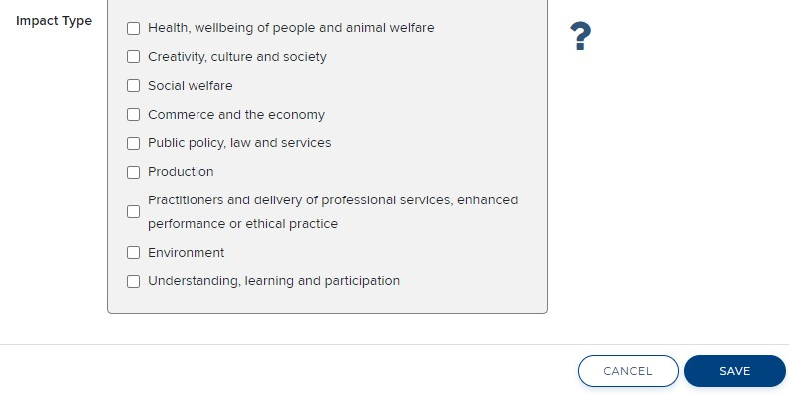
Add impact narrative – create record
Title and Lead Contributors/Contributors: As for other records.
Description of impact achieved: Provide a description of the impact achieved (the effect, change or benefit beyond academia) and a brief summary of activities which led to the impact. You can add further entries at any point. + Add to save.
Underpinning Research: Outline the key research or insights that underpinned this impact. This work may be a body of work or project that underpins this impact. Relevant research outputs can be linked separately afterwards.
Organisations: Add details of organisations involved with this impact. + Add to save.
Impact Type: Select the type(s) of impact achieved (see Annex A of the REF2021 Guidance on Submissions). Multiple types can be selected.
Next step - Link other users, as outlined for the impact plan record
Slide 18

Slide 20
Add impact narrative – attach evidence
Attach ‘evidence’ as outlined for the impact plan record.
For the impact narrative record you will need to record evidence of impact by attaching a document, providing a link or contact details. Examples of impact evidence could include testimonials, reports, webpages etc. Find out more about different types of impact evidence in the Research Impact Toolkit.
For each of the different types of evidence entries you should add:
Date of “testimonial”: Add a date that the evidence was made available. For a document this would be when it was created, for a website or URL the date it was made accessible. Remember to upload consent for testimonials too. Nature of evidence: Describe how this evidence confirms or demonstrates the impact. In the case of contact details you could provide details of why this contact is important to the impact record e.g. they held a particular role that provided testimonial evidence to support your impact claims. Click ‘Save’.
Once you have completed this page click ‘Done’.
Slide 1290

Slide 21
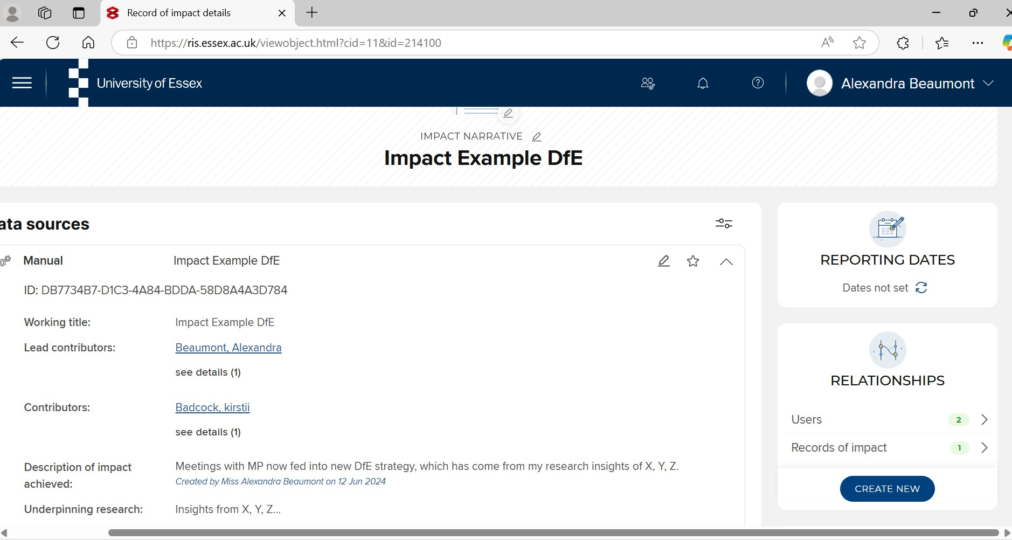
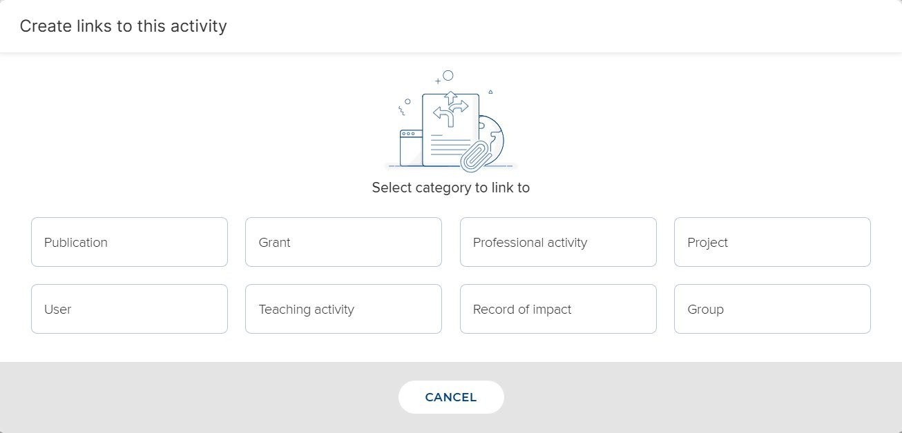
Linking records

Slide 22
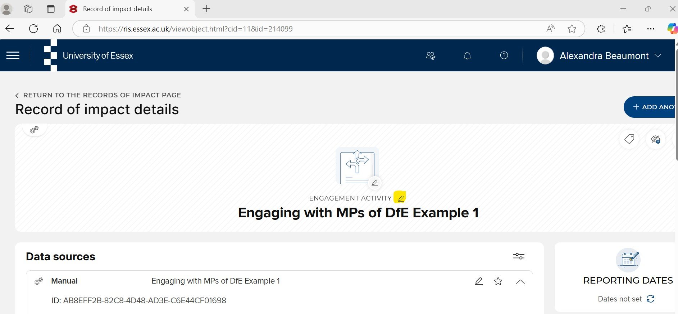
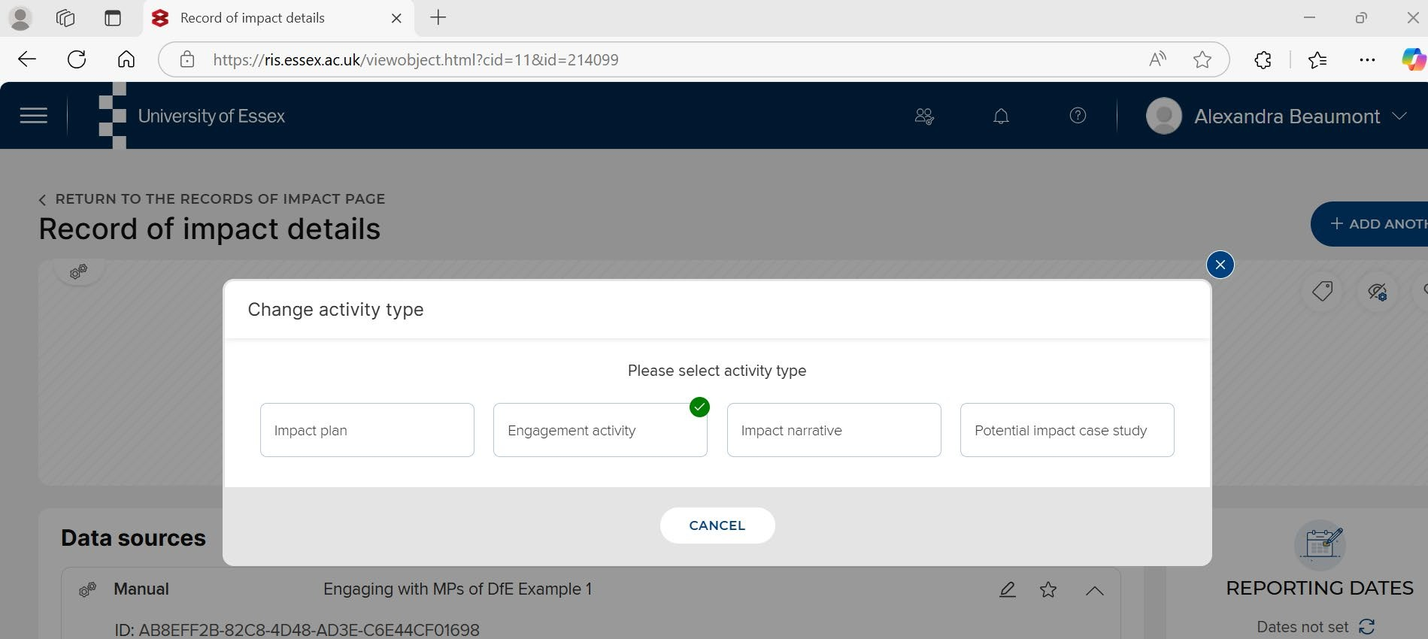
Converting records

Slide 23
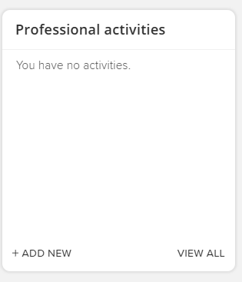
Viewing Professional Activities Records
You can view your existing impact records on your Homepage by clicking ‘View all’ in the ‘Professional Activities’ box
Slide 2

Slide 24
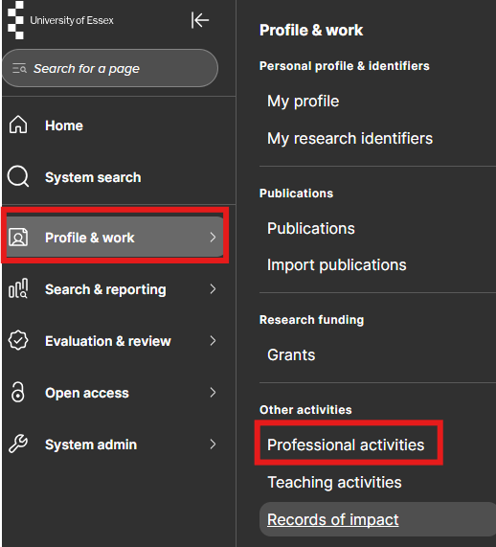
Viewing Professional Activities Records
Alternatively, from your Homepage go to your Profile & work drop down and choose ‘Professional activities’, under Other activities.

Slide 25
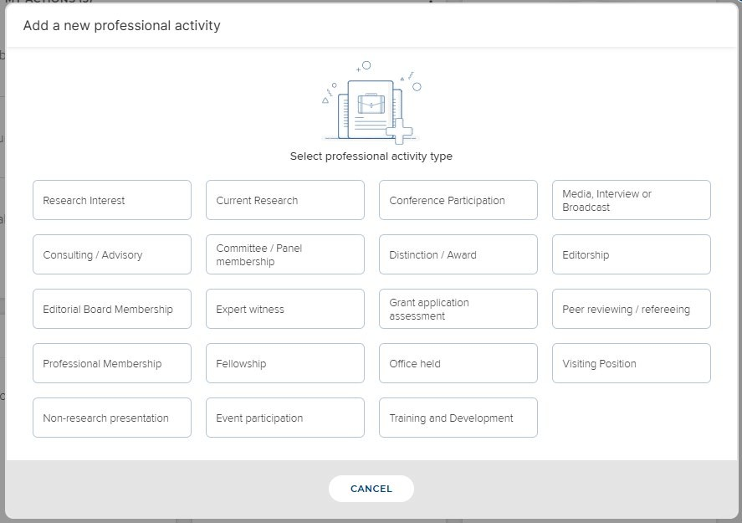
Choose professional activities record type
Whichever route you take to add a new record you will be taken to a window where you will need to choose the type of professional activity record that you’d like to add.
There are many professional activities in an academic sense but this guide focuses on those that relate to engagement and impact only.

Slide 26
Types of Professional Activity Relevant to Impact
Use these records to document wider professional activity that could lead to further engagement and later impact:
Consulting / Advisory – any contract research, advisory posts with external non- academic audiences
Committee / Panel Membership – membership of external committees or panels, especially on non-academic boards
Expert Witness – When you have been invited to give expert testimony based on your research, for example as part of a court case or if you have been invited to give Oral evidence submissions for Government/Parliament
Office Held – any positions held in non-academic scenarios, which may open the door to greater engagement
Media, interview or broadcast – It is fantastic to get picked up in media, but alone is not impact just yet….

Slide 27
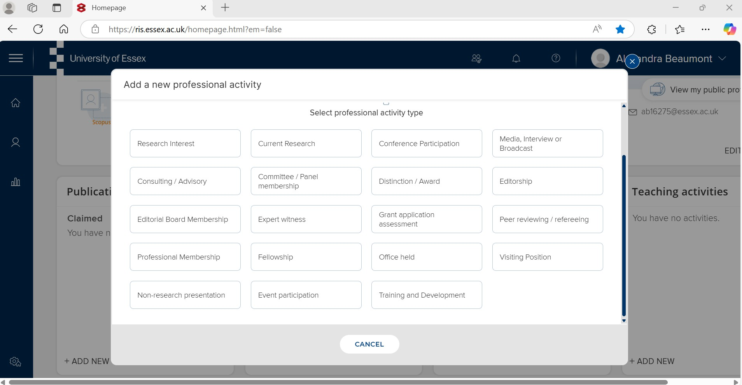
Adding Professional Activities relevant to impact

Slide 28

Linking records

Slide 29

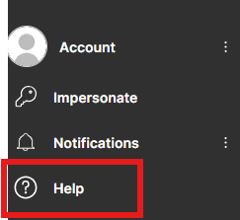
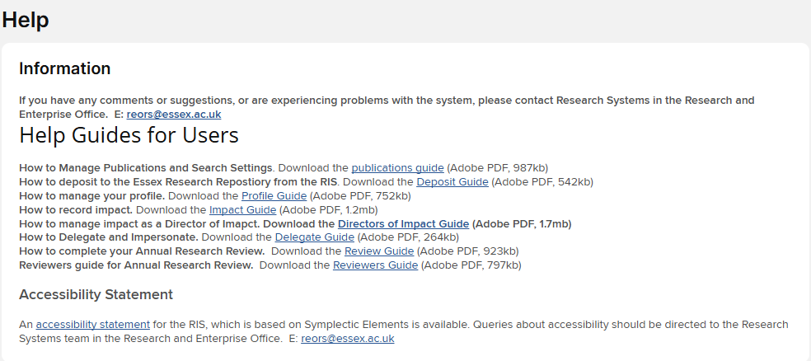
Need Help?
You can access help and guidance resources from the Menu on your homepage. At the bottom of the home tab, under Account, click ‘Help’.
If you have any further questions please email reors@essex.ac.uk or contact the Research Impact Team

