Slide 1
RIS IMPACT MODULE
Directors of Impact Guidance 2025

Slide 2
About this guide
Directors of Impact can create engagement records, edit and view records of impact for staff in their school/department, in addition to their own, via the 'Category Admin' option of their role on RIS
It is essential to use this 'Category Admin' option rather than the 'My Profile' option on RIS which is strictly for a user's personal impact records
This guide outlines how to use the access the additional role and what you can do using it

Slide 3
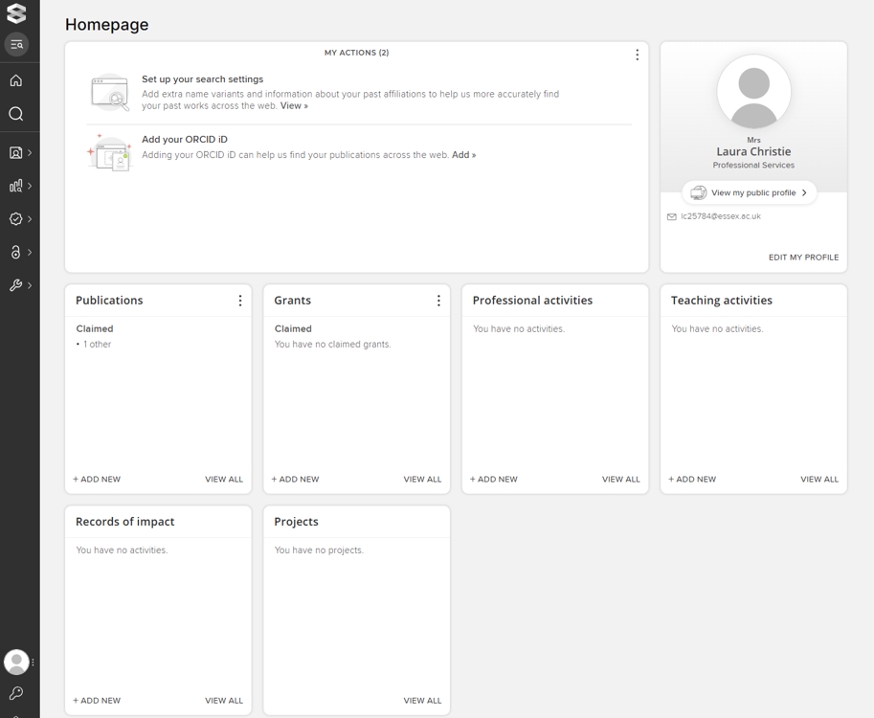

Managing Impact Records
Click on the symbol on the top left of the browser window to reveal the menu

Slide 4
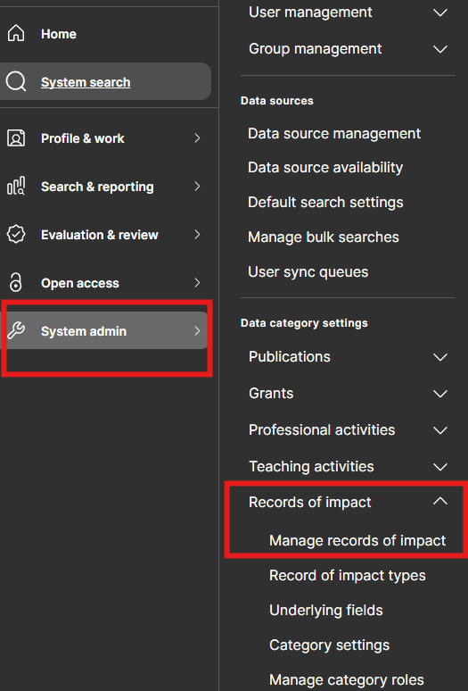
Managing Impact Records
Directors of Impact have an
additional ‘Data Category Settings’.
Menu > System Admin > Data Category Settings > Records of impact > Manage records of impact

Slide 5
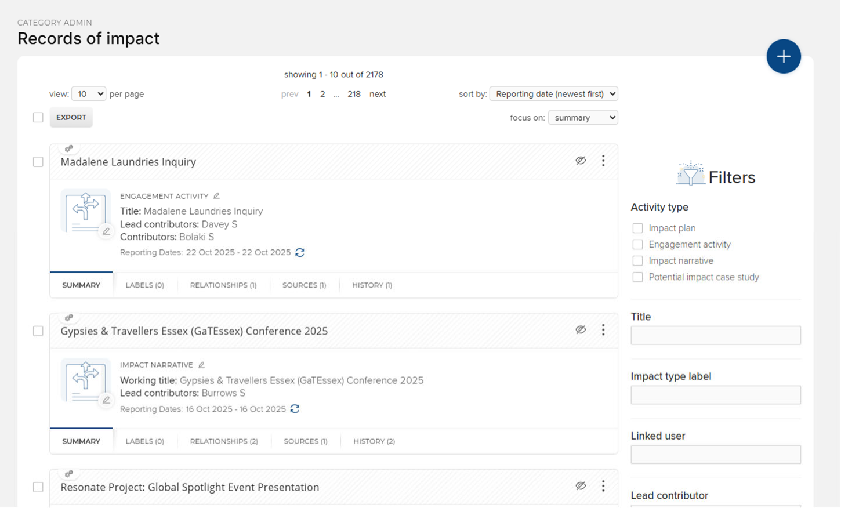
Types of Impact Record
Manage Records of Impact displays all the records of impact for staff in the DOI’s school/department
‘Category Admin’ allows users to access all records for the school/ department users
Note that it is not possible for users, Directors of Impact included, to view Impact Records other than those which they are linked to in their ‘My Profile’ area; the ‘Category Admin’ route is required

Slide 6
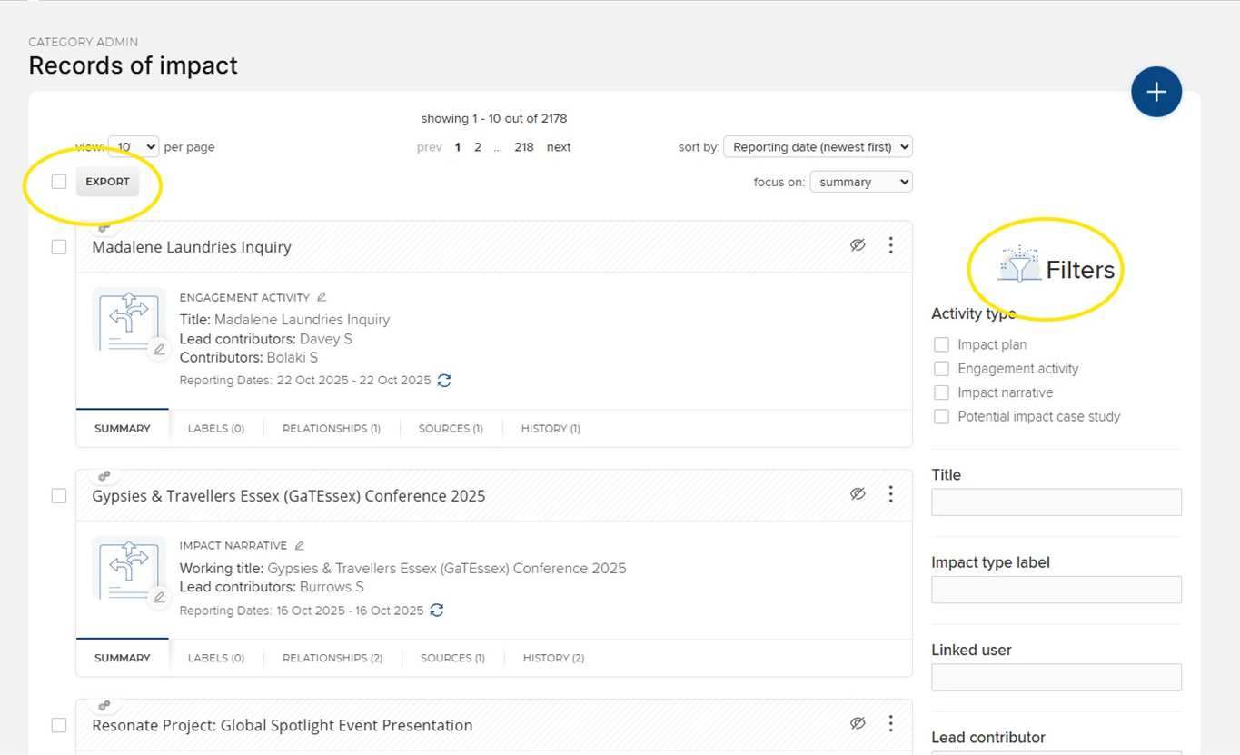
Exporting records of impact
DoI’s can export engagement and impact data from their department / school as a .csv file
Filters can be added prior to download as required.

Slide 7
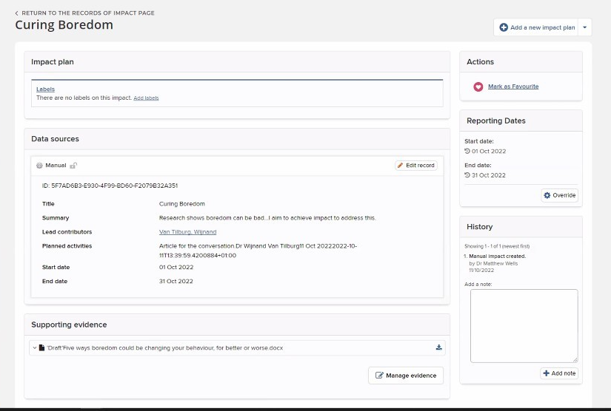
Editing Impact Records
Editing impact works in the same way as editing a personal impact record
The Record can be edited, evidence added and managed
Links can be made to other RIS users and other RIS records, e.g., Publications, Grants, Professional activities, and Impact records

Slide 8
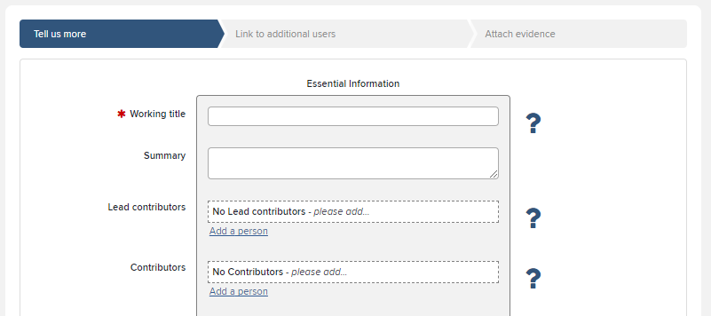
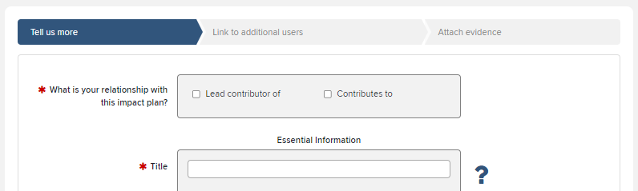
Adding a new Impact Record
Adding impact works much as adding impact as a personal record – the same ‘Essential Information’ (top right picture)
There is no ‘What is your relationship with this impact plan/engagement activity/ impact narrative’ field (bottom right picture)
‘Lead contributors’ and ‘Contributors’ can be selected to indicate which user (or users) the impact record corresponds to
For general advice on impact records please see the RIS impact module guidance

Slide 9
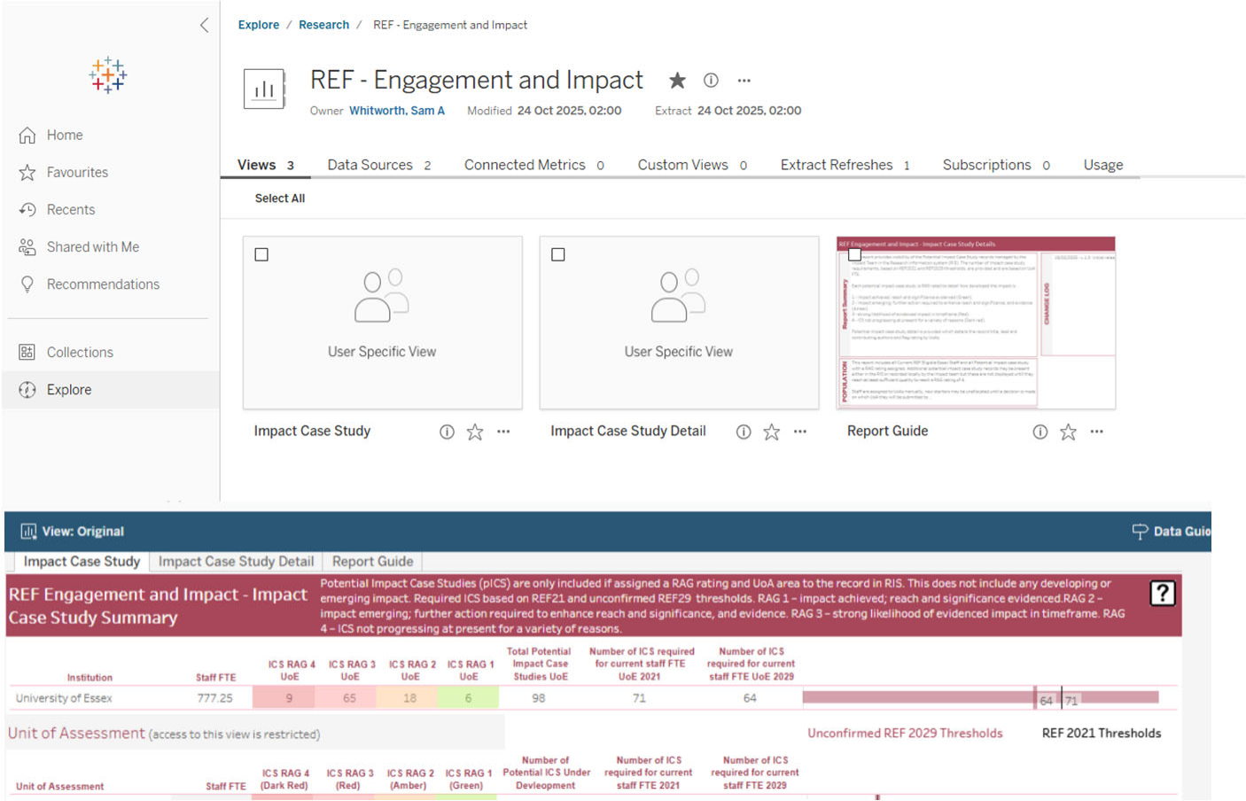
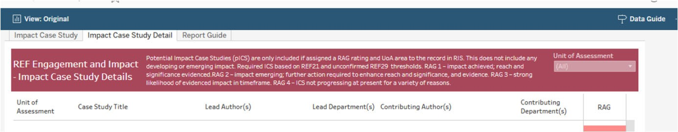
Potential Impact Case Studies on Tableau
In Spring 2025 all REF reporting moved onto Tableau dashboards.
These live reports provide visibility of the Potential Impact Case Study (pICS) records in the RIS.
Each pICS is RAG rated. The first report (Impact Case Study) shows a summary, the second report (Impact Case Study Detail) displays the record title, lead and contributing authors and RAG rating.
DoIs are able to view UoAs that their department is contributing to.

Slide 10
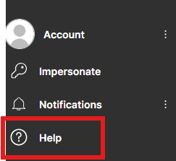
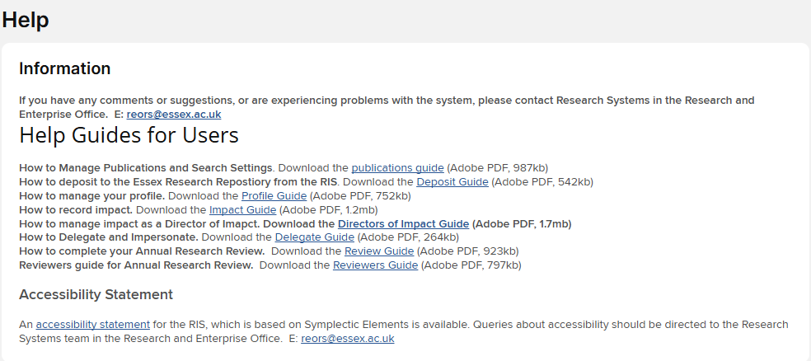
Need Help?
You can access help and guidance resources from the Menu on your homepage (see page 3). At the bottom of the home tab, under Account, click ‘Help’.
If you have any further questions please email reors@essex.ac.uk or contact the Research Impact Team
Slide

