Slide 1

Contractor
Briefing
Southend and Loughton
February2025_v1.1

Slide 2
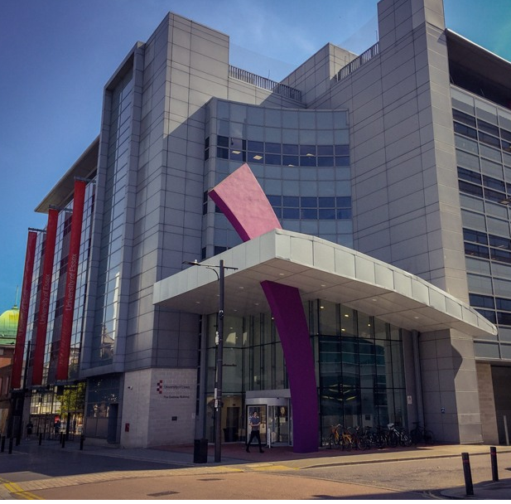
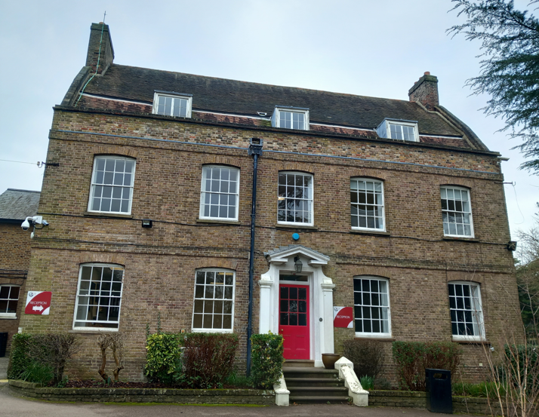
Welcome
Notes:
On behalf of the University I would like to welcome you to the University of Essex.
Please watch this video and take on board the points raised.
I will tell you essential safety information to deliver your project safely, and successfully, at the University.
For more information refer to the Contractor Handbook

Slide 3

Diverse Community
Notes:
Our campus is a wonderfully diverse community.
When you are on campus you represent the University.
Always be respectful towards other contractors, staff, students and visitors.
Please be well behaved and respect the rules and regulations of the University.

Slide 4
Conduct and appearance
As an educational establishment we try to instil the importance of health and safety.
We require contractors to lead by example in demonstrating high standards of health and safety.
Notes:
You will need to be appropriately dressed and wear the right personal protective equipment for the job you are undertaking.
You will need to ensure visitors to your site are also appropriately dressed.
Our staff are vigilant and will report behaviour they feel is unsafe.
The University does monitor contractor safety standards.
Failure to comply can result in being excluded from site.

Slide 5
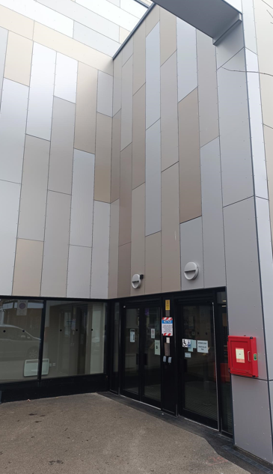
Security
University Square
Hatfield House
Gateway
Notes:
The University’s Security in Southend are based in Gateway reception and University Square reception, at Loughton, they are based in Hatfield House Reception.
University Square Security in Southend is open 24 hours a day, all year round.
Hatfield House Security in Loughton is open 07:00 – 23:30 Mon-Sat (outside of opening hours, Security at Southend can be contacted)

Slide 6
Security
If the Security team know where you are they can quickly get help in an emergency.
You will need to be aware of where you are working.
Southend - Telephone 07920 822 061 or 07920 821 931
Emergency 01702 328208
Loughton – 07920 822 101
Notes:
You will need to go to security out of hours to collect any keys you require

Slide 7

Fire
Know the fire exits and alarm call points where you work.
Read the Fire Action Notice.
Co-operate with Fire Evacuation Stewards or Security.
Work to minimise the risk from fire and false alarms.
Notes:
For more on expected contractor fire safety, read the Contractor Handbook.

Slide 8

First Aid
Before work identify:
your First Aider
Location of your First Aid kit
In an emergency contact Security.
Southend - Telephone 07920822061 or 07920821931
Emergency 01702 328208
Loughton - 07920822101
Notes:
Do not dial 999.
This can delay the emergency services getting to you.
Security can quickly organise emergency service response for you.

Slide 9
Working safely
Follow these safety guidelines.
Failure to do so will mean you and your company will be removed from site permanently.
If in doubt – ask your University Contact.
Always work safely.

Slide 10
Risk assessment and method statements (RAMS)
Make sure you read, understand and follow the risk assessments and method statements (RAMS) for your work.
RAMS must be suitable and sufficient.
If not a permit will not be issued.
Notes:
Before coming onto site you’ll be given information.
This is about your risk assessments and method statements (RAMS).
Your manager or supervisor will complete the RAMS for the work that you do. You must have your RAMS with you whilst working on site.
RAMS identify the things that may cause harm and injury in the workplace and what needs to be in place to protect you, your workmates and others from harm.
If work or hazard level changes you must stop work, make the area safe as necessary and consult your line manager or University Contact.

Slide 11
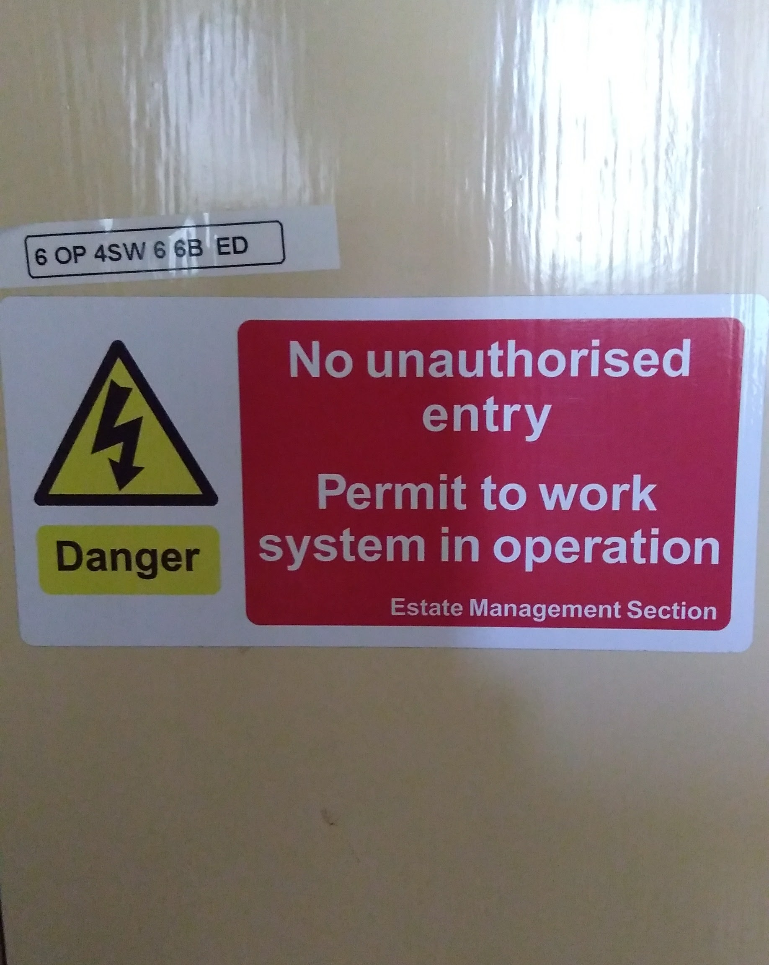
Permit to Work System
Any work or inspection that you do will need either a permit or authority to work.
The university operates an online permit to work system. To apply for a permit, first contact your university contact for a link.
No permit. No work.
Notes:
You must have permission from your University Contact who will issue the permit before work starts
The new electronic/online permit system is a simple process, you will add a copy of your RA/MS and answer some simple questions. This will be reviewed by the university who will either accept or refuse (with comments).
When you attend site, you will be signed electronically onto the job, following any review of controls etc.
To register for the permit system, you can go to the contractor safety web page:- https://www1.essex.ac.uk/forms/staff/contractor-safety/register-worker.aspx
If you have any queries go back to the person who issued the permit.
Do not ignore permit to work signs.
Remember. No permit. No work. Contractors failing to comply with these requirements maybe barred from site in the future.

Slide 12
Lifting operations
Lifting operations can only be carried out by trained and competent people.
Notes:
There are beams and eyes located around campus installed during its construction that are no longer safe.
Only use beams and lifting equipment that has an in date and visible sticker or ScafTag detailing the next inspection and test. If not, do not use it.

Slide 13
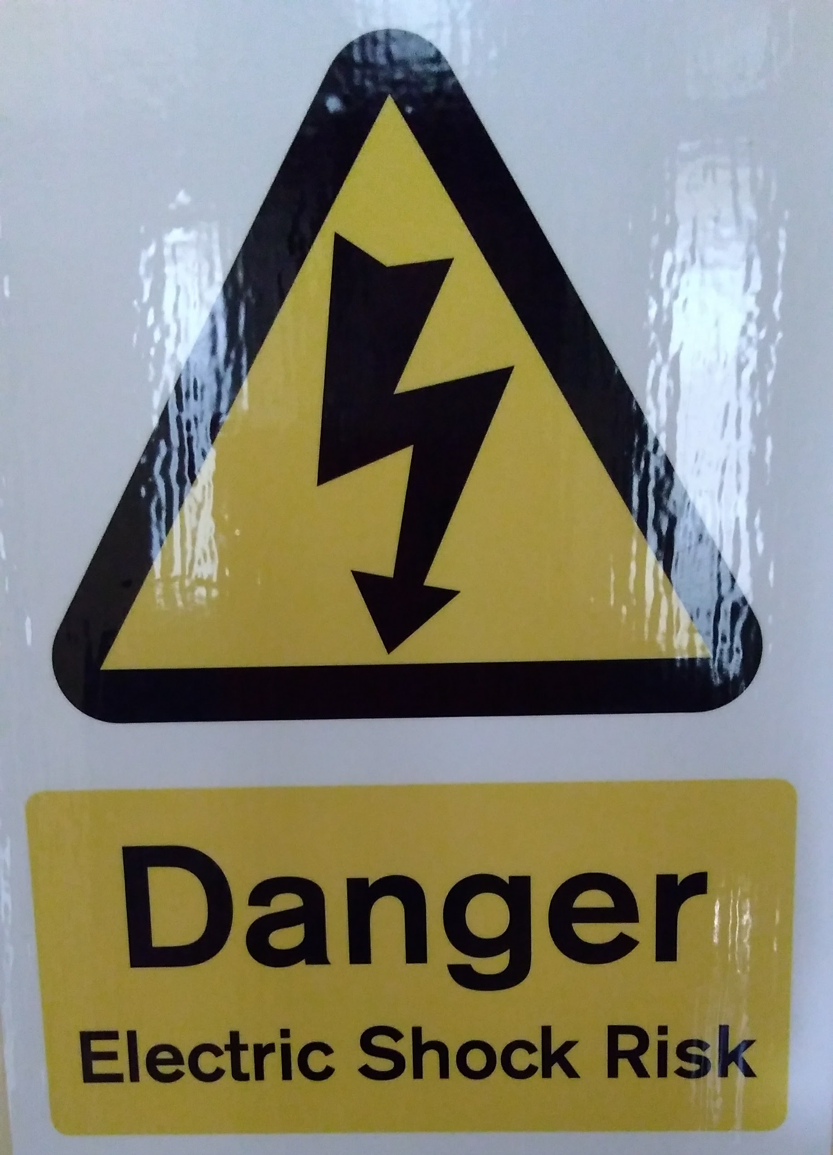
Electrical safety
Consider all services to be live.
Use battery tools as the first option or 110v supply where feasible.
If you need to use 230v power tools or task lighting you must use a RCD adaptor.

Slide 14
Confined spaces
Only work in confined spaces if you have a Permit to Work document from your University Contact.
You must be competent and have had the correct training.
Notes:
The University has confined spaces.
A confined space is anywhere which is suitably enclosed (though not always entirely) and where serious injury can occur from hazardous substances or conditions within the space or nearby (for example lack of oxygen).
If you need to enter or work in a confined space you will need a permit and to be trained before you go in to them.

Slide 15
Plumbing
Speak to your University Contact before breaking into hot or cold water supplies.
Do not reconnect without appropriate collaboration.
Notes:
Check the Contractor Handbook for more information. You may need a Permit to Work.

Slide 16
Asbestos
Check Asbestos Surveys, relating to your area of work, and be certain that asbestos will not be disturbed.
If you are uncertain contact your University contact before continuing and obtain formal consent prior to starting the work.

Slide 17
Excavations
Do not break or penetrate ground without the express permission of your University Contact.
Many services run below the surface.
Notes:
You may need a permit to work.

Slide 18
Working at height
Only work at height if you:
Have the right access equipment
Received the correct training and are competent
Where necessary, have a permit to work
Notes:
Working at height is any work undertaken where there is a risk of injury through falling to a lower level. It covers roof work, ladders, mobile elevated working platforms, mobile towers and scaffolds.
All working at height must be risk assessed and have a method statement.
Access authorisation is needed to go on roof areas.
Safety equipment is installed on many university roof areas. Man safe wire systems and safety handrails are tested and inspected at regular intervals. People using these must be trained.

Slide 19
Traffic and road safety
Vehicles must be driven with due caution.
Pedestrians have priority.
Take particular care under podia and in residential accommodation areas.
Notes:
Drive your vehicles with due regard to the Highway Code and within the speed limits on campus.
Make sure your vehicle has a relevant MOT, insurance and is roadworthy.
Please wear a seat belt and do not use a phone whilst driving.
Secure your vehicle and the load on campus.
Absolutely no driving or parking on the grass without formal agreement from the University.
Please remember pedestrians have priority and drive slowly.

Slide 20
Parking
Contractors must park in available paid street parking or car parks in Southend, or as directed by Estates/Security at Loughton
If alternative parking is required and agreed, register your vehicle with Security.
Notes:
Parking is limited and in demand.
Contractors must park in any available paid street parking or car parks in Southend or as directed by Estates/Security in Loughton. If you need to offload elsewhere, you will need to organise with Security. You can get advice on parking from your university contact.

Slide 21
No parking
Bays marked for disabled drivers or block disabled spaces.
On double yellow lines,
On carriageways, hatched areas and delivery areas
Block access for emergency vehicles.
Notes:
At the University of Essex we operate a considerate parking system. By observing our rules you are helping make parking easier for everyone.

Slide 22
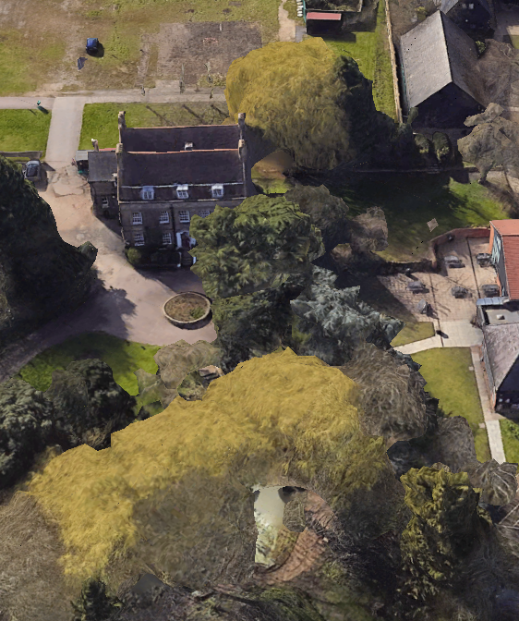
Protecting the environment
Turn off heating, appliances and lighting
Don’t waste materials
Do Recycle and properly dispose of waste
Please Ensure compliance with environmental law
Notes:
Protecting the environment.
Help the University maintains high environmental standards by:
Turning off heating, appliances and lighting when not in use
Not wasting materials needed for a job
Recycling and properly disposing of waste
Not leaving vehicles or generators idling
Ensuring compliance with relevant environmental law
The University has team which can help with environment concerns, questions and ideas and a recognition scheme for our greenest contractors. Visit our sustainability webpages ask at the EMS Helpdesk for more information.

Slide 23
Round up
University
Contractors
Contractors work safely.
Meet legislation, standards, good practice.
You
Follow RAMS, permits.
Report concerns.
H&S is a core value.
Everyone works safely to minimise risk.
Notes:
The University makes health and safety part of how we do things.
It is important that everyone, including contractors, work safely to minimise the risk of injury and ill health.
When you are undertaking work we expect you to do it in way meets legal requirements and current good practice. This includes following your risk assessment and method statement, permit to work systems.
If you are concerned about anything or find anything untoward please refer it to a supervisor, manager or University Contact. You can also refer to your Contractor Handbook.
Thanks for watching.

