Slide 1

Practice supervisor & Practice Assessor - Transition for mentors
Developed by PAN Midlands Yorkshire and East Practice Learning Group for use and amendments under the Creative Commons licence. Details at https://creativecommons.org/licenses/by-nc-nd/3.0/

Slide 2
Aim
Introduction of new NMC standards from September 2019 means mentorship is changing
Each university is also redeveloping new curricula for nursing through 2019-2021 and in turn will redevelop all NMC approved programmes as new professional standards are published
All existing mentors will need information on these changes and the impact on their future roles in supervising and assessing students.

Slide 3
Learning Outcomes
By the end of this preparation, the registrant will:
demonstrate a clear understanding about the responsibility of the Practice Supervisor and Practice Assessor role in the supervision and coordination of safe student learning and assessment in practice.
present knowledge and understanding of the locally agreed model of student supervision, assessment and feedback including the interconnection of the three new NMC roles
be able to design a bespoke learning experience for a student’s scope of practice and their specific learning needs including consideration of equality and diversity and reasonable adjustments
be able to identify internal and external sources of information and feedback to support the objective assessment of student progression and proficiency
demonstrate knowledge about the Practice Assessment Document and written forms of evidence to support objective student assessment and progression
show understanding of the student’s programme of study and the proficiencies to be achieved
illustrate ways in which the role can be used for your own CPD/revalidation

Slide 4
Overview of Content
An Overview of the NMC Standards for Students Supervision and Assessment (SSSA)
Focus on the Practice Supervisor role and the expectations of this and how it links into the assessor roles
Identify models to support student learning in practice and how these can be applied
Consider students with additional learning support needs in practice
Focus onto the Practice Assessor role and the expectations for objective, evidence based assessment
Outline local models for practice support for students.
Own goals and action plan for transfer to the new roles

Slide 5

Standards for education and training
Notes:
Explain overview of new NMC standards.
Part 1 Standards framework for nursing and midwifery education (for all NMC approved programmes)
Part 2 Standards for student supervision and support (the new approach to learning and assessment which replaces mentorship)
Part 3 Programme standards with detail relevant to each approved programme: entry requirements, length, hours and the award etc. (so far NMC have published Standards for pre registration nursing programmes and Standards for prescribing programmes. Building on this with a publication for each approved programme)
The proficiencies for nursing and midwifery professions (including nursing associates). As with the programme standards, so far published the nursing proficiencies, and adopting the Royal Pharmaceutical Society Competency Framework for prescribing.

Slide 6

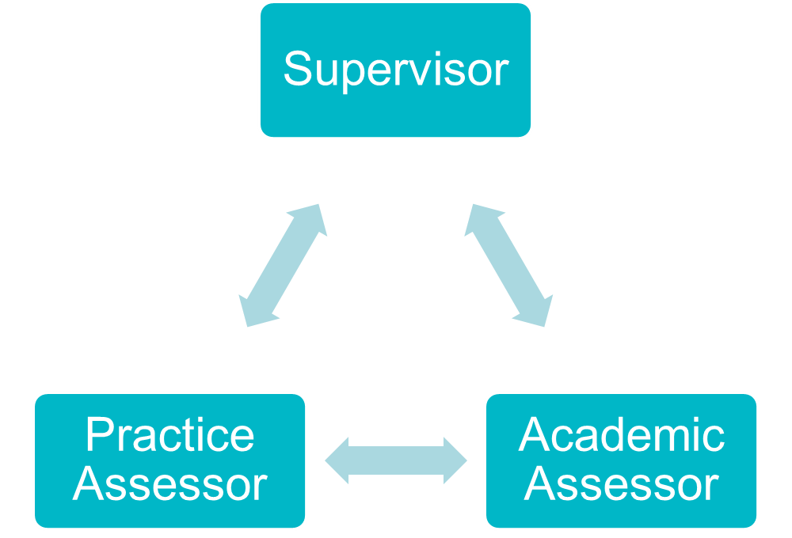
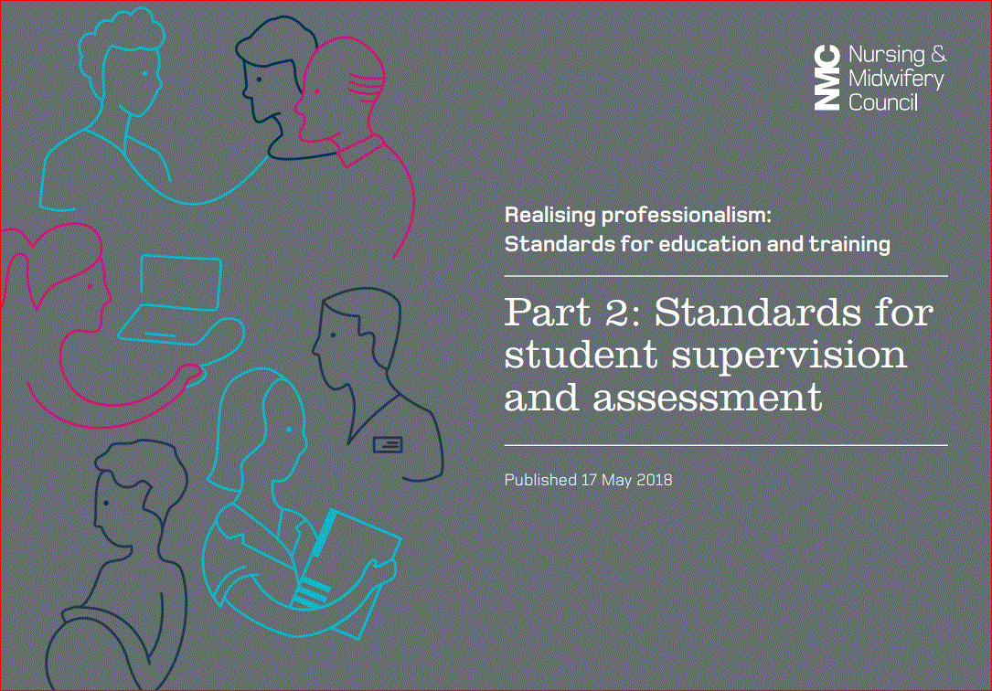

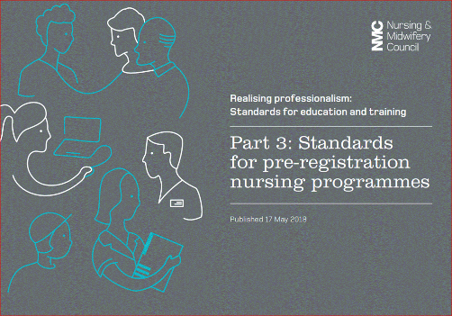
Notes:
This diagram shows the three parts of the Standards for education and training.
The diagram on the right highlights the three new roles that will need to be in place to support the supervision and assessment of the student
Please note that each of these roles is held by a different person so a person can not simultaneously be the supervisor and assessor or both practice and academic assessor for the same student.
Nursing and midwifery students must be supervised while learning in practice. The supervisor can be any registered health and social care professional working in a practice environment. For example in a social care environment a registered social worker could be the supervisor to a student if they are deemed to have the right qualifications and experience for the learning experiences/outcomes the student needs to achieve. We’ve published supporting information that has more examples in it (https://www.nmc.org.uk/supporting-information-on-standards-for-student-supervision-and-assessment/).
Practice supervision ensures safe and effective learning experiences that uphold public protection and safety of people
There is sufficient coordination and continuity of support and supervision of students to ensure safe and effective learning experiences and facilitate independent learning, including the support and development of the practice supervisors.
There are two assessor roles: the practice assessor and the academic assessor. They are:
registered nurses or midwives with appropriate experience for the student’s field of practice or relevant programme standards for post qualifying programmes. In this instance due regard is taken into account.
The practice assessor will:
Conduct assessments to confirm that the student has achieved the proficiencies and outcomes for practice learning
The academic assessor will:
Collate and confirm student achievement of proficiencies and programme outcomes in the academic environment for each part of the programme
Both roles make and record objective evidence-based assessments on conduct, proficiency and achievement, drawing on student records, direct observations, student self-reflection, and other resources.
Work in partnership with the nominated practice/academic assessor to evaluate and recommend the student for progression for each part of the programme, in line with the programme standards and local and national policies.

Slide 7
Roles for student supervision and assessment
PRACTICE SUPERVISOR
Any registered professional after preparation,
Continuity needed to measure student progress
Will document feedback on performance of proficiencies and professional values
NMC registered (not field specific), current, suitably prepared, supported. Must observe student in practice. Assess and confirm achievement. Do not supervise then assess the student in same part
PRACTICE ASSESSOR
Academic Assessor
Academic staff, NMC Registered. Current, suitably prepared, supported, Not field specific. Collate and confirm achievement in practice in conjunction with PA to enable student to progress to next stage of the programme
Notes:
AA cannot be sequential so need at least 2 in a 3 year programme.

Slide 8


For existing mentors
An expectation that all mentors transition to the role of Practice Supervisor and in many cases also into Practice Assessor.
You cannot be a Practice Supervisor and a Practice Assessor to the same student at the same time.
Mentor role is separated

Slide 9

Benefits of New Roles
Separates supervision and assessment roles
Everyone will have an input into assessment
Improves interprofessional working
Supporting student learning becomes everyone's responsibility
You can be both a Practice Supervisor and a Practice Assessor, but not to the same student

Slide 10
Effective practice learning
Learning Environment
Delegation
Supervision
Public safety
Learning opportunities
New models of supervision & assessment
Empower and meet student expectations
Delegation of care interventions
Learn in a safe & effective way
The student level
The programme
The route
New roles:
Practice Supervisor
Practice Assessor
Notes:
Practice learning will be enhanced by the creation of a good learning environment, and needs to account for:
The level of the student and which programme the student is on (nurse, midwife, nursing associate, post-registration)
The route - either traditional or apprenticeships. It’ll be for each AEI and its practice partners to ensure effective practice learning with consideration of learning opportunities.
the learning environment in all placements should provide and support learning activities designed to achieve the desired learning outcomes.
must empower students to actively participate in their own learning through those activities and to meet student expectations.
Supervision :Consideration must be given to the new roles of supervision and assessment, which includes the delegation of care interventions and responsibilities depending on the capability, scope of practice and required learning outcomes.
Thus an expectation to provide innovative approaches to education while being accountable for the local delivery and management of approved programmes in line with our standards.
Public safety is central to our standards – noting that students will be in contact with people throughout their education and its important that they learn in a safe and effective way.
.

Slide 11
All students are supervised
Level of supervision reflects student learning needs and stage of learning
Expectations of Practice Supervision
All students are supervised by registered nurses /midwives and other registered health and social care professionals
There is support and oversight of practice supervision to ensure safe/ effective learning
Practice supervision facilitates independent learning
Sufficient co-ordination and continuity of support and supervision of students to ensure safe/effective learning

Slide 12
Support and supervise students
Have current knowledge and experience of the area in which they are providing support and feedback
Provide feedback on student progress towards achievement
Practice Supervisor: role and responsibilities
Support learning in line with their scope of practice
Serve as role models
Receive ongoing support to participate in student practice learning

Slide 13
Periodically record observations of student conduct, proficiency and achievement
Raise and respond to concerns regarding conduct, competence and achievement
Practice Supervisors contribution to assessment
Contribute to student assessments to inform progression decisions
Have sufficient opportunities to share relevant observations with Practice and Academic Assessors

Slide 14
Liaison with the 3 new roles
PS
Practice Supervisor – any registered health and social care professional. supports student learning, identifies learning opportunities on each shift, gives feedback to student and assessor.
PA
Practice Assessor – conducts objective, evidence based assessments, works alongside the student to observe their achievement, works in partnership with the academic assessor and has an overview of academic achievement as well as progress in practice
PA can’t be the PS or AA to the same student at the same time
AA
Academic Assessor – based in university, works in partnership with the practice assessor to collate and confirm achievement. Will offer support when student or PA is struggling, allocated to the student at the start of each part, cannot be sequential so need at least 2 in a 3 part programme

Slide 15
Models and Scope of Practice
There can be multiple supervisors in a specific placement who can support the student in achieving a range of learning outcomes
When identifying a PS or PSs to support the student their scope of practice needs to be considered. For example a newly registered nurse will be a valuable PS in supporting achievement of some proficiencies but will not always have the required knowledge and skills
How would this work in your placement area?

Slide 16



Proposed Model, based on 2 placements per year
Each Part of Programme
Placement A
Placement B
Notes:
One model of how the new models sit together based on 2 placements a year with a practice assessor (PA) in each placement.
PA in each placement receives feedback from the PS and then academic assessor tracks student through each placement, receives feedback from PA in each placement and in final summative placement discusses student achievement and progression with PA there.
Documented throughout in assessment document records which may be electronic, so communication may not always be face to face.

Slide 17

As a Practice Supervisor, what do you think you would need to know more about to support learning?
Notes:
5 minute discussion then note answers as they feedback
Content to come includes giving feedback, the PAD

Slide 18
To support others learning you should…
Support others to achieve their personal and professional goals
Link the learning into the requirements of the student programme
Use a range of methods
Give prompt feedback on learning, encouraging reflection and improvement
Provide feedback to the assessor to create an objective evidence based assessment
Ensure the student is an active participant

Slide 19

Notes:
Has anyone been involved in any form of coaching before and if so, what skills did this involve?

Slide 20


Coaching
"A one-to-one conversation focused on the enhancement of learning and (the) development (of a daily goal)....where the coach facilitates the ...learning of the coachee through questioning, active listening and appropriate challenge in a supportive and encouraging climate."
(Van Nieuwerburgh, 2012)

Slide 21

The skills involved in successful coaching
Skillful questioning
High quality listening
Guiding
Encouraging
Trusting
Supporting
(Rollnick & Miller, 2012)
Notes:
A range of skills are involved in successful coaching.
Essentially for any learning to take place, the student must feel that they are welcome and that the coach is interested in supporting them.
Simple measures like calling the student by their name, acknowledging that they were expected and encouraging them to discuss their learning, concerns etc will support a healthy learning relationship.
It is not about judging the student in terms of assessment.
Skillful questioning will help to promote student learning and all coaches should engage in this activity when working with students.

Slide 22




Skillful Questioning
Notes:
Open questions or using the terms ‘how?’, ‘why?, ‘what?, ‘who?, ‘when?’ and ‘where?’ require a response that will allow you to gain insight into the student’s understanding. These questions develop higher order thinking skills and students are more likely to retain this knowledge when they learn in this way.
e.g. Tell me what the fasting time is for a patient having hip surgery. Why is this important? Who should you contact if this fasting time has been breached? When can the patient safely have food and fluids re-introduced after their surgery?
Closed questions on their own provide very limited insight into a student’s understanding .
Students should not feel that they are being interrogated and the delivery of questions should be with the understanding that if the student does not know that will have opportunity to find out during the shift. We do not want to damage their confidence and so a tactful and sensitive approach is required.

Slide 23

Applying Skillful Questioning
List the open questions you might ask a student to explore their understanding of each of the following:
A patient's prescribed drug (e.g. Digoxin for a patient with atrial fibrillation).
A patient whose blood pressure is high.
The challenges faced when nursing a patient with dementia.
The Glasgow Coma Scale
Notes:
In pairs, take each of the points on the slide and list a range of open questions that could be asked to gain understanding of the student’s level of knowledge and identify areas that they require further support in ( 20 mins)

Slide 24

COACHING USING THE T-GROW MODEL
Topic
Goal
Reality
Way Forward
Options
Topic ....Tell me what you want to gain from today and how this fits with your stage of training?
Goal .... What is your actual goal for this shift?
Reality .... What experience do you have related to this already?
Options.....What is available / happening today that will support you in achieving this goal? What options do we have?
Way Forward.......What else could you have considered today? What do you think you would do differently next time? How can you further improve?
Notes:
The T-GROW model is a coaching model used in many aspects of coaching (including life-coaching) .
This model has been utilised in the Anglia Ruskin University coaching log for student nurses and can be used to frame the setting of a goal at the beginning of a shift.
.
In pairs – ask staff to take 2 practice competencies and for each of these review the descriptors and write one practical goal that a student could aim for within the shift in relation to these.

Slide 25

Anglia Ruskin University practice learning Log
Topic
Goal
Reality
Options
Way Forward
Practice Supervisor Feedback
Date
Provides guidance for the daily goal to be achieved by the student
Student's responsibility to complete documentation.
Practice Supervisor can give feedback
The practice learning log provides written evidence that the Practice Assessor can review and also acts as a record of the student's experience.

Slide 26
Supporting students with learning needs
Students’ learning needs may manifest in different ways depending on the practice experience.
Any student with an identified need will have a statement of reasonable adjustment (SORA)
The student will have a personalised guide to enable their learning in a practice environment.
The personal tutor will have reviewed the guide with the student and asked the student to present it to their practice assessor.
The student should discuss the guide with their practice assessor.
The guide will be available in either a paper or electronic format, depending on what is used in each Organisation

Slide 27
Supporting students with learning needs
Practice Assessors should ask students if they require support with their learning;
The student is directed to share the guide with their Practice Assessor, in order to enhance their learning experience;
Practice Assessors should be aware of the suggested strategies to support learning;
If there are any concerns, please contact the Education Champion, link lecturer or student’s Academic Assessor.

Slide 28
The Practice Assessor Role

Slide 29
Students are assigned to a different nominated Academic Assessor for each Part
All students are assigned to a
nominated Practice
Assessor for a practice placement /Part
Practice /Academic Assessors have appropriate, equivalent experience for the students field of practice
Assessor roles
Specialist community public health nurse (SCPHN) students are assigned to Practice / Academic Assessors who are registered SCPHNs
Practice/Academic Assessors receive ongoing support to fulfil their roles
Nursing students are assigned to Practice /Academic Assessors who are registered nurses
Midwifery students are assigned to Practice/ Academic Assessors who are registered midwives
Nursing Associate students are assigned to Practice / Academic Assessors who are either a registered nursing associate or a registered nurse

Slide 30
Have an understanding of the student learning and achievement in theory
Works in partnership with Academic Assessor to evaluate and recommend student for progression
Periodically observe the student across environments
Practice Assessor responsibilities
Gather and coordinate feedback from Practice Supervisors, any other practice assessors and relevant people
Raise and respond to concerns regarding conduct, competence and achievement
Conduct and make and record objective, evidence based assessments on conduct, proficiency and achievement
Communication and collaboration between Practice / Academic Assessor is scheduled for relevant points in the programme
Are not simultaneously the Practice Assessor and Supervisor for the same student

Slide 31
Have an understanding of the student learning and achievement in practice
Maintain current knowledge and expertise relevant for the programme they are assessing
Work in partnership with Practice Assessor to evaluate and recommend student for progression
Academic Assessor responsibilities
Raise and respond to concerns regarding conduct, competence and achievement
Collate and confirm student achievement of proficiencies and programme outcomes
Communication and collaboration between Practice / Academic Assessor is scheduled for relevant points in the programme
Make and record objective, evidence based decisions on conduct, proficiency and achievement / progression using student records/resources
Are not simultaneously the Practice Assessor and Supervisor for the same student

Slide 32

Pan Midlands, Yorkshire and East - Student responsibilities
Student responsibilities
Students must take a key role in their supervision and assessment in practice and must be:
Prepared for and have a sound understanding of the proficiencies they need to achieve
Aware of the person they should to speak to in the practice area if they have concerns – nominated person
Actively encouraged to seek out Practice Supervisors to support their learning and encourage feedback to be recorded in their PADs
Made aware of their nominated PA and AA from the beginning of the placement

Slide 33
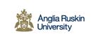
Process of Practice Assessment – Initial to Mid-point (ARU)
Prior to placement
Preparation in University Student to contact placement area
Initial interview – Practice Supervisor(s) involved at induction
Practice Assessor identified Placement orientation Meeting between Practice Supervisor(s) or Practice Assessor or Nominated Person Learning opportunities discussed & agreed Learning contract agreed
Mid-point interview – Practice Supervisor(s) involved in IP (if so must be confirmed by Practice Assessor. Practice Assessor completes formative of cluster skills
Formative of Interpersonal and Professional skills Formative assessment of cluster skills

Slide 34

Process of Practice Assessment – Initial to Mid-point (UoE)
Prior to placement
Preparation in University Student to contact placement area
Initial interview – Practice Supervisor(s) or nominated person involved at induction
Practice Assessor identified Placement orientation Learning opportunities discussed & agreed Learning contract agreed
Mid-point interview – Practice Assessor in collaboration with supervisors and student
Review of progress towards learning contract outcomes Review of progress in completing reflective logs Review of progress and feedback in formative assessments undertaken Practice Assessor may undertake some summative assessments at this point Goal-setting for remainder of placement

Slide 35
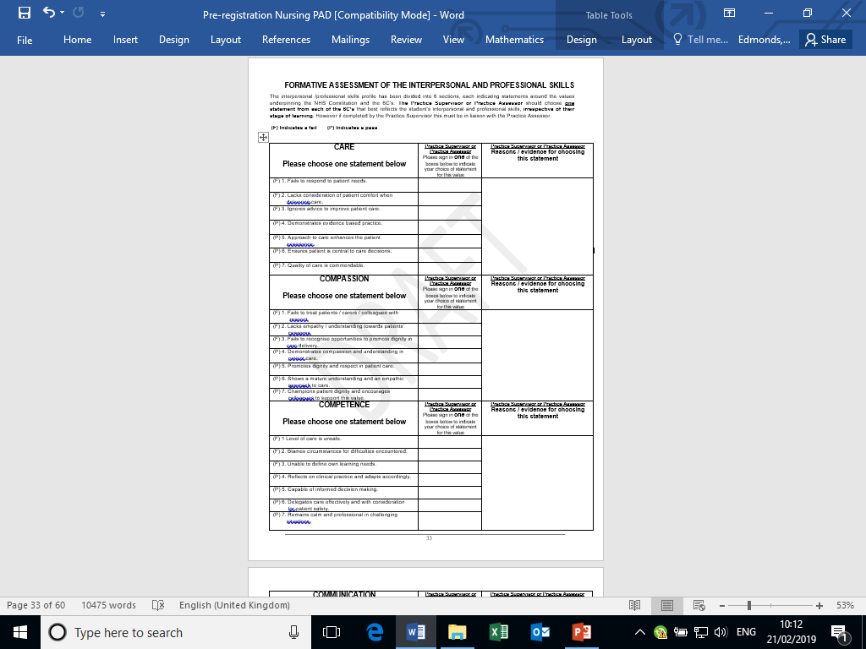
Formative Assessment of Interpersonal and Professional skills (ARU)
If completed by the Practice Supervisor must be in liaison with the Practice Assessor
The Practice Supervisor or Practice Assessor should choose one statement
Notes:
Just an example of what the new assessment document consists of –

Slide 36

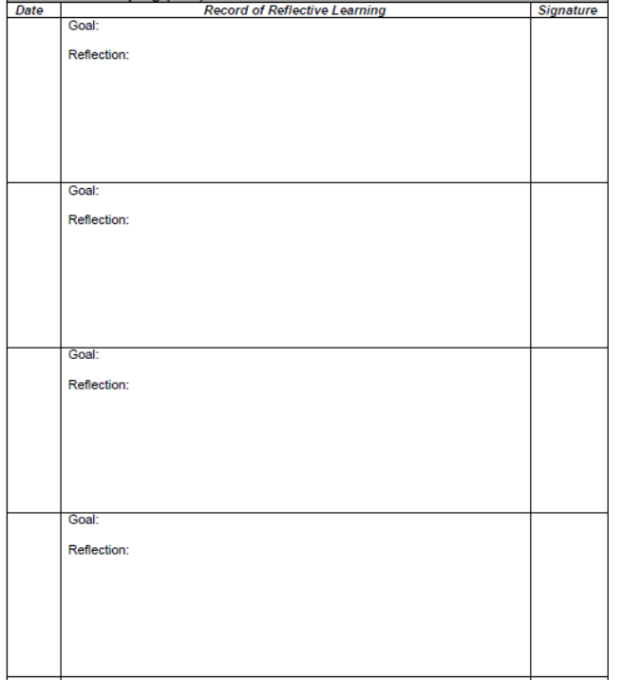
Student-led goal-setting and Supervised Coaching (UoE PAD)
Students complete reflections.
Practice Supervisors countersign reflections based on their observations of student’s experiential learning

Slide 37

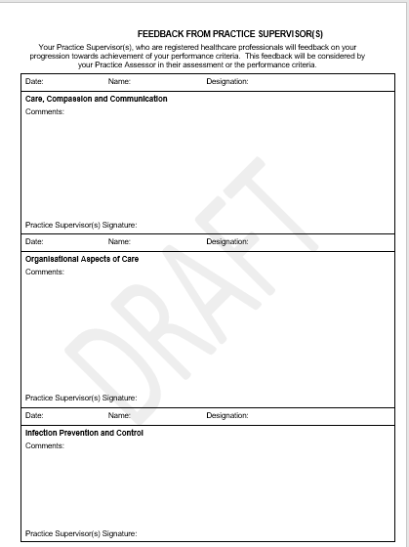
Feedback from Practice Supervisor(s) (ARU PAD)
Practice Supervisor(s) will document written feedback to students on their performance criteria
This feedback will be considered by the Practice Assessor in their assessment of the performance criteria
Practice Supervisor (s) provides feedback about particular skills.
Record of Additional Feedback pages:
Can be completed by Practice Supervisor(s), Practice Assessor and Academic Assessor

Slide 38
Formative Assessment by Practice Supervisors (or Assessors) in UoE PAD
Practice Supervisor(s) or assessors provide feedback about particular performance
Practice Assessor completes summative assessment based on sources of evidence

Slide 39
Process of Practice Assessment – Summative
ARU Final Interview – Summative Practice Supervisors can contribute to assessment of cluster skills (within their scope of practice) by providing written feedback to support achievement/non-achievement of performance criteria | University of Essex - Completion review Practice Assessors use feedback from students and supervisors as well as their own observations to make a judgement about students summative achievements and professional values
Held in final week of placement Between student and Practice Assessor Student to complete reflections Fine grading of practice completed by Practice Assessor Ongoing learning needs identified Academic Assessor to confirm in collaboration with Practice Assessor | Held towards the end of placement between student and practice assessor Practice Assessor will have worked periodically with the student over the preceding weeks Summative performance and professional values assessed Outcome confirmed in collaboration with academic assessor

Slide 40
Summative Assessment of Professional Values by Practice Assessor
Practice Assessor completes summative assessment based on sources of evidence

Slide 41
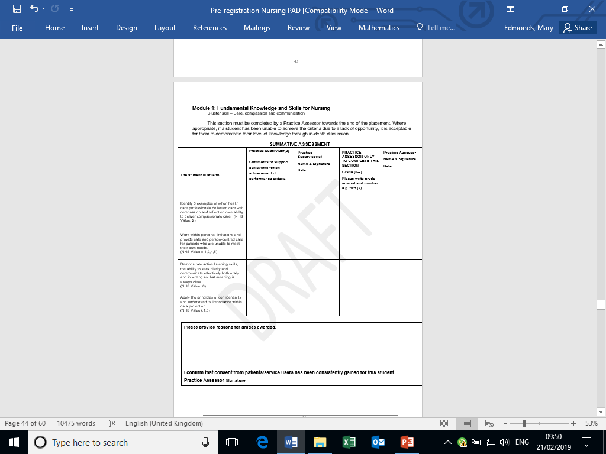
Summative Assessment of Practice Competencies
Practice Assessor will complete end point and review student reflection with feedback from Practice Supervisors and service users / carers
Practice Supervisor contributes to assessment by providing feedback
ce
Practice Assessor confirms grade based on sources of evidence
Notes:
Just an example of what the new assessment document consists of –

Slide 42
Documentation and assessment
Practice Supervisor
Practice Assessor
Completes:
Initial interview per placement
Mid-point professional values
Contributes to assessment of proficiencies based on scope of practice in liaison with the Practice Assessor
Signs off Service User Feedback
Provides feedback interprofessional working page
Completes:
Confirm initial interview per placement
Mid-point and final interview per placement
Assessment and confirmation of proficiencies
Final professional values per placement
Episode (s) of care
Medicines Management
Completes OAR at end of each placement & progression point

Slide 43
Academic Assessor
Documentation and assessment
Completes:
Action Plan (if required and with Practice Assessor)
Signs off Final Interview if required
Signs off OAR at end of each placement and progression point

Slide 44
Case study
Student A is in the middle of her programme of study. She has been in the placement where you are the Practice Assessor for four weeks. Her Practice Supervisor has raised some concerns regarding her competence with some skills following several learning opportunities and she has failed these. As the PA you arrange to discuss this with her.
What communication and interpersonal skills would you need to demonstrate?
What do you need to address?
What would you do after the discussion?
Notes:
Use the range of case studies available on the MYE PLG web page

Slide 45
CasE Study 2
Student B is at the beginning of his programme of study. He has already undertaken a six week placement. He started in placement where you are the Practice Assessor two weeks ago. His Practice Supervisor reports to you that members of the team have seen him using his phone frequently and seems to have limited professional boundaries with patients/service users.
What would you do as the Practice Assessor?
Who would you liaise with?
How would you monitor the student?

Slide 46
SSSA model

Slide 47
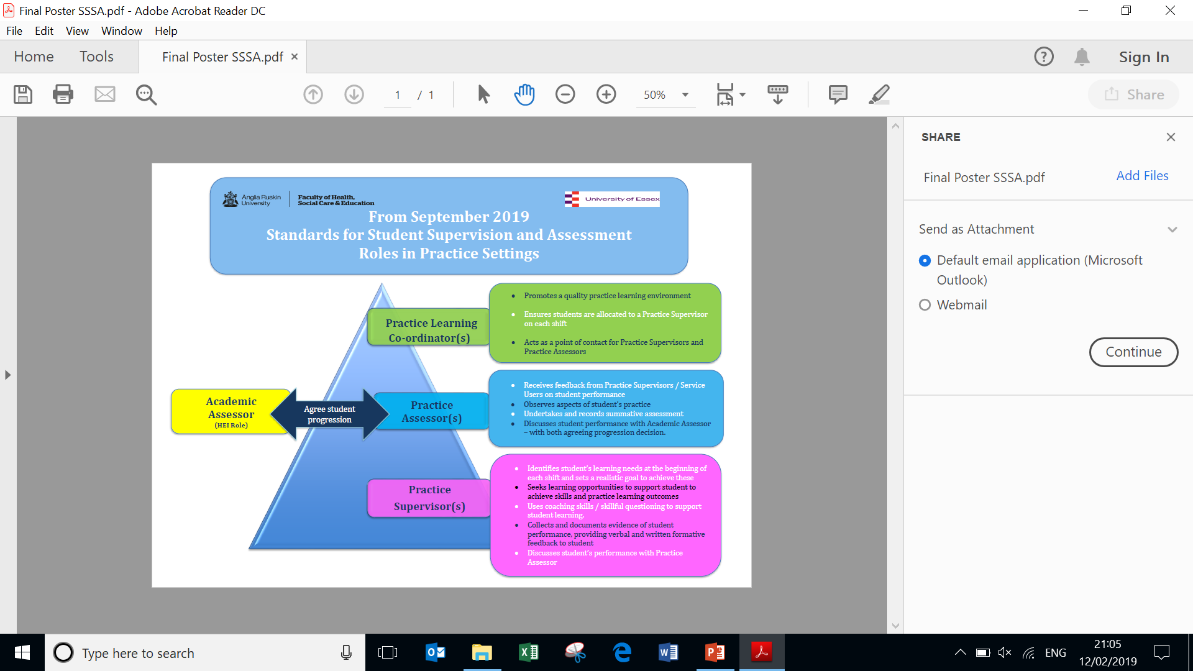
Notes:
The Practice learning coordinator is not a role identified by the NMC but the NMC clearly state in the Standards (2018) that practice learning must be coordinated and there should be clear evidence of planned allocation of supervisors and assessor for each student and that students should not be randomly allocated to different supervisors each day. An education lead in each clinical area/team is an ideal model, as seen on the previous slide and the term Practice Learning Co-coordinator is also an ideal term for this role.
Every student should be engaged in supervised practice

Slide 48
Nominated person (NMC requirement)
The NMC ask that a nominated person is identified for the students placement learning to act as;
A point of contact for students
Support students and addresses their concerns
Liaise with Practice Supervisors and Practice Assessors where necessary
The Practice Learning Co-ordinater, is ideally placed to be the nominated person;
Students will ask for the name of this person and their contact details to be identified on their PADs
Notes:
The NMC as for a nominated person, not involved in assessment, who can address student concerns and support students. This person can be the service manager, education lead for the organisation itself, directorate lead, team lead etc The previous slide refers to the role of a practice learning coordinator as the NMC ask that there is co-ordination of placement learning and that students are always supervised by a Practice Supervisor but to ensure they are not just randomly allocated to supervisors, that is a different one each day, but that there is co-ordination and students can identify with these supervisors and also that the practice assessor is identified and the student meets and works with the Assessor at dedicated times – the practice learning coordinator is therefore an ideal person to be identified as the nominated person in each area/team

Slide 49
ACADEMIC ASSESSORS NURSING
Who?
Nursing Academic Assessors will be the current link tutors in each Trust and/or personal tutors who are registered nurses and actively involved in the nursing curriculum;
Nursing students will know the name of their Academic Assessor before starting placement and the name will be identified in the Practice Assessment Document
Contact with Practice Assessors?
Nursing Academic Assessors will make contact with the student’s Practice Assessor, to discuss the student’s achievement/non-achievement, if appropriate and to agree student progression at relevant points in the programme

Slide 50
How will supervisors and assessors work in your area?
Team approach?
Individual with an assessor close by?
Individual with an assessor in another area?
Notes:
Gives an opportunity to start to consider models for supervision as they transition
This may have already been considered as part of the earlier discussions.

Slide 51
SSSA – Key Contacts
Please visit the HEI placement information sites below which identify key nursing contacts and information related to the new NMC Standards for Student Supervision and Assessment
ARU practice hub portal
UoE placement information

Slide 52
Underlying processes will remain
Cause for concern process remains the same – outlined in all PADs
Student attendance in placement should continue to be monitored and any absence or sickness reported to the HEI: Student timesheets record start time and finish time only (Breaks are no longer deducted from the overall hours)
Notes:
Cause for concern
Identify the issue early in the placement and raise it with the student. Discuss with the student how the issue could be addressed. Consider contacting the link lecturer/education champion./Develop an action plan in collaboration with the student and provide support to help the student achieve the agreed outcomes by a set review date. Document in student’s practice assessment document.

Slide 53
What remains the same?
Students will remain supernumerary and require the support of a registered practitioner on each shift
Induction, learning contracts, mid-point (formative) assessment, action plans and summative assessment will continue
Students will receive continuous feedback to inform their progress
The cause for concern process will continue to apply
Further information may be accessed at NMC 2018 Standards for Student Supervision and Assessment
Notes:
Note it says registered practitioner rather than ‘nurse’ or ‘midwife’ – so this could include any member of the MDT – including doctors. Registered nurse associates can also be practice supervisors. Current trainee nursing associates are supernumerary in some organisations – for the new course from Sept 19 they will also be given protected time

Slide 54

Any questions

Slide 55
Reflection
After this session take some time to reflect on how this new role will impact on your current way of working
As an individual
In your team
What other activities might you need to do prior to starting in your practice supervisor role?
Add this reflection to your certificate of attendance from this session.

Slide 56
Further information
Pan Midlands Yorkshire and East Practice Learning group website
www.myeplg.ac.uk
NMC SSSA Supporting Information on their website
www.nmc.org.uk/supporting-information-on-standards-for-student-supervision-and-assessment
Add Local HEI Contact / web page link
Add Local Placement Contact / web page link

