Slide 1


Dare to C.A.R.E
Talk to Transform
Workshop 1
14 October 2021
Facilitator: Jannett Morgan

Slide 2
Workforce Race Equality Standard (WRES) 2019/20
There is considerable evidence that the less favourable treatment of BAME colleagues in the NHS, through poor treatment and opportunities, has a significant impact on colleague well-being, patient outcomes and on the efficient and effective running of the NHS and that the measures needed to address such discrimination will benefit patient care and organisational effectiveness.
Source: https://www.hee.nhs.uk/sites/default/files/documents/WRES%202019-20.pdf

Slide 3
In varying degrees, your ‘BAME’ colleagues/service users/students will bring…
High
Lived experience
Conscious awareness of racism (whether articulated or not) perpetrated against them or others from the same background
Evidence
Investment of time and money gathering of research to make sense of the lived experience
Activism
Willingness to challenge racist practices often at their own risk
Lived Experience
Activism
Evidence
Low

Slide 4

Resistance
A response to:
Genuine grievances being dismissed minimalised or overlooked
Punishment for speaking out
Emotional/physical and financial burden of having to deal with racism
What are signs of resistance have you observed in your setting?
What was the response?

Slide 5

5 tools for transformation
Power dynamics
Cultural humility
Tools
Respectful enquiry
Resilience
Self care

Slide 6

Talk to Transform: workshop 1 objectives
To curate a psychologically safe space to get maximum benefit from the workshops
To become conversant in anti-racism terminology.
To identify the roadblocks to conversations about race and how to remove them
To develop communication skills necessary to have empathic and productive conversations about race
Source: https://youtu.be/P-WpHgGTGkM?t=11

Slide 7


Which association is your brain most likely to make (even if you don’t want it to)?
Black male + bird watcher
Black male + menace
Image source: istock
https://www.56blackmen.com/

Slide 8
Anti-racism
…a focus on transforming the unequal social and workplace relations that shape our interactions between black, Asian and other ethnic minorities and white people.
Ibram X Kendi
“Anti-racists are constantly looking around to say, what tools do I have available to make it clear that [racism] is not acceptable?”
John Amaechi

Slide 9

Racism: the ultimate shapeshifter
“Today racism is subtle and nuanced, detected mostly by people on the receiving end, but ignored and possibly not even seen by perpetrators and bystanders.”
Binna Kandola, Racism at Work. The Danger of Indifference

Slide 10

Talking about Race – common reactions

Slide 11

Have a race conversation with your breakout partner
Minimum 30 minutes
Arrange a suitable time and platform
Agree groundrules for the conversation in advance
If appropriate and possible, have a cross cultural conversation with another colleague

Slide 12
Dare to C.A.R.E
Talk to Transform
Workshop 2
27 October 2021
Facilitator: Jannett Morgan

Slide 13
Talk to Transform: workshop 2 objectives
To explain how Talk to Transform contributes to Dare to C.A.R.E.
To feed back and reflect upon your race conversations
Explore how ‘privilege’ and ‘advantage’ impact the talent pipeline
Understand how and why allyship is more likely to reduce biased behaviours and promote conscious inclusion
Discuss how you can further leverage the inclusive behaviours identified from the workshops can be leveraged to “transform” the culture in your work settings

Slide 14
DISCUSSION: RACE CONVERSATION REFLECTION
Share you insights from the conversation
  What went well?
  What would make it even better?
What practical steps can you take now to ensure a culture where productive conversations are the rule and not the exception?

Slide 15
Ten steps NHS staff could consider taking to support the NHS Workforce Race Equality Standard (WRES)
Has your employer completed a WRES baseline audit?
If so, what involvement have Black and Minority Ethnic (BME) staff and your local social partnership body had with any issues arising from the audit?
Do the conclusions drawn, and actions proposed, actually reflect the data published?
Is there a Board member responsible for WRES and the Equality Delivery System (EDS2) implementation in your organisation?
For each of the WRES indicators where there is a significant gap between the experience, treatment and opportunities for BME and White staff, what course of action has been chosen, and what good practice for each indicator has been considered?
https://www.england.nhs.uk/wp-content/uploads/2015/10/wres-ten-steps-leaflet.pdf

Slide 16
Ten steps NHS staff could consider taking to support the NHS Workforce Race Equality Standard (WRES)
Is there a formal arrangement for the BME staff group to meet with organisation’s HR team regularly (for example for the last half hour of any regular meeting)?
What steps is your employer taking to ensure that the levels of self-reporting on ethnicity are not lower than 95 percent?
What steps is your employer taking to ensure that the proportion of BME staff responding to the next staff survey is as high as the levels of White staff responses?
If a CQC inspection is due in the next 12 months what steps is your employer taking to ensure that concerns of BME staff are heard by the Inspection Team?
Have arrangements been made to link employers with one another within your region to provide peer support to each other on these matters?
https://www.england.nhs.uk/wp-content/uploads/2015/10/wres-ten-steps-leaflet.pdf

Slide 17

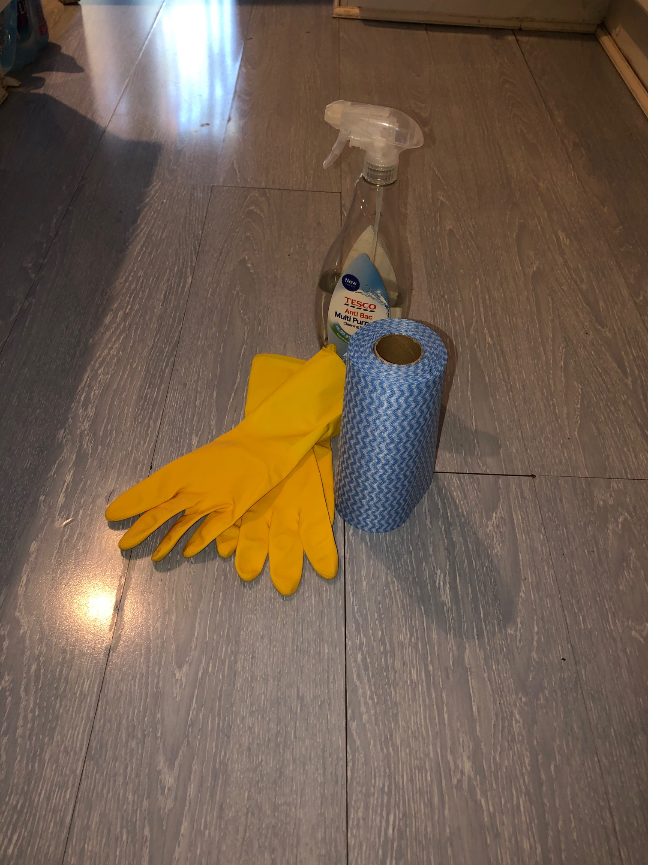

Micro-aggression Bingo (race)
No, where do you REALLY come from?

Slide 18
What is an ally?
“An ally is a person who speaks up for or champions underrepresented groups while not being part of that demographic. They use their white advantage to create opportunities for those less privileged.
Allyship is not only standing up for what’s right, but acknowledging that, as a part of the privileged group, you have probably benefited from the systemic racism, and then using that knowledge to make efforts to address any of your own ingrained beliefs”.
CIPD

Slide 19
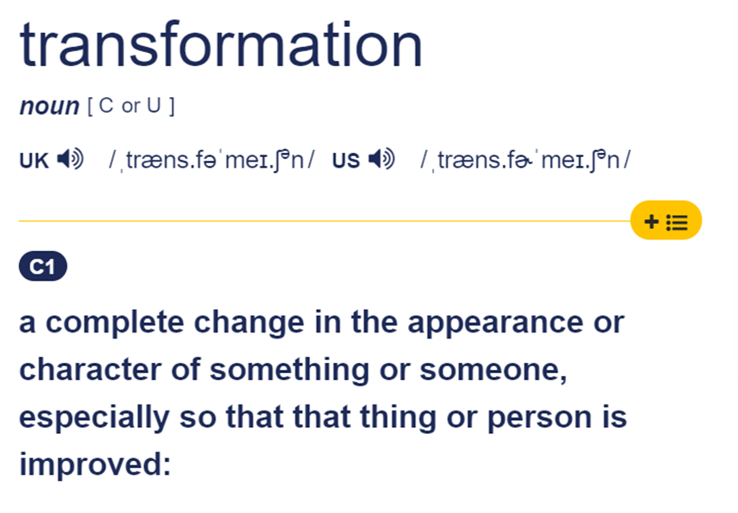
Being a culture change agent
State TWO ACTIONS you will commit to as a result of the Talk and Transform workshops.
What RESOURCES do you need to complete these actions?

Slide 20
Useful links
CIPD (October 2020). Building anti-racist and compassionate workplaces https://www.cipd.co.uk/news-views/tackling-racism-workplace/anti-racism-videos
UCL: Better Allies. Everyday Actions to Create Inclusive,
Engaging Workplaces https://www.ucl.ac.uk/chemical-engineering/edi/better-allies
Robin DiAngelo (October 2018). Why “I’m not racist” is only half the story https://www.youtube.com/watch?v=kzLT54QjclA&feature=emb_logo
James R. Dent and Laura Morgan Roberts (July 2020). How to Call Out Racial Injustice at Work https://hbr.org/2020/07/how-to-call-out-racial-injustice-at-work
Ally Continuum image credit: Thomson Reuters’ Management Associate Program 2018 The journey - From Aware to Advocate on the Ally Continuum: Insights from the Better Man Conference) Source: https://www.legalexecutiveinstitute.com/krishnadas-better-man-conference/

