Slide 1
Predictive Learning Analytics
HUCBMS 2018
Heads of University Centres of Biomedical Sciences 25th anniversary conference
If you want to vote and share, log into:
https://pollev.com/bartrienties552
@DrBartRienties
Professor of Learning Analytics

Slide 2
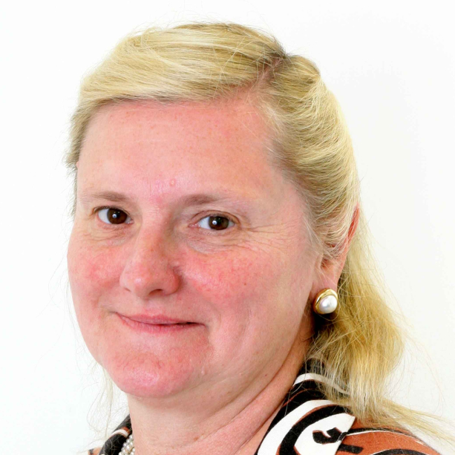
A special thanks to Avinash Boroowa, Shi-Min Chua, Simon Cross, Doug Clow, Chris Edwards, Rebecca Ferguson, Mark Gaved, Christothea Herodotou, Martin Hlosta, Wayne Holmes, Garron Hillaire, Simon Knight, Nai Li, Vicky Marsh, Kevin Mayles, Jenna Mittelmeier, Vicky Murphy, Quan Nguygen, Tom Olney, Lynda Prescott, John Richardson, Saman Rizvi, Jekaterina Rogaten, Matt Schencks, Mike Sharples, Dirk Tempelaar, Belinda Tynan, Lisette Toetenel, Thomas Ullmann, Denise Whitelock, Zdenek Zdrahal, and others…

Slide 3
Notes:
Poll Title: What is the first thing that comes to mind when you hear the term "Learning Analytics"? https://www.polleverywhere.com/free_text_polls/z0HKA5mcfAxVPXj

Slide 4
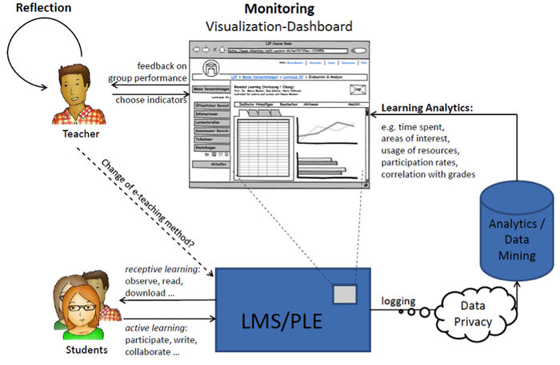
Dyckhoff, A. L., Zielke, D., Bültmann, M., Chatti, M. A., & Schroeder, U. (2012). Design and Implementation of a Learning Analytics Toolkit for Teachers. Journal of Educational Technology & Society, 15(3), 58-76.

Slide 5
Notes:
Poll Title: What is wrong with this holy grail? https://www.polleverywhere.com/multiple_choice_polls/ExlwUwMcyZFIphm

Slide 6
Dyckhoff, A. L., Zielke, D., Bültmann, M., Chatti, M. A., & Schroeder, U. (2012). Design and Implementation of a Learning Analytics Toolkit for Teachers. Journal of Educational Technology & Society, 15(3), 58-76.

Slide 7
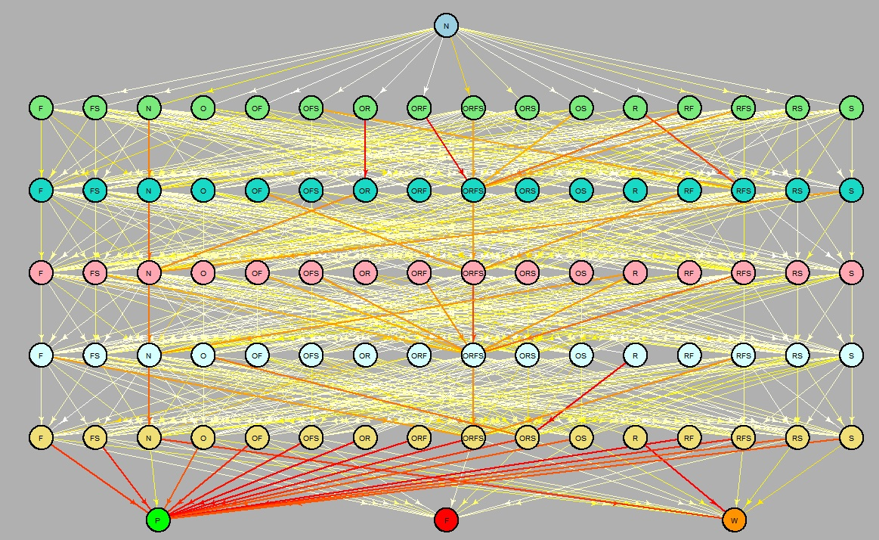
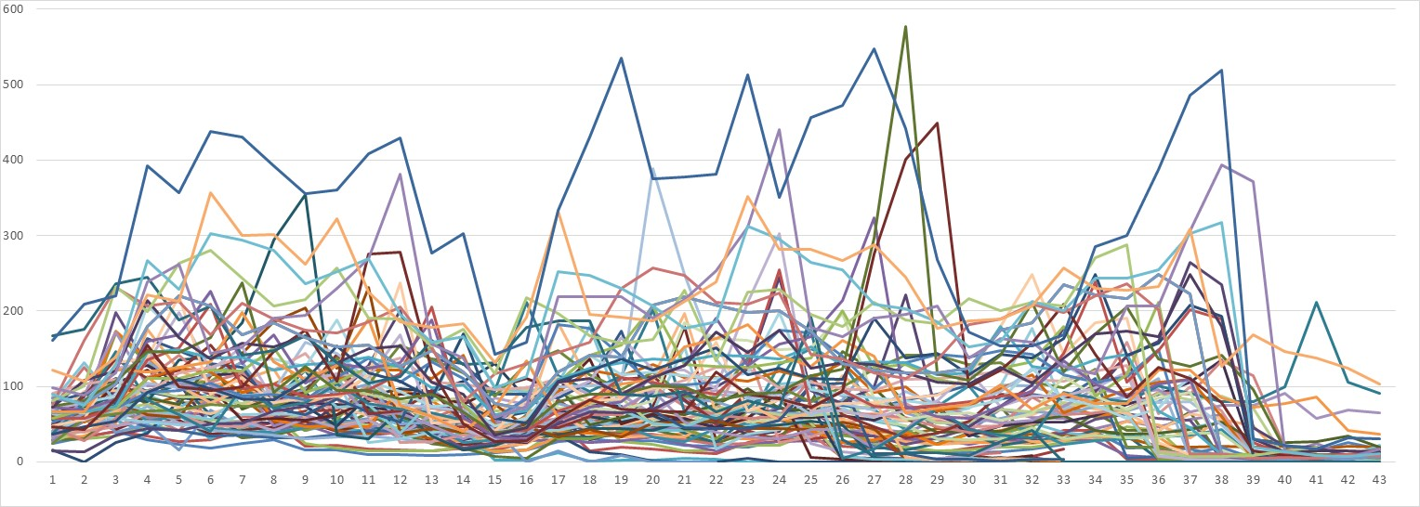
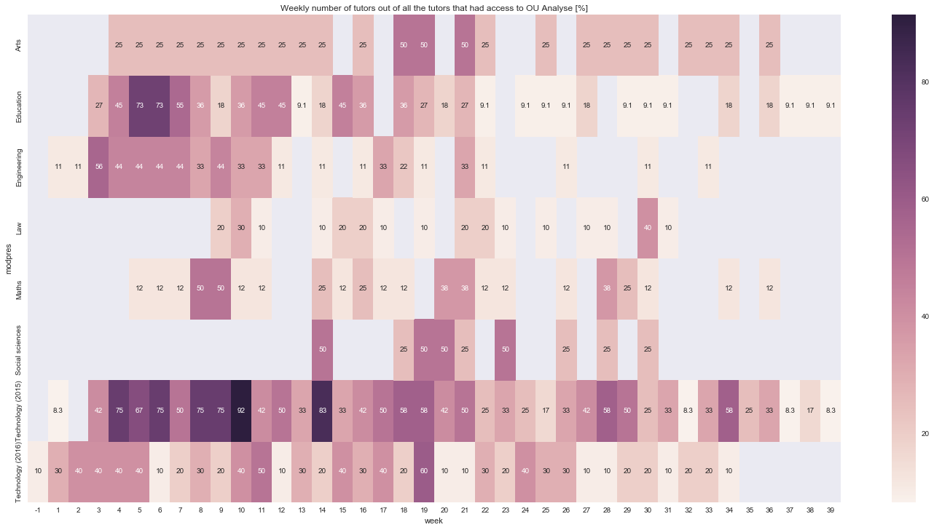
Big Data is messy!!!

Slide 9
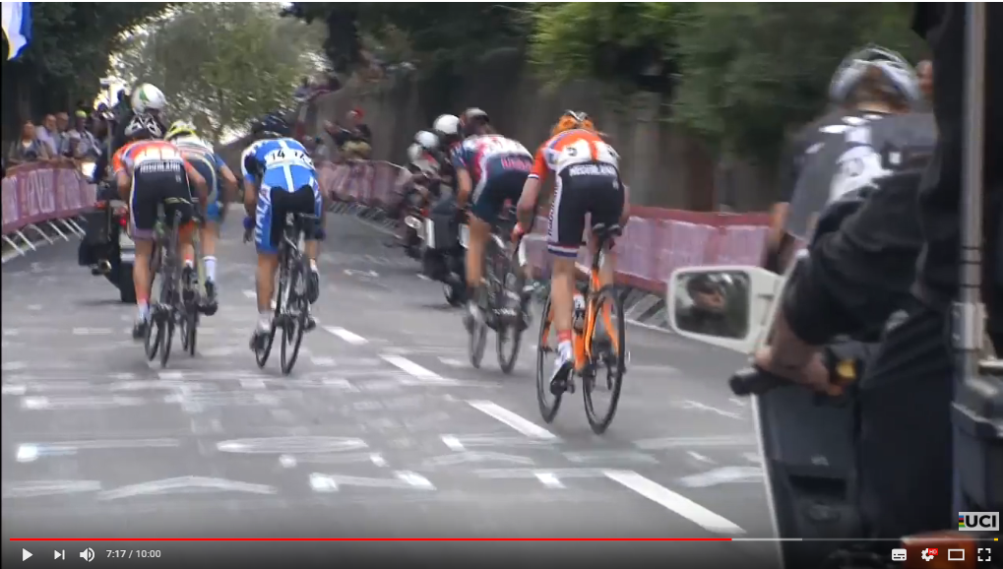
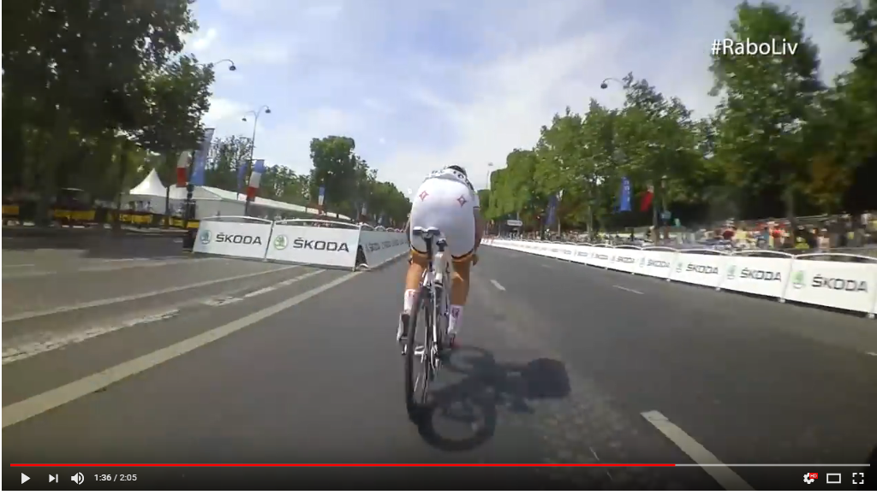
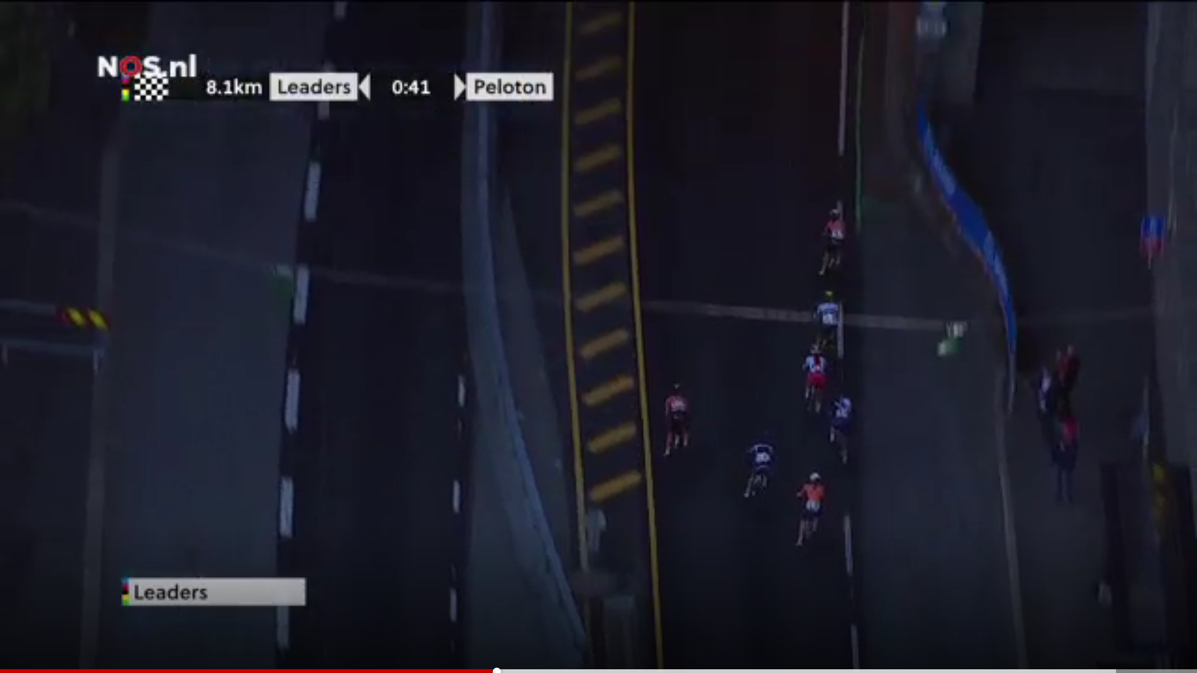
Option 1: Do a long solo from beginning of the race: Boston Mayor Cup 2015: Emma Grant
Option 2: Be the strongest on final climb: WC 2012 Marianne Vos
Option 3: Wait and be the fastest in final peloton sprint: 2013 Marianne Vos
Option 4: Break away from peloton in final lap like WC 2017 Chantal Blaak

Slide 10
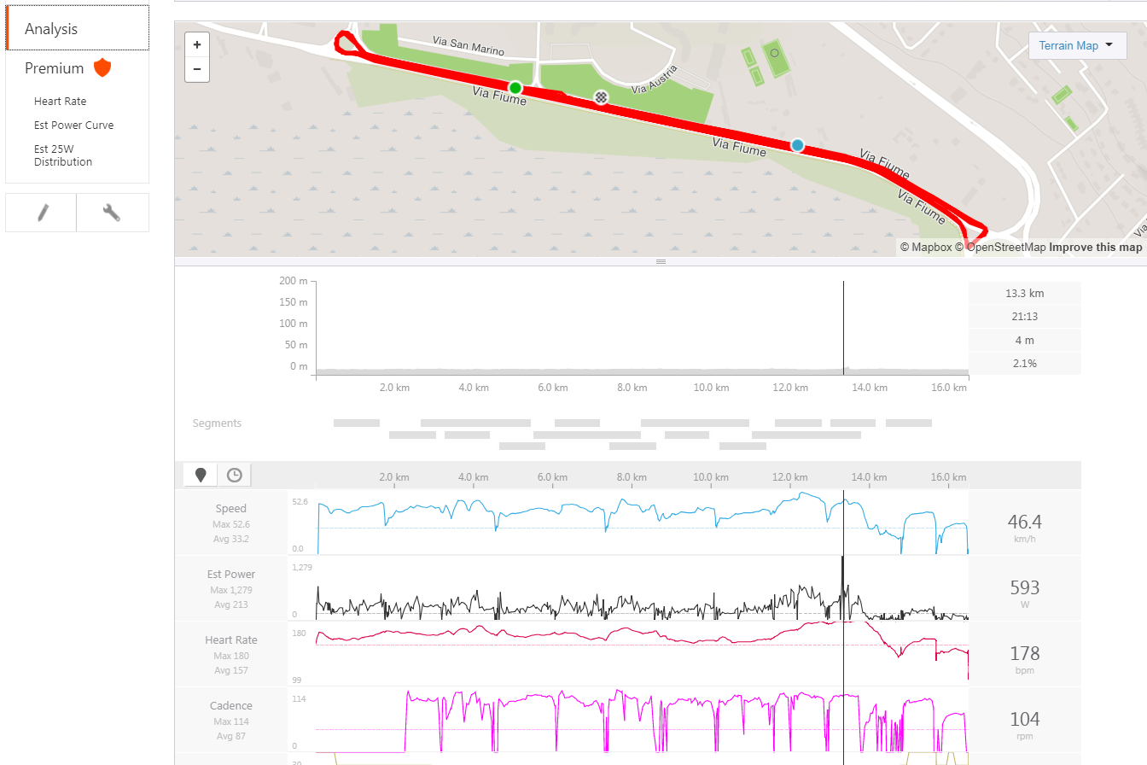

Slide 11
Notes:
Poll Title: Based upon the data, Bart won the Eurotransplant road race because he: https://www.polleverywhere.com/multiple_choice_polls/brzxCqdrOx8biri

Slide 12
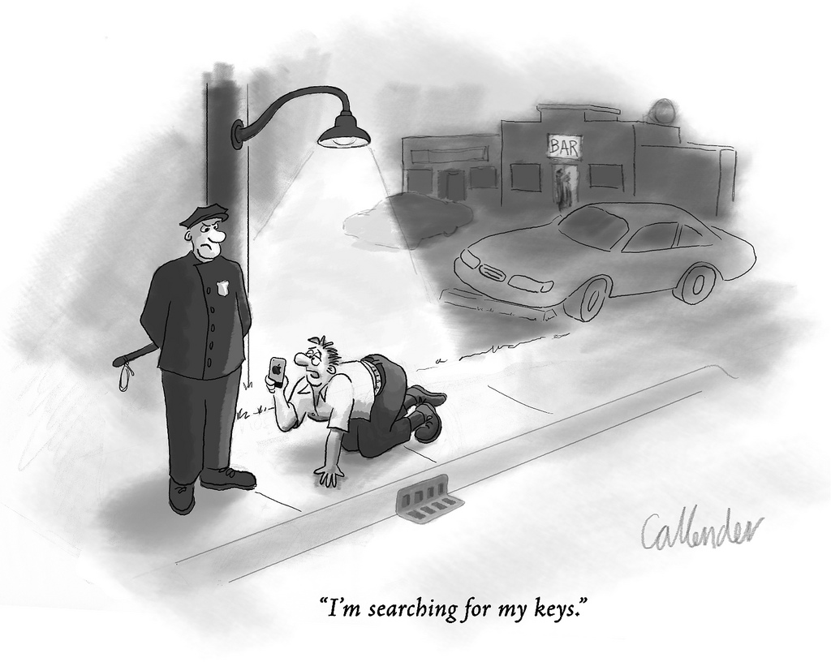
Prof Paul Kirschner (OU NL)
“Learning analytics: Utopia or dystopia”, LAK 2016 conference

Slide 13
Learning Design is described as “a methodology for enabling teachers/designers to make more informed decisions in how they go about designing learning activities and interventions, which is pedagogically informed and makes effective use of appropriate resources and technologies” (Conole, 2012).

Slide 14
Open University Learning Design Initiative (OULDI)
 | Assimilative | Finding and handling information | Communication | Productive | Experiential | Interactive/ Adaptive | Assessment
Type of activity | Attending to information | Searching for and processing information | Discussing module related content with at least one other person (student or tutor) | Actively constructing an artefact | Applying learning in a real-world setting | Applying learning in a simulated setting | All forms of assessment, whether continuous, end of module, or formative (assessment for learning)
Examples of activity | Read, Watch, Listen, Think about, Access, Observe, Review, Study | List, Analyse, Collate, Plot, Find, Discover, Access, Use, Gather, Order, Classify, Select, Assess, Manipulate | Communicate, Debate, Discuss, Argue, Share, Report, Collaborate, Present, Describe, Question | Create, Build, Make, Design, Construct, Contribute, Complete, Produce, Write, Draw, Refine, Compose, Synthesise, Remix | Practice, Apply, Mimic, Experience, Explore, Investigate, Perform, Engage | Explore, Experiment, Trial, Improve, Model, Simulate | Write, Present, Report, Demonstrate, Critique
Conole, G. (2012). Designing for Learning in an Open World. Dordrecht: Springer.
Rienties, B., Toetenel, L., (2016). The impact of learning design on student behaviour, satisfaction and performance: a cross-institutional comparison across 151 modules. Computers in Human Behavior, 60 (2016), 333-341
Notes:
Explain seven categories

Slide 15
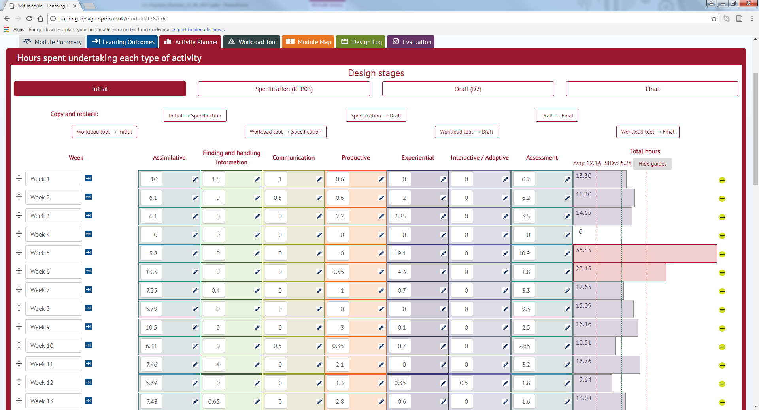
Notes:
For each module, the learning design team together with module chairs create activity charts of what kind of activities students are expected to do in a week.

Slide 16
Merging big data sets
Learning design data (>300 modules mapped)
VLE data
>140 modules aggregated individual data weekly
>37 modules individual fine-grained data daily
Student feedback data (>140)
Academic Performance (>140)
Predictive analytics data (>40)
Data sets merged and cleaned
111,256 students undertook these modules
Notes:
5131 students responded – 28%, between 18-76%

Slide 17
Notes:
Poll Title: A typical course at the Open Univerisity https://www.polleverywhere.com/multiple_choice_polls/4xUdq8bAmxQgJrp

Slide 18
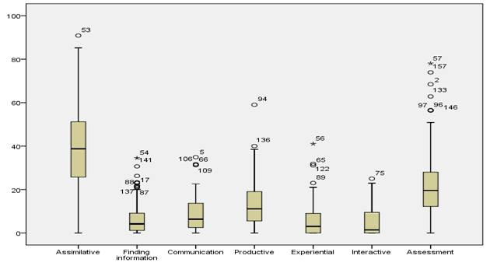
Toetenel, L., Rienties, B. (2016). Analysing 157 Learning Designs using Learning Analytic approaches as a means to evaluate the impact of pedagogical decision-making. British Journal of Educational Technology, 47(5), 981–992.

Slide 19
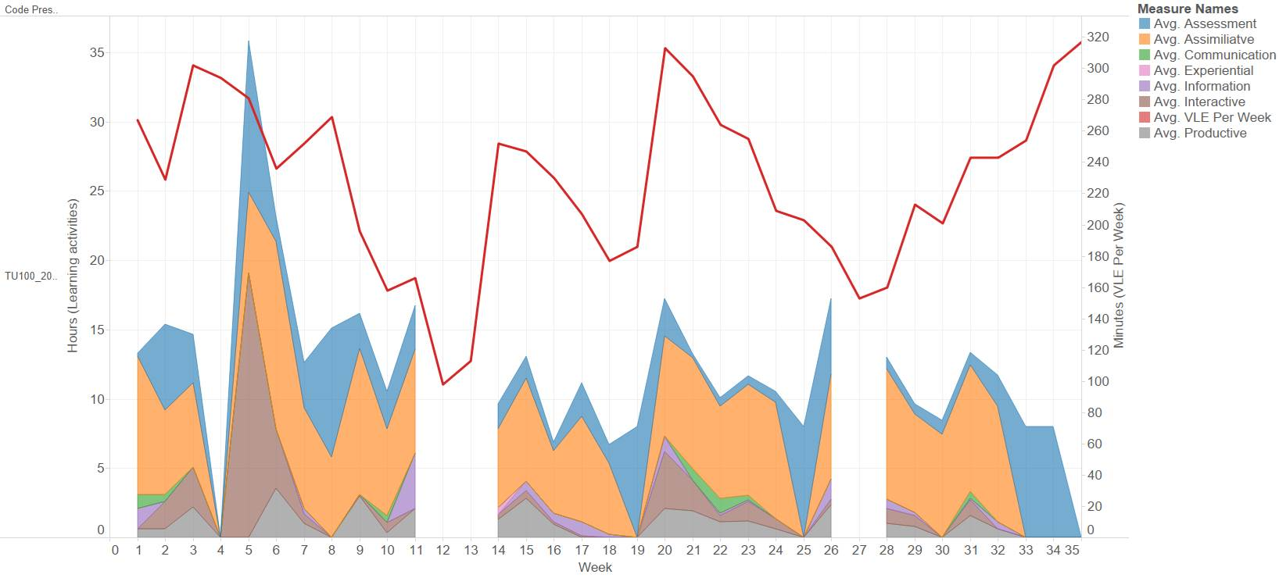

Slide 20
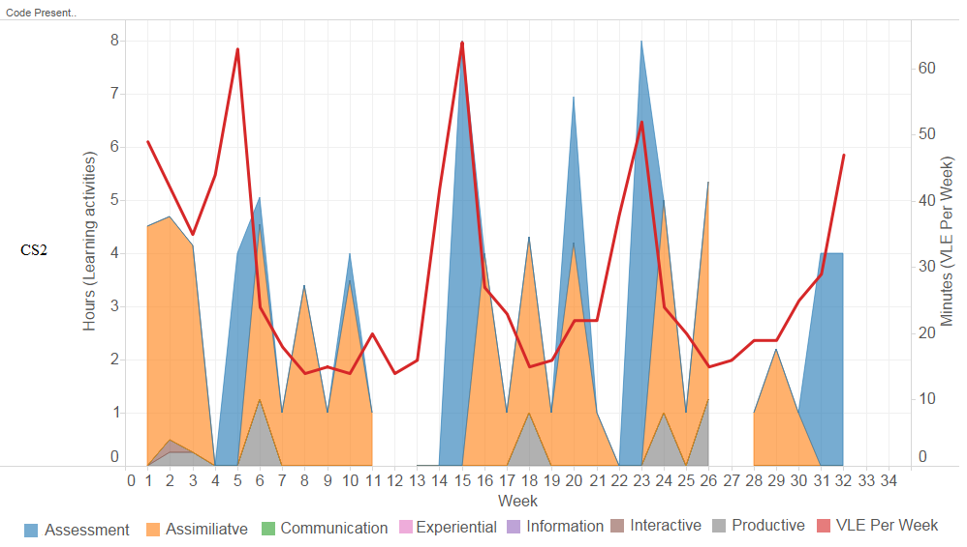
69% of what students are doing in a week is determined by us, teachers!
Nguyen, Q., Rienties, B., Toetenel, L., Ferguson, R., Whitelock, D. (2017). Examining the designs of computer-based assessment and its impact on student engagement, satisfaction, and pass rates. Computers in Human Behavior. DOI: 10.1016/j.chb.2017.03.028.

Slide 21
Constructivist Learning Design
Student Satisfaction
Assessment Learning Design
VLE Engagement
Productive
Learning Design
Week 1
Week 2
Week30+
Socio-construct. Learning Design
Student retention
Communication
150+ modules
Rienties, B., Toetenel, L., (2016). The impact of learning design on student behaviour, satisfaction and performance: a cross-institutional comparison across 151 modules. Computers in Human Behavior, 60 (2016), 333-341
Nguyen, Q., Rienties, B., Toetenel, L., Ferguson, R., Whitelock, D. (2017). Examining the designs of computer-based assessment and its impact on student engagement, satisfaction, and pass rates. Computers in Human Behavior. DOI: 10.1016/j.chb.2017.03.028.
Notes:
Cluster analysis of 40 modules (>19k students) indicate that module teams design four different types of modules: constructivist, assessment driven, balanced, or socio-constructivist. The LAK paper by Rienties and colleagues indicates that VLE engagement is higher in modules with socio-constructivist or balanced variety learning designs, and lower for constructivist designs. In terms of learning outcomes, students rate constructivist modules higher, and socio-constructivist modules lower. However, in terms of student retention (% of students passed) constructivist modules have lower retention, while socio-constructivist have higher. Thus, learning design strongly influences behaviour, experience and performance. (and we believe we are the first to have mapped this with such a large cohort).

Slide 22
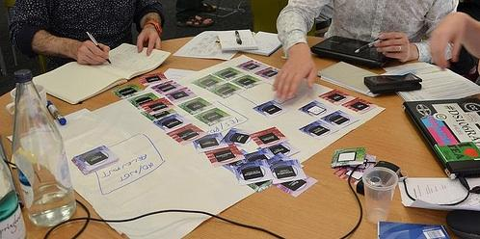
So what happens when you give learning design visualisations to teachers?
Toetenel, L., Rienties, B. (2016) Learning Design – creative design to visualise learning activities. Open Learning: The Journal of Open and Distance Learning, 31(3), 233-244.

Slide 23
Notes:
Poll Title: So what happens when you give learning visualisations to teachers? https://www.polleverywhere.com/multiple_choice_polls/KXEJ86zVPtZeU4y

Slide 24
Toetenel, L., Rienties, B. (2016) Learning Design – creative design to visualise learning activities. Open Learning: The Journal of Open and Distance Learning, 31(3), 233-244.

Slide 25
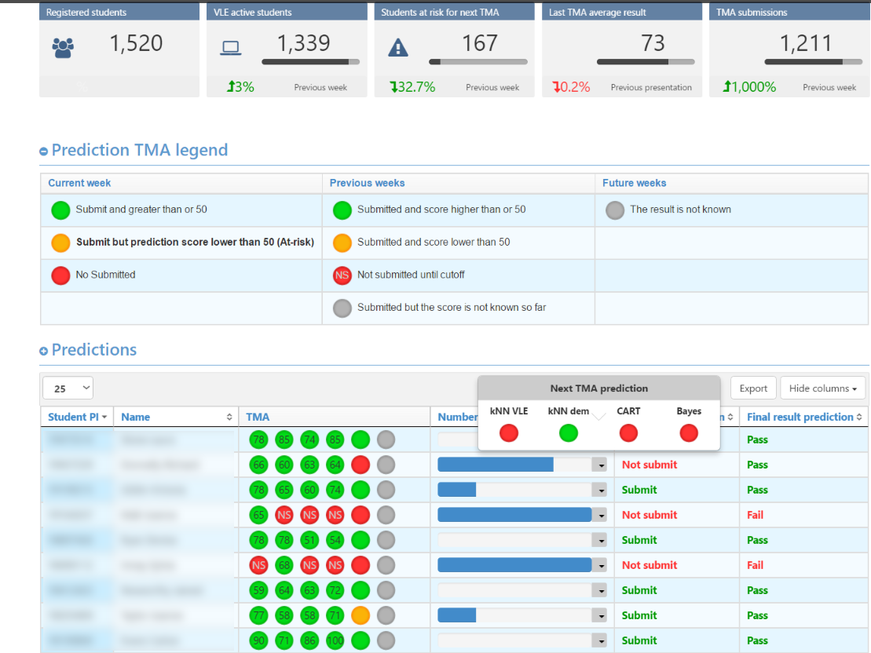
So what happens when you give learning analytics data about students to teachers?
How did 240 teachers within the 10 modules made use of PLA data (OUA predictions) and visualisations to help students at risk?
To what extent was there a positive impact on students' performance and retention when using OUA predictions?
Which factors explain teachers' uses of OUA?

Slide 26
Usage of OUA dashboard by participating teachers
Herodotou, C., Rienties, B., Boroowa, A., Zdrahal, Z., Hlosta, M., & Naydenova, G. (2017). Implementing predictive learning analytics on a large scale: the teacher's perspective. Paper presented at the Proceedings of the Seventh International Learning Analytics & Knowledge Conference, Vancouver, British Columbia, Canada, pp. 267-271

Slide 27
Regression analysis
Which factors better predict pass and completion rates?
Teacher characteristics
Module presentations per teacher
Students per module presentation
OUA usage
Student characteristics
Age
Gender
New/continuous
Disability
Ethnicity
Education
IMD band
Best previous score
Sum of previous credits
module design
Herodotou, C., Rienties, B., Boroowa, A., Zdrahal, Z., Hlosta, M. (Submitted: 01-08-2017). Using Predictive Learning Analytics to Support Just-in-time Interventions: The Teachers' Perspective Across a Large-scale Implementation.

Slide 28
Notes:
Poll Title: So after students' initial performance, what is the biggest predictor of passing a module? https://www.polleverywhere.com/multiple_choice_polls/1WohjbRMUEgd0df

Slide 29
Logistic regression results (pass rates)
Significant model (pass: χ²= 76.391, p < .001, df = 24).
Best predictors of pass rates
OUA usage
Best previous score
Nagelkerke’s R2 = .185 (model explains 18% of the variance in passing rates)
Correctly classified over 70% of the cases (prediction success overall was 70.2%: 33.5 % for not passing a module and 88.7% for passing a module).
Significant predictors of both pass and completion rates:
OUA usage (p=.006)
Best previous module score achieved (p=.005)
All other predictors were not significant.
Herodotou, C., Rienties, B., Boroowa, A., Zdrahal, Z., Hlosta, M. (Submitted: 01-08-2017). Using Predictive Learning Analytics to Support Just-in-time Interventions: The Teachers' Perspective Across a Large-scale Implementation.
Notes:
Same results for completion rates.

Slide 30
Conclusions and moving forwards
Teachers and professional development key in world of learning analytics
Learning design and teachers strongly influences student engagement, satisfaction and performance
Learning analytics can be quite powerful to understand complexities of learning in- and outside class

Slide 31
Conclusions and moving forwards
Learning analytics approaches can help researchers and practitioners to test and validate big and small theoretical questions
I am open for any collaborations or any wild ideas ☺

Slide 32
Predictive Learning Analytics
HUCBMS 2018
Heads of University Centres of Biomedical Sciences 25th anniversary conference
If you want to vote and share, log into:
https://pollev.com/bartrienties552
@DrBartRienties
Professor of Learning Analytics

